Slide 1

A CURSORY GLANCE AT BAYESIAN ANALYSIS
SPECIAL TOPICS IN A.I. and DATA SCIENCE
“Classical data analysts need a large bag of clever tricks to unleash on their data, but Bayesians only ever really need one.”
(author unknown)
data-action-lab.com

Slide 2
OUTLINE
Part 1
Part II
Plausible Reasoning
The Rules of Probability
Bayes’ Theorem
Example: the Fair (?) Coin
Example: the Salary Question
Example: Money ($ Bill Y’All)
Marginalization
Prior Distributions
Model Selection
Naïve Bayes Classification
Bayesian Inference
MCMC and Numerical Methods

Slide 3
PLAUSIBLE REASONING
A CURSORY GLANCE AT BAYESIAN ANALYSIS
“A decision was wise, even though it lead to disastrous consequences, if the evidence at hand indicated it was the best one to make; and a decision was foolish, even though it lead to the happiest possible consequences, if it was unreasonable to expect those consequences.”
Herodotus, in Antiquity

Slide 4
PLAUSIBLE REASONING
Consider the following scenario [Jaynes, 2003]:
  you are walking down a deserted street at night
  you hear a security alarm, look across the street, and see a store with a broken window
  someone wearing a mask crawls out of the broken window with a bag full of smart phones
You conclude that the person crawling out of the store is stealing merchandise from the store.

Slide 5
PLAUSIBLE REASONING
How do you come to that conclusion? It cannot come from a logical deduction based on evidence.
Indeed, the person crawling out of the store could have been its owner who, upon returning from a costume party, realized that they had misplaced their keys just as a passing truck was throwing a brick in the store window, triggering the security alarm. The owner then went into the store to retrieve items before they could be stolen, which is when you happened unto the scene.
The original reasoning process is not deductive, but it is at least plausible.

Slide 6
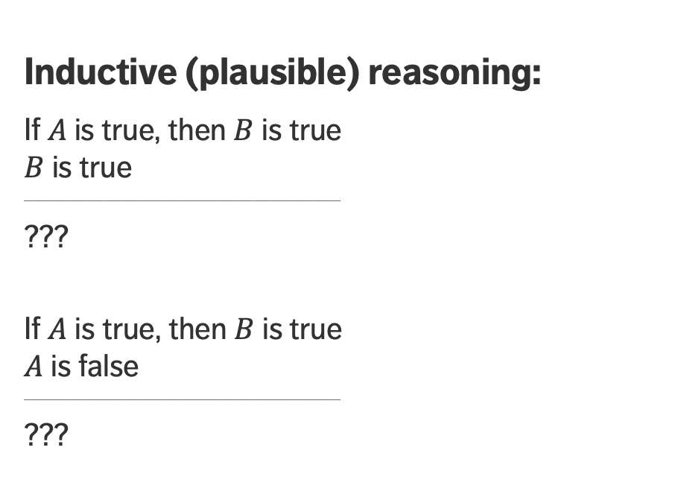
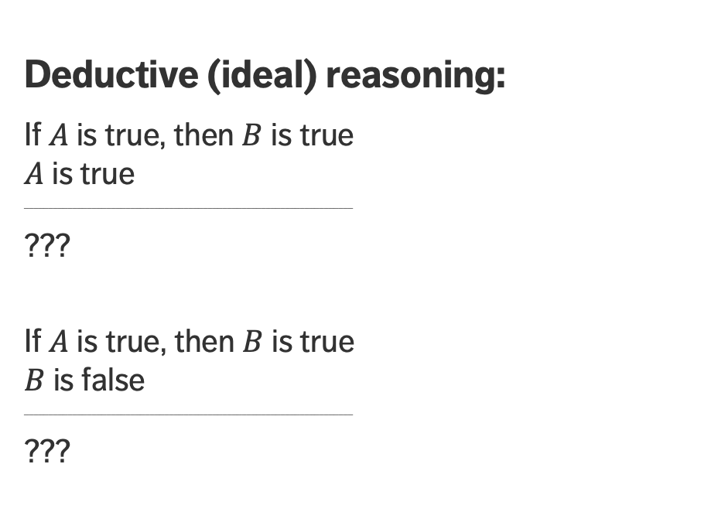
DEDUCTIVE VS. PLAUSIBLE REASONING
Deductive (ideal) reasoning:
If$A$is true, then $B$ is true
$A$ is true
________________________________________________________________________________________________________________________________________
???
If $A$ is true, then $B$ is true
$B$ is false
________________________________________________________________________________________________________________________________________
???
Inductive (plausible) reasoning:
If$A$is true, then $B$ is true
$B$ is true
________________________________________________________________________________________________________________________________________
???
If $A$ is true, then $B$ is true
$A$ is false
________________________________________________________________________________________________________________________________________
???

Slide 7
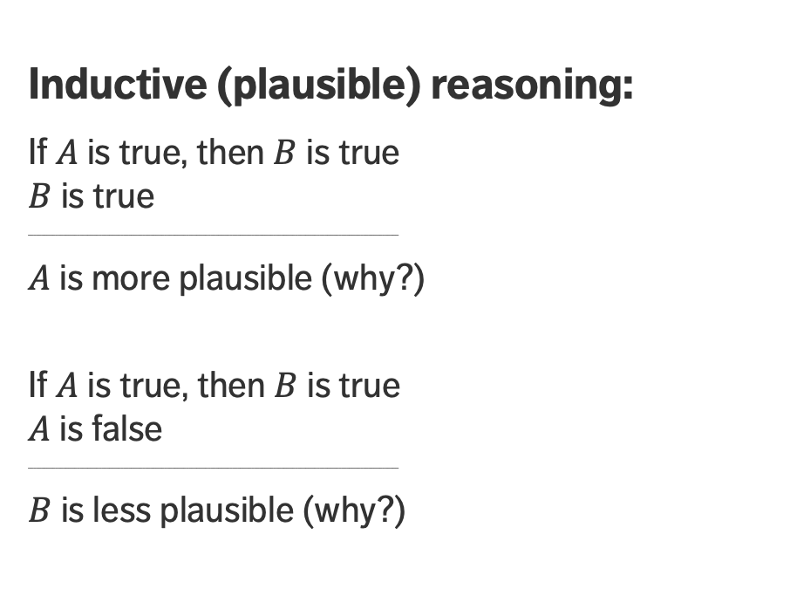
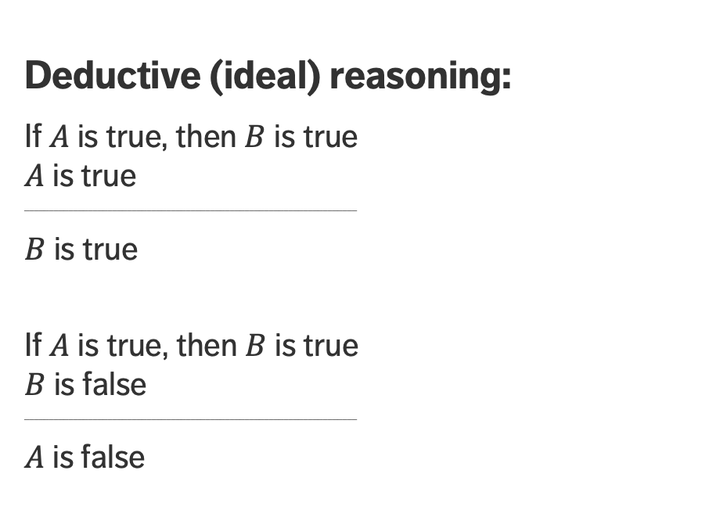
DEDUCTIVE VS. PLAUSIBLE REASONING
Deductive (ideal) reasoning:
If$A$is true, then $B$ is true
$A$ is true
________________________________________________________________________________________________________________________________________
$B$ is true
If $A$ is true, then $B$ is true
$B$ is false
________________________________________________________________________________________________________________________________________
$A$ is false
Inductive (plausible) reasoning:
If$A$is true, then $B$ is true
$B$ is true
________________________________________________________________________________________________________________________________________
$A$ is more plausible (why?)
If $A$ is true, then $B$ is true
$A$ is false
________________________________________________________________________________________________________________________________________
$B$ is less plausible (why?)

Slide 8
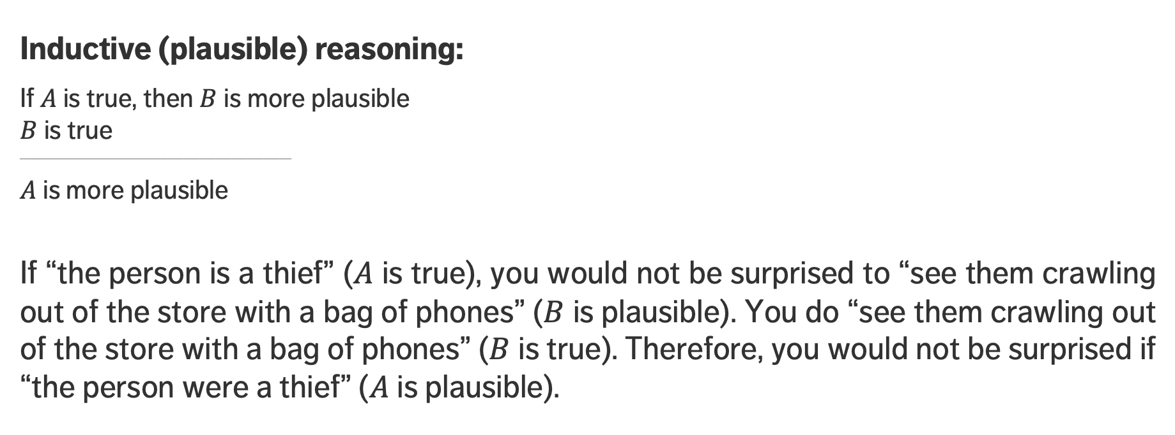
DEDUCTIVE VS. PLAUSIBLE REASONING
Inductive (plausible) reasoning:
If$A$is true, then $B$ is more plausible
$B$ is true
________________________________________________________________________________________________________________________________________
$A$ is more plausible
If “the person is a thief” ($A$ is true), you would not be surprised to “see them crawling out of the store with a bag of phones” ($B$ is plausible). You do “see them crawling out of the store with a bag of phones” ($B$ is true). Therefore, you would not be surprised if “the person were a thief” ($A$ is plausible).

Slide 9
DEDUCTIVE VS. PLAUSIBLE REASONING
[Sivia, Skilling, Data Analysis: A Bayesian Tutorial]
Deductive reasoning
Plausible reasoning
Effects
or
Outcomes
Possible
Causes
Cause
Observations

Slide 10
DISCUSSION
In Tom Stoppard’s 1966 play Rosencrantz and Guildenstern are Dead, the main characters bet on coin flips. Rosencrantz wins by flipping heads 92 times in a row.
This result is of course not impossible, but is it plausible? If this happened to you, what would you conclude?

Slide 11
THE RULES OF PROBABILITY
A CURSORY GLANCE AT BAYESIAN DATA ANALYSIS

Slide 12
WHAT IS PROBABILITY?
Inductive reasoning requires methods to evaluate the validity of various propositions.
For Bernouilli, Bayes, and Laplace (1700’s to 1800’s), a proposition’s probability represents the degree-of-belief in the proposition (i.e., its plausibility).
Subsequent scholars found this vague and subjective (how can you be sure that my degree-of-belief matches yours?) and they redefined probability as the long-run relative frequency of an event, given infinite repeated trials.

Slide 13
WHAT IS PROBABILITY?
A forecast calling for rain with 90% probability doesn’t mean the same thing to Bayesians and frequentists:
  in the Bayesian framework, this means that the forecaster is 90% certain that it will rain;
  in the frequentist framework, this means that, historically, it rained in 90% of the cases when the conditions were as they currently are.
The Bayesians framework is more aligned with how humans understand probabilities (92 heads in a row probably mean that that the coin is biased, right?), but how can we be certain that the degree-of-belief is a well-defined concept?

Slide 14
WHAT IS PROBABILITY?
As it happens, there is a well-defined way to determine the rules of probability, based on a small list of axioms [Jaynes, 2003; Cox, 1946]:
  if a conclusion can be reasoned out in more than one way, then every possible way must lead to the same result;
  all (known) evidence relevant to a question must be taken into consideration;
  equivalent states of knowledge must be assigned the same probabilities;
  if we specify how much we believe something is true, we have implicitly specified how much we believe it’s false, and
  if we have specified our degree-of-belief in a first proposition, and then our degree-of-belief in a second proposition if we assume the first one is true, then we have implicitly specified our simultaneous degree-of-belief in both propositions being true.

Slide 15
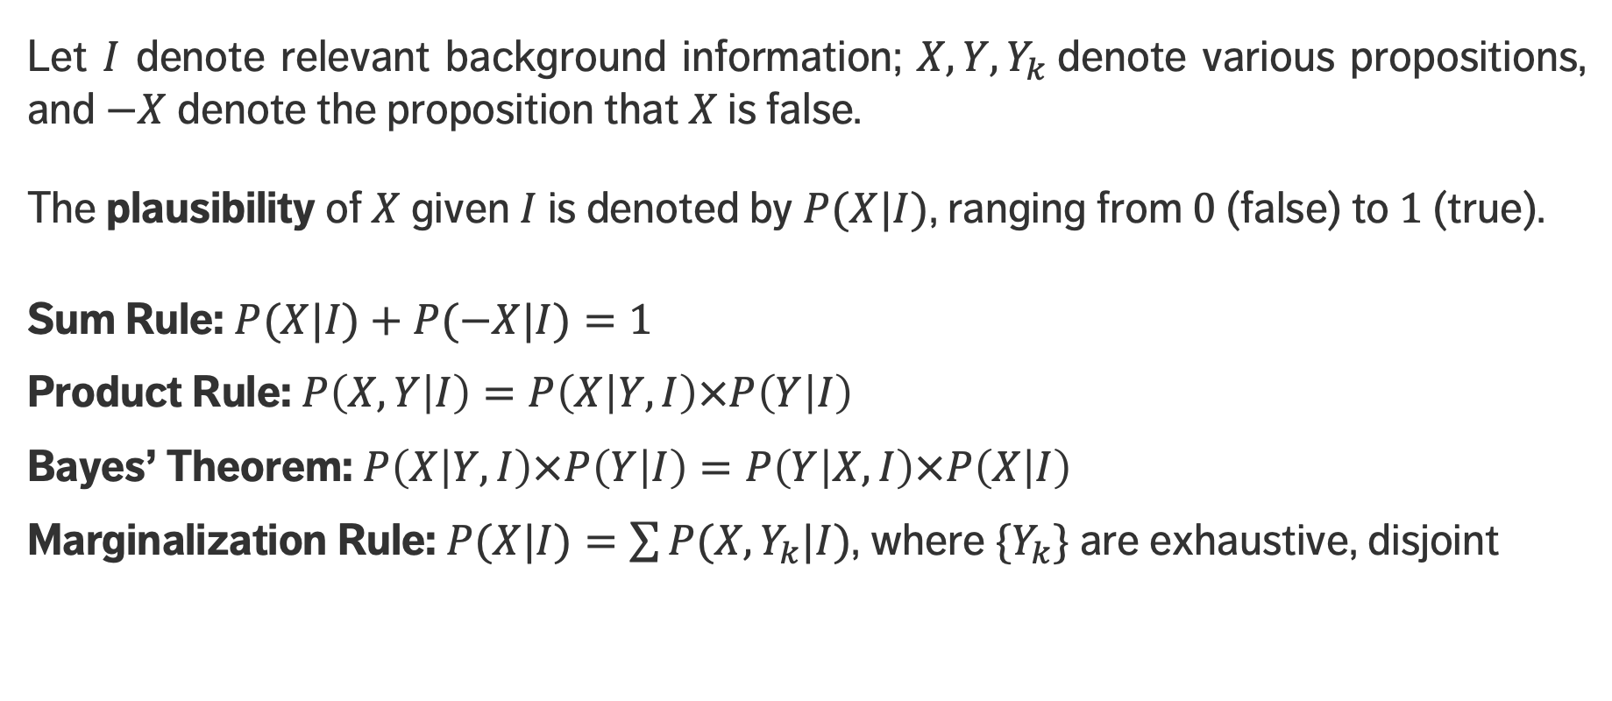
Rules of Probability
Let $I$ denote relevant background information; $X, Y, Y_{k}$denote various propositions, and $−X$ denote the proposition that $X$ is false.
The plausibility of $X$ given $I$ is denoted by $P(X|I)$, ranging from $0$ (false) to $1$ (true).
Sum Rule: $P(X|I)+P(−X|I)=1$
Product Rule: $P\left(X,Y | I\right)=P\left(X | Y,I\right)×P\left(Y | I\right)$
Bayes’ Theorem: $P\left(X | Y,I\right)×P\left(Y | I\right)=P\left(Y | X,I\right)×P\left(X | I\right)$
Marginalization Rule: $P(X|I)=\sum{P(X,Y_{k}|I)}$, where ${\{Y}_{k}\}$ are exhaustive, disjoint

Slide 16
Conditional Probabilities
We then have an interest in determining the likelihood of an event occurring given that another event (or series of events) has occurred.
Examples include:
  the probability that a train arrives on time given that it left on time
  the probability that a PC crashes given the operating system installed
  the probability that a bit is transmitted over a channel is received as a 1 given that the bit transmitted was a 1
  the probability that a website is visited given its number of in-links
  the rules of probability!

Slide 17
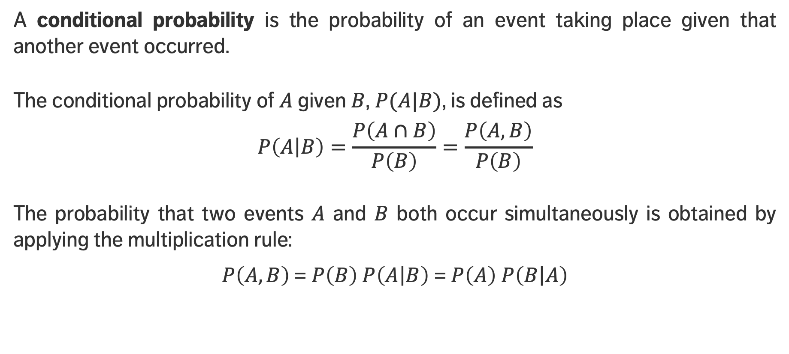
Conditional Probabilities
A conditional probability is the probability of an event taking place given that another event occurred.
The conditional probability of $A$ given $B$, $P(A|B)$, is defined as
$$P\left(\left.A\right|B\right)=\frac{P\left(A∩B\right)}{P\left(B\right)}=\frac{P\left(A,B\right)}{P\left(B\right)}$$
The probability that two events $A$ and $B$ both occur simultaneously is obtained by applying the multiplication rule:
$P\left(A,B\right)$= $P\left(B\right) P\left(\left.A\right|B\right)$ = $P\left(A\right) P\left(\left.B\right|A\right)$

Slide 18
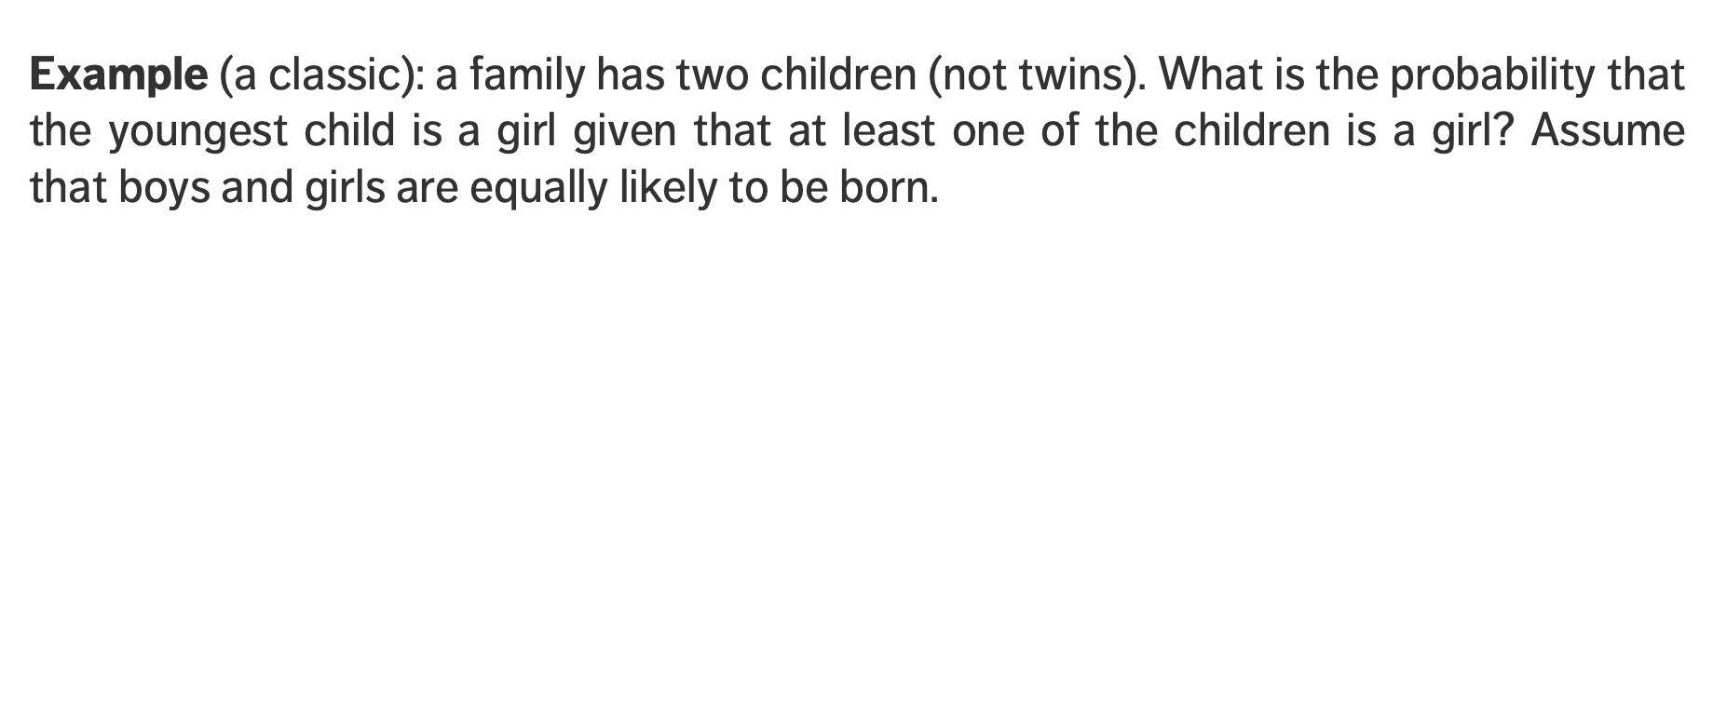
EXERCISE – Conditional Probabilities
Example (a classic): a family has two children (not twins). What is the probability that the youngest child is a girl given that at least one of the children is a girl? Assume that boys and girls are equally likely to be born.
Solution: Let $A$ and $B$ be the events that the youngest child is a girl and that at least one child is a girl, respectively:
$$A = \left\{GG, BG\right\}, B= \{GG, BG, GB\}$$
Then $P\left(\left.A\right|B\right)=\frac{P\left(A∩B\right)}{P\left(B\right)}$ = $\frac{2}{3}$ (not ½, as one might naively assume).

Slide 19
EXERCISE – Conditional Probabilities
We will first try to answer this question by generating a number of trials and identifying successful events (a frequentist approach?)

Slide 20
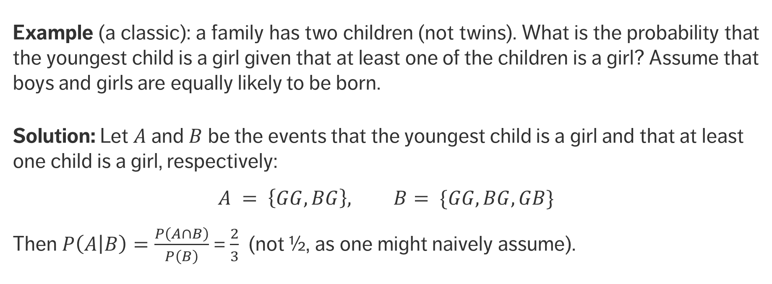
EXERCISE – Conditional Probabilities
Example (a classic): a family has two children (not twins). What is the probability that the youngest child is a girl given that at least one of the children is a girl? Assume that boys and girls are equally likely to be born.
Solution: Let $A$ and $B$ be the events that the youngest child is a girl and that at least one child is a girl, respectively:
$$A = \left\{GG, BG\right\}, B= \{GG, BG, GB\}$$
Then $P\left(\left.A\right|B\right)=\frac{P\left(A∩B\right)}{P\left(B\right)}$ = $\frac{2}{3}$ (not ½, as one might naively assume).

Slide 21
Bayes’ Theorem
A CURSORY GLANCE AT BAYESIAN DATA ANALYSIS

Slide 22
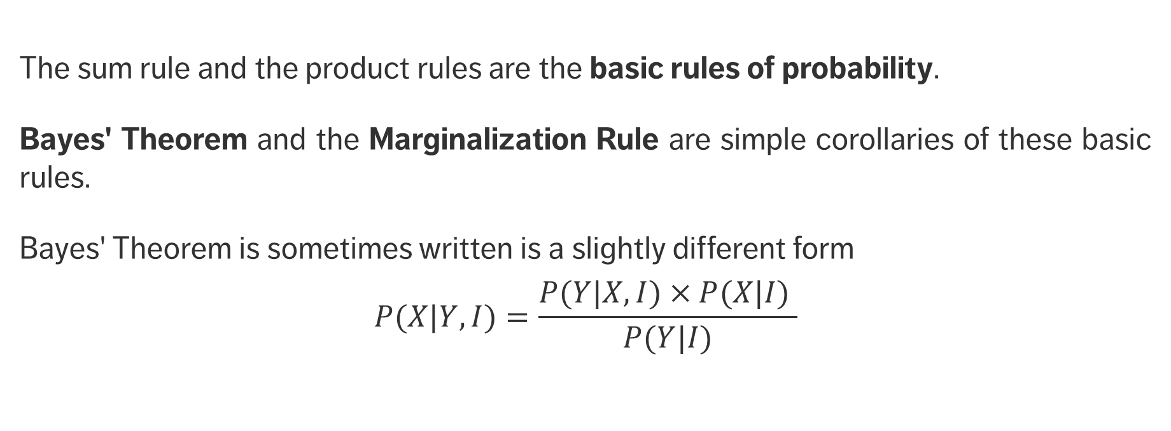
Bayes’ Theorem
The sum rule and the product rules are the basic rules of probability.
Bayes' Theorem and the Marginalization Rule are simple corollaries of these basic rules.
Bayes' Theorem is sometimes written is a slightly different form
$$P(X|Y,I)=\frac{P(Y|X,I)×P(X|I) }{P(Y|I)}$$

Slide 23
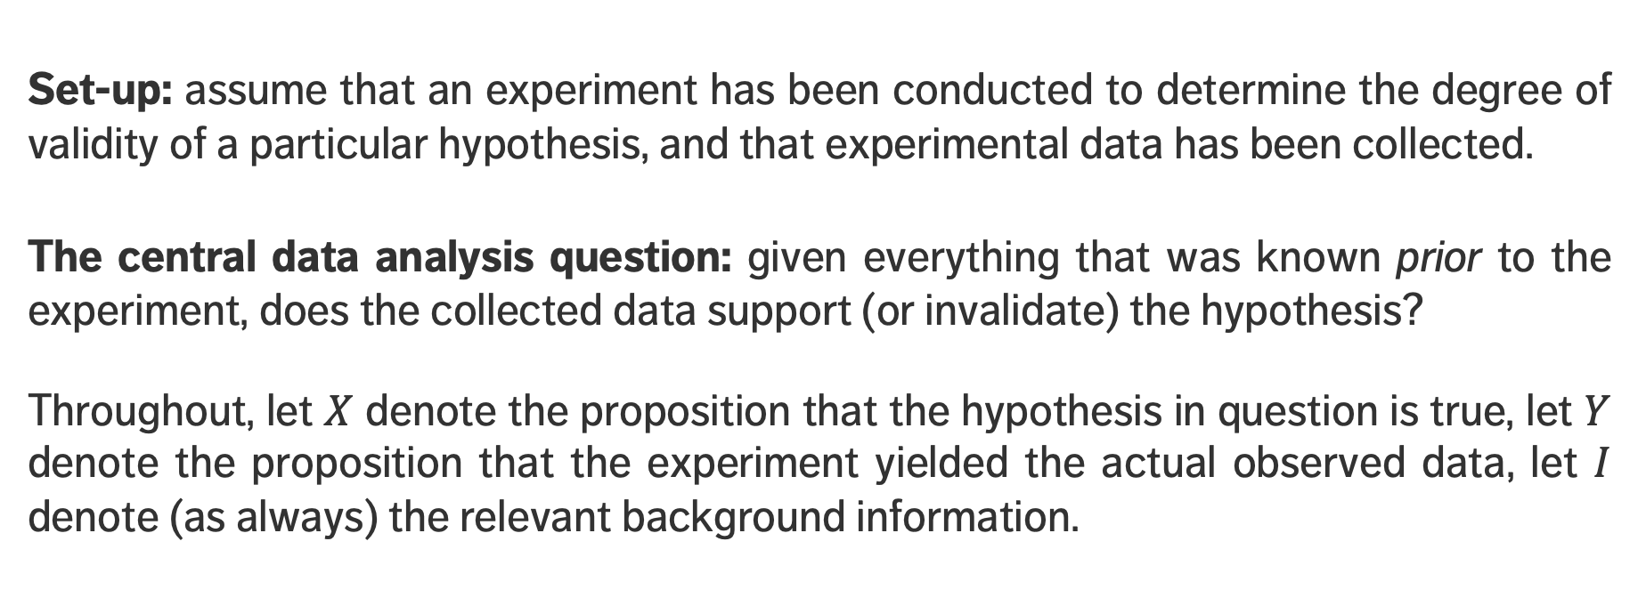
Bayes’ Theorem
Set-up: assume that an experiment has been conducted to determine the degree of validity of a particular hypothesis, and that experimental data has been collected.
The central data analysis question: given everything that was known prior to the experiment, does the collected data support (or invalidate) the hypothesis?
Throughout, let $X$ denote the proposition that the hypothesis in question is true, let $Y$ denote the proposition that the experiment yielded the actual observed data, let $I$ denote (as always) the relevant background information.

Slide 24
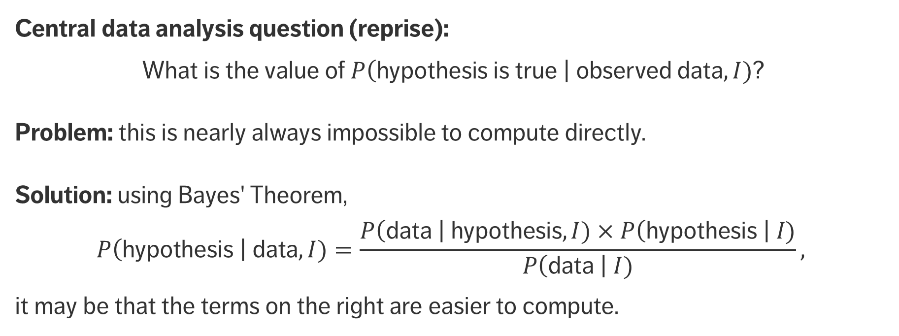
Bayes’ Theorem
Central data analysis question (reprise):
What is the value of $P\left(\text{hypothesis} \text{is} \text{true} \right| \text{observed} \text{data},I)$?
Problem: this is nearly always impossible to compute directly.
Solution: using Bayes' Theorem,
$$P\left(\text{hypothesis} \right| \text{data},I)=\frac{P\left(\text{data} \right| \text{hypothesis},I)×P\left(\text{hypothesis} \right| I)}{P\left(\text{data} \right| I)},$$
it may be that the terms on the right are easier to compute.

Slide 25
EXERCISE – WORLD TRADE CENTER
[Silver, The Signal and the Noise, pp. 247-248]
“Consider a somber example: the September 11 attacks. Most of us would have assigned almost no probability to terrorists crashing planes into buildings in Manhattan when we woke up that morning. But we recognized that a terror attack was an obvious possibility once the first hit the World Trade Center. And we had no doubt we were being attacked once the second tower was hit. Bayes’ Theorem can replicate this result.”

Slide 26
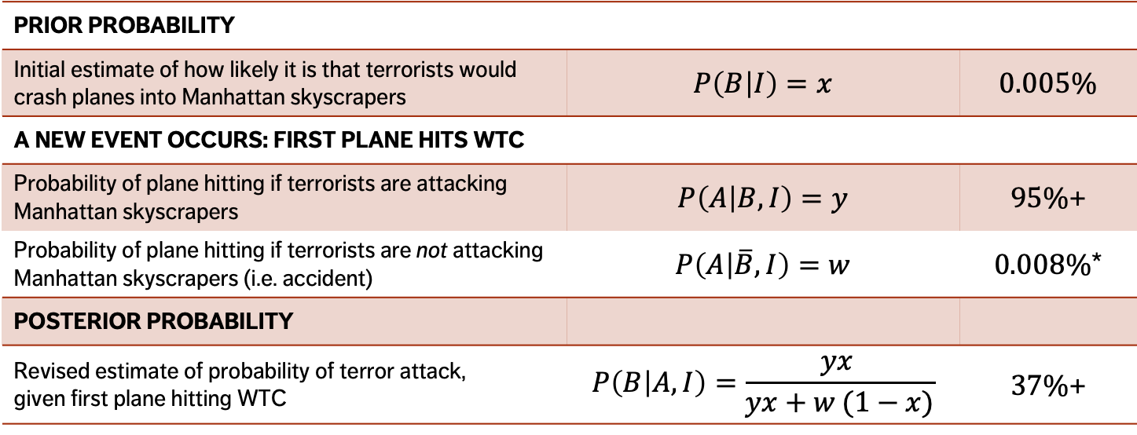
EXERCISE – WORLD TRADE CENTER (1st PLANE)
[Silver, The Signal and the Noise, pp. 247-248]
PRIOR PROBABILITY
Initial estimate of how likely it is that terrorists would crash planes into Manhattan skyscrapers | $$P\left(B | I\right)=x$$ | $$0.005\%$$
A NEW EVENT OCCURS: FIRST PLANE HITS WTC
Probability of plane hitting if terrorists are attacking Manhattan skyscrapers | $$P\left(A | B,I\right)=y$$ | $95\%$+
Probability of plane hitting if terrorists are not attacking Manhattan skyscrapers (i.e. accident) | $$P\left(A | \overline{B},I\right)=w$$ | $0.008\%$*
POSTERIOR PROBABILITY
Revised estimate of probability of terror attack, given first plane hitting WTC | $$P\left(B | A,I\right)=\frac{yx }{yx+w (1−x)}$$ | $37\%$+
*2 incidents in the previous 25,000 days

Slide 27
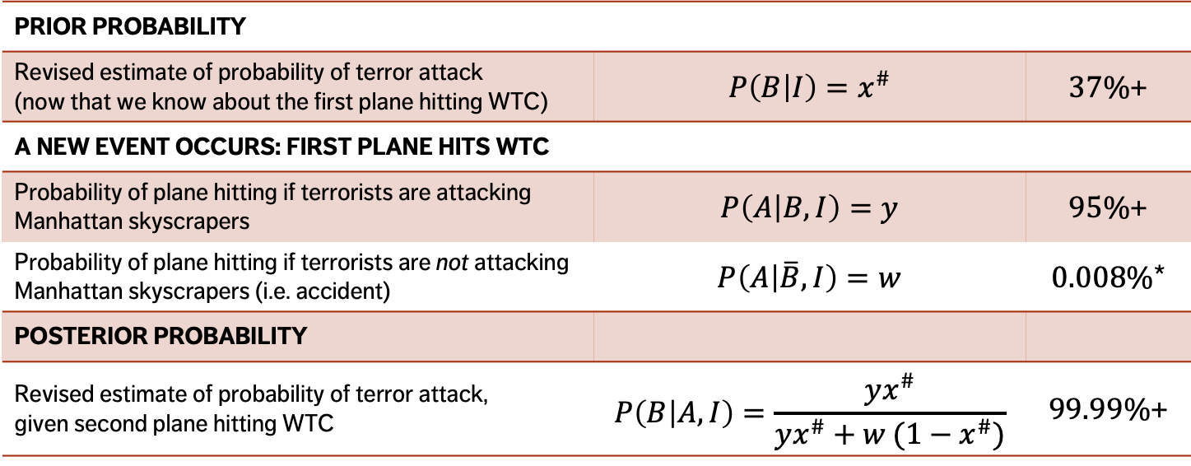
EXERCISE – WORLD TRADE CENTER (2nd PLANE)
[Silver, The Signal and the Noise, pp. 247-248]
PRIOR PROBABILITY
Revised estimate of probability of terror attack (now that we know about the first plane hitting WTC) | $$P\left(B | I\right)=x^{\#}$$ | $37\%$+
A NEW EVENT OCCURS: FIRST PLANE HITS WTC
Probability of plane hitting if terrorists are attacking Manhattan skyscrapers | $$P\left(A | B,I\right)=y$$ | $95\%$+
Probability of plane hitting if terrorists are not attacking Manhattan skyscrapers (i.e. accident) | $$P\left(A | \overline{B},I\right)=w$$ | $0.008\%$*
POSTERIOR PROBABILITY
Revised estimate of probability of terror attack, given second plane hitting WTC | $$P\left(B | A,I\right)=\frac{yx^{\#}}{yx^{\#}+w (1−x^{\#})}$$ | $99.99\%$+
*2 incidents in the previous 25,000 days

Slide 28
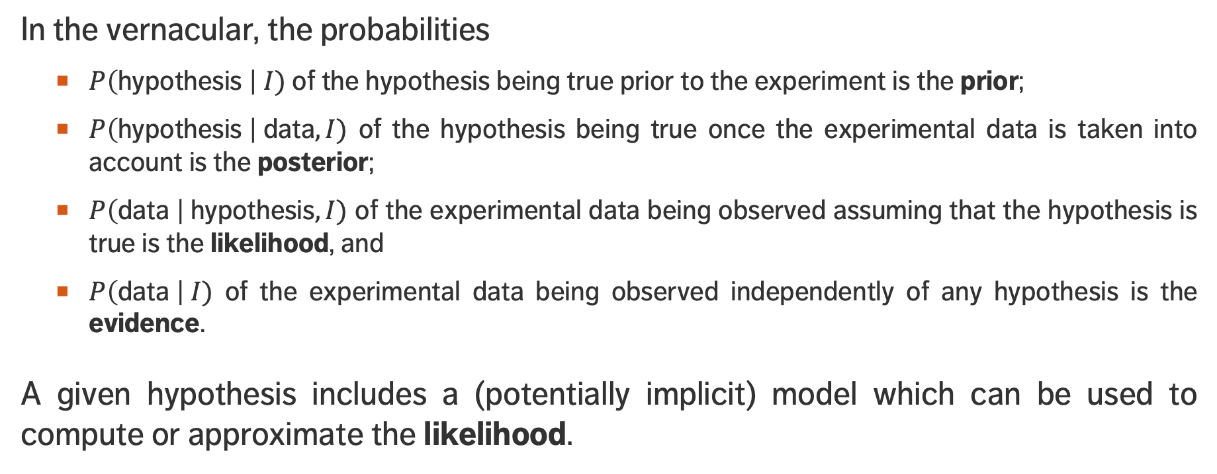
Bayes’ Theorem
In the vernacular, the probabilities
  $P\left(\text{hypothesis} \right| I)$ of the hypothesis being true prior to the experiment is the prior;
  $P\left(\text{hypothesis} \right| \text{data},I)$ of the hypothesis being true once the experimental data is taken into account is the posterior;
  $P\left(\text{data} \right| \text{hypothesis},I)$ of the experimental data being observed assuming that the hypothesis is true is the likelihood, and
  $P\left(\text{data} \right| I)$ of the experimental data being observed independently of any hypothesis is the evidence.
A given hypothesis includes a (potentially implicit) model which can be used to compute or approximate the likelihood.

Slide 29
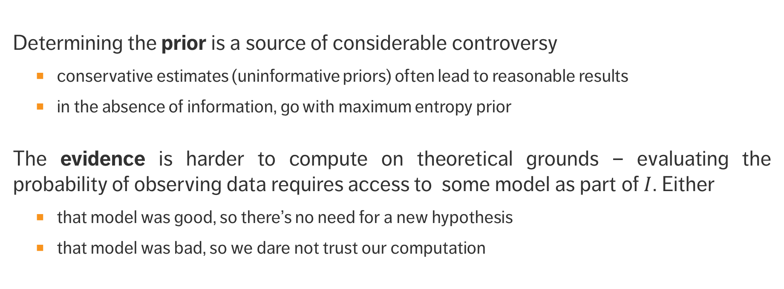
Bayes’ Theorem
Determining the prior is a source of considerable controversy
  conservative estimates (uninformative priors) often lead to reasonable results
  in the absence of information, go with maximum entropy prior
The evidence is harder to compute on theoretical grounds – evaluating the probability of observing data requires access to some model as part of $I$. Either
  that model was good, so there’s no need for a new hypothesis
  that model was bad, so we dare not trust our computation

Slide 30
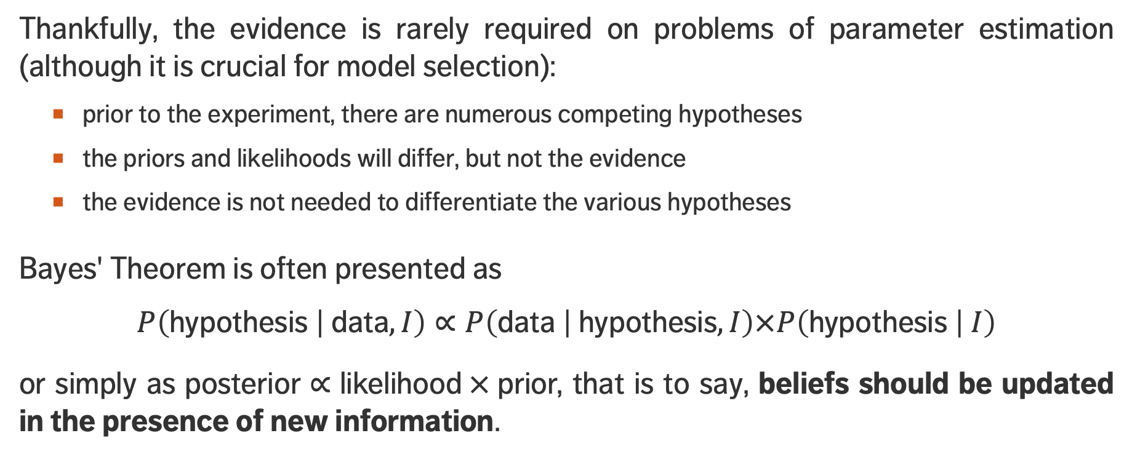
Bayes’ Theorem
Thankfully, the evidence is rarely required on problems of parameter estimation (although it is crucial for model selection):
  prior to the experiment, there are numerous competing hypotheses
  the priors and likelihoods will differ, but not the evidence
  the evidence is not needed to differentiate the various hypotheses
Bayes' Theorem is often presented as
$$P\left(\text{hypothesis} | \text{data},I\right)∝P\left(\text{data} | \text{hypothesis},I\right)×P\left(\text{hypothesis} | I\right)$$
or simply as $\text{posterior}∝\text{likelihood} × \text{prior}\text{,}$ that is to say, beliefs should be updated in the presence of new information.

Slide 31
DISCUSSION
What would it take for you to update …
  … your belief in the existence/non-existence of a deity?
  … your belief in the shape of the Earth?
  … your political affiliation?
  … your allegiance to a sport team?
  … your belief in the effectiveness of homeopathic remedies?
  … your belief in the effectiveness of Bayesian analysis?

Slide 32
EXERCISE – FALSE POSITIVE TESTING
Suppose that a test for a particular disease has a very high success rate. If a patient
  has the disease, the test accurately reports a ’positive’ with probability 0.99;
  does not have the disease, the test accurately reports a ’negative’ with probability 0.95.
Assume further that only 0.1% of the population has the disease. What is the probability that a patient who tests positive does not in fact have the disease?

Slide 33
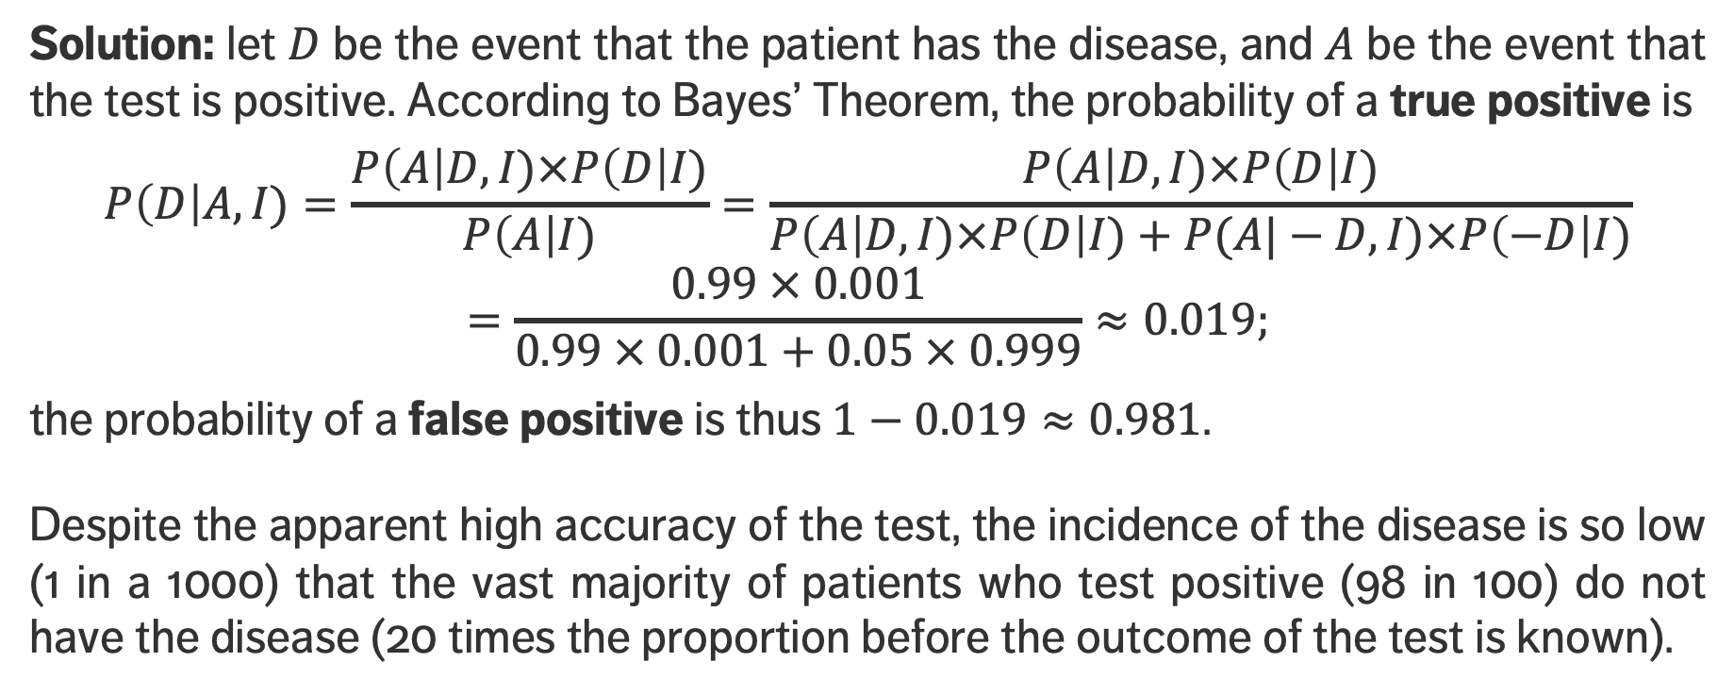
EXERCISE – FALSE POSITIVE TESTING
Solution: let $D$ be the event that the patient has the disease, and $A$ be the event that the test is positive. According to Bayes’ Theorem, the probability of a true positive is
$$P\left(D\right|A,I)=\frac{P\left(A\right|D,I)×P\left(D\right|I)}{P\left(A\right|I)}=\frac{P\left(A\right|D,I)×P\left(D\right|I)}{P\left(A\right|D,I)×P\left(D\right|I)+P(A|−D,I)×P\left(−D\right|I)}=\frac{0.99 × 0.001}{0.99 × 0.001+0.05 × 0.999}≈0.019;$$
the probability of a false positive is thus $1−0.019≈0.981$.
Despite the apparent high accuracy of the test, the incidence of the disease is so low (1 in a 1000) that the vast majority of patients who test positive (98 in 100) do not have the disease (20 times the proportion before the outcome of the test is known).

Slide 34
EXERCISE – DRIVING CONDITIONS
A road safety analyst has access to a dataset of fatal vehicle collisions (such as the NCDB) on roads in a specific region.
The dataset is built using police reports, and it contains relevant collision information such as:
  the severity of the collision, the age of the drivers, the number of passengers in each vehicle, the date and time of the collision, weather and road conditions, blood alcohol content (BAC), etc.
Let us further assume that the analyst has access to aggregated weather data and R.I.D.E. (sobriety checkpoint) reports for that region.

Slide 35
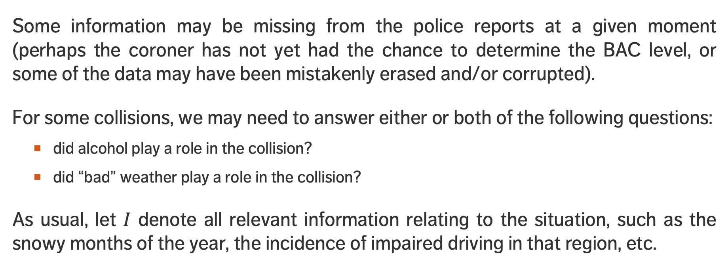
EXERCISE – DRIVING CONDITIONS
Some information may be missing from the police reports at a given moment (perhaps the coroner has not yet had the chance to determine the BAC level, or some of the data may have been mistakenly erased and/or corrupted).
For some collisions, we may need to answer either or both of the following questions:
  did alcohol play a role in the collision?
  did “bad” weather play a role in the collision?
As usual, let $I$ denote all relevant information relating to the situation, such as the snowy months of the year, the incidence of impaired driving in that region, etc.

Slide 36
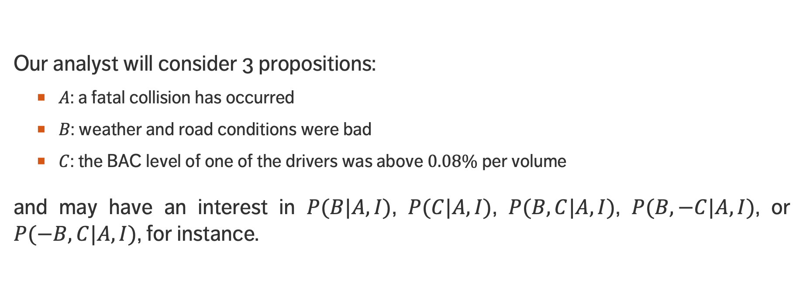
EXERCISE – DRIVING CONDITIONS
Our analyst will consider 3 propositions:
  $A$: a fatal collision has occurred
  $B$: weather and road conditions were bad
  $C$: the BAC level of one of the drivers was above $0.08\%$ per volume
and may have an interest in $P(B|A,I)$, $P(C|A,I)$, $P(B,C|A,I)$, $P(B,−C|A,I)$, or $P(−B,C|A,I)$, for instance.

Slide 37
EXERCISE – DRIVING CONDITIONS
Derive an expression to compute the probability that “bad” weather and road conditions were present at the time of the collision.
A Mild Winter scenario: during a mild winter, “bad” weather affected regional road conditions 5% of the time. The analyst knows from other sources that the probabilities of fatal collisions given “bad” and “good” weather conditions in the region over the winter are 0.01% and 0.002%, respectively. If a fatal collision occurred on a regional road that winter, what is the probability that the weather conditions were “bad” on that road at that time? Is the result surprising?

Slide 38
EXERCISE – DRIVING CONDITIONS
Not quite as Mild a Winter scenario: let’s assume that the winter was not quite as mild (perhaps “bad” weather affected regional road conditions 10% of the time, say). If a fatal collision occurred on a regional road that winter, what is the probability that the weather conditions were “bad” on that road at that time? How much of a jump are you expecting compared to question 2?
Just how rough of a winter would be necessary before we conclude that a given fatal collision was more likely to have occurred in “bad” weather?

Slide 39
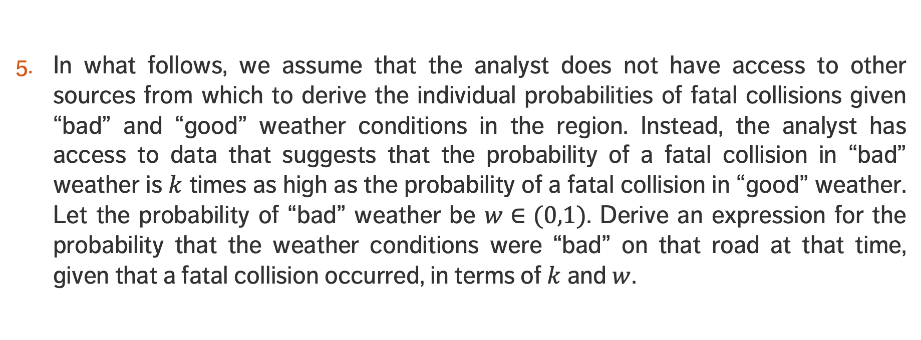
EXERCISE – DRIVING CONDITIONS
In what follows, we assume that the analyst does not have access to other sources from which to derive the individual probabilities of fatal collisions given “bad” and “good” weather conditions in the region. Instead, the analyst has access to data that suggests that the probability of a fatal collision in “bad” weather is $k$ times as high as the probability of a fatal collision in “good” weather. Let the probability of “bad” weather be $w∈(0,1)$. Derive an expression for the probability that the weather conditions were “bad” on that road at that time, given that a fatal collision occurred, in terms of $k$ and $w$.

Slide 40
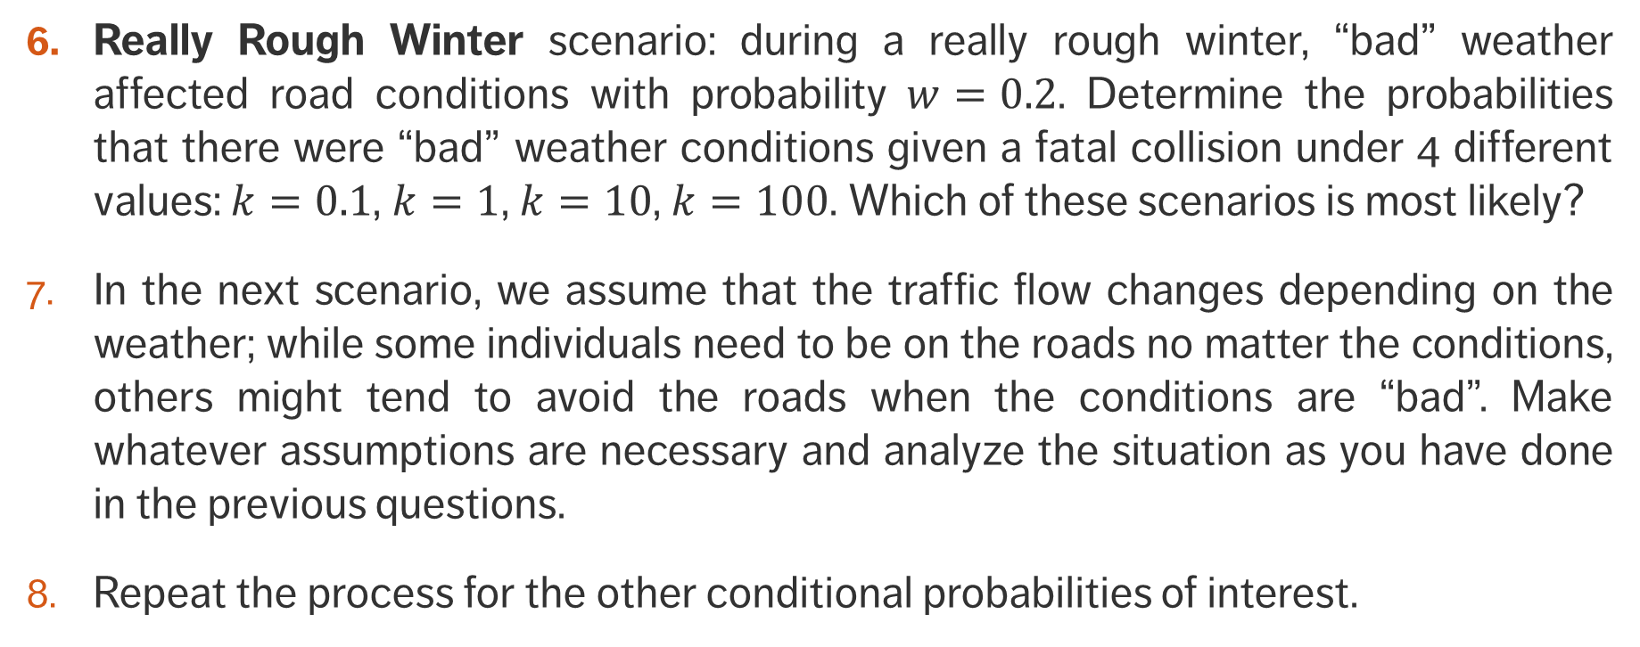
EXERCISE – DRIVING CONDITIONS
Really Rough Winter scenario: during a really rough winter, “bad” weather affected road conditions with probability $w=0.2$. Determine the probabilities that there were “bad” weather conditions given a fatal collision under 4 different values: $k=0.1$, $k=1$, $k=10$, $k=100$. Which of these scenarios is most likely?
In the next scenario, we assume that the traffic flow changes depending on the weather; while some individuals need to be on the roads no matter the conditions, others might tend to avoid the roads when the conditions are “bad”. Make whatever assumptions are necessary and analyze the situation as you have done in the previous questions.
Repeat the process for the other conditional probabilities of interest.

Slide 41
EXERCISE – MONTY HALL PROBLEM
(Another classic) A lifetime’s supply of poutine is placed randomly behind one of three identical doors. You are asked to pick a door. One of the doors you have not selected is opened, revealing an empty room. You are given the option of changing your pick. What is your optimal strategy?
  Determine the ideal strategy using a simulation.
  Analyze a similar situation (for 100 doors instead of 3) using Bayes’ Theorem.
  Analyze the situation using Bayes’ Theorem.

Slide 42
EXAMPLE: THE FAIR (?) COIN
A CURSORY GLANCE AT BAYESIAN DATA ANALYSIS

Slide 43
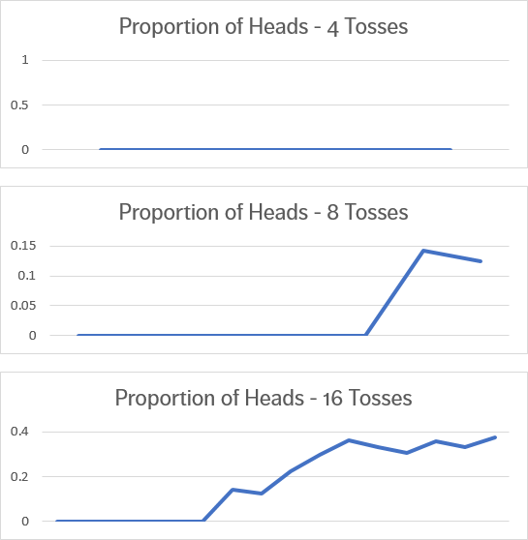
THE FAIR (?) COIN – SET-UP
I brought back a souvenir coin from a trip to a strange and distant land.
I have been flipping it pretty much non-stop since I’ve returned. You can see the proportion of heads I obtained for 4, 8, and 16 tosses.
At first, I thought the coin might be biased, but the proportion of heads seems to inch its way towards 50%...

Slide 44
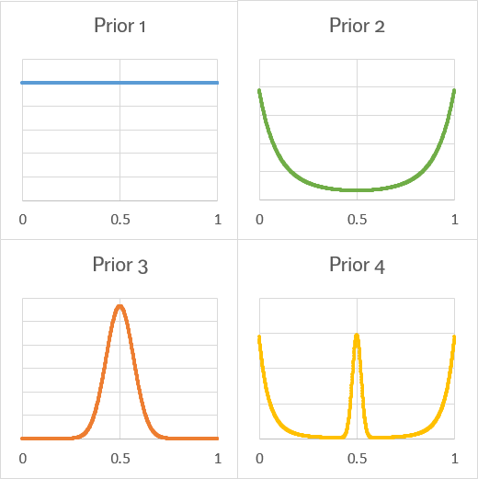
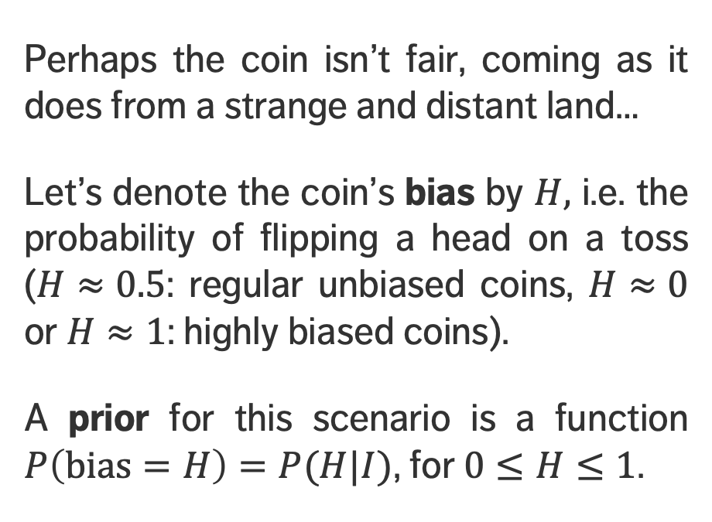
THE FAIR (?) COIN – PRIORS
Perhaps the coin isn’t fair, coming as it does from a strange and distant land…
Let’s denote the coin’s bias by $H,$ i.e. the probability of flipping a head on a toss ($H≈0.5$: regular unbiased coins, $H≈0$ or $H≈1$: highly biased coins).
A prior for this scenario is a function $P\left(\text{bias}=H\right)=P(H|I)$, for $0≤H≤1$.

Slide 45
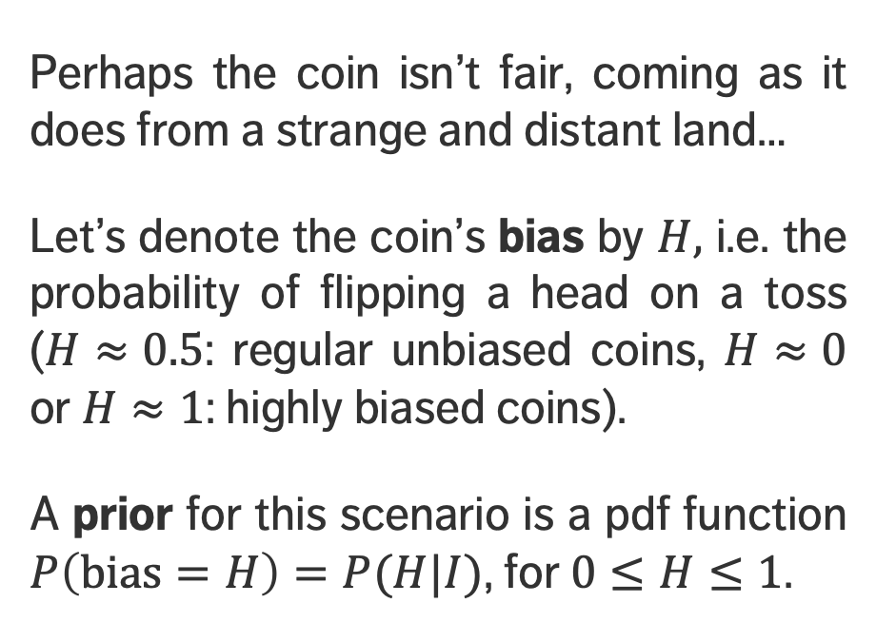
THE FAIR (?) COIN – PRIORS
I have no idea…
I suspect foul play…
Perhaps the coin isn’t fair, coming as it does from a strange and distant land…
Let’s denote the coin’s bias by $H,$ i.e. the probability of flipping a head on a toss ($H≈0.5$: regular unbiased coins, $H≈0$ or $H≈1$: highly biased coins).
A prior for this scenario is a pdf function $P\left(\text{bias}=H\right)=P(H|I)$, for $0≤H≤1$.
It’s a regular coin, you numbskull…
The fact that you’re asking makes me doubt myself…

Slide 46
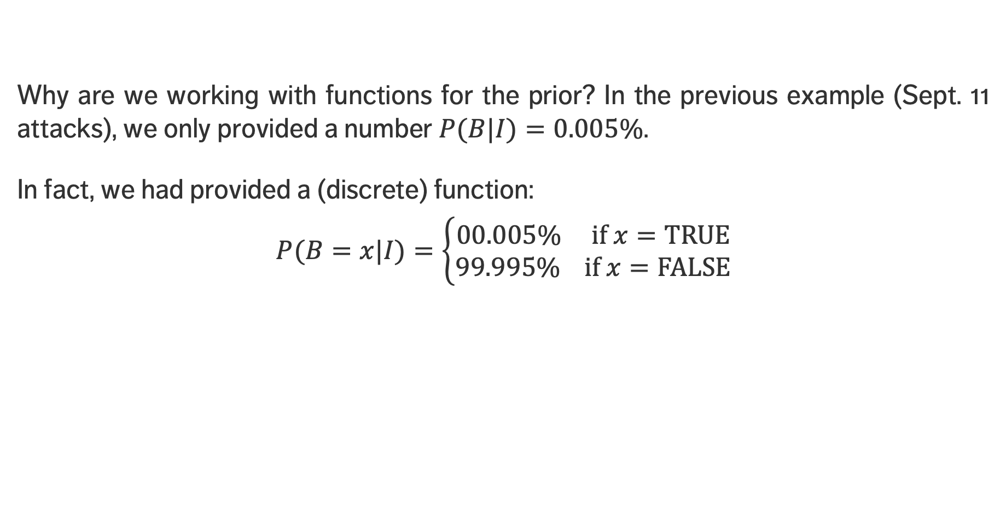
THE FAIR (?) COIN – PRIORS
Why are we working with functions for the prior? In the previous example (Sept. 11 attacks), we only provided a number $P(B|I)=0.005\%$.
In fact, we had provided a (discrete) function:
$$P(B=x|I)=\left\{\begin{aligned}00.005\% \text{if} x=\text{TRUE} \\ 99.995\% \text{if} x=\text{FALSE}\end{aligned}\right.$$

Slide 47
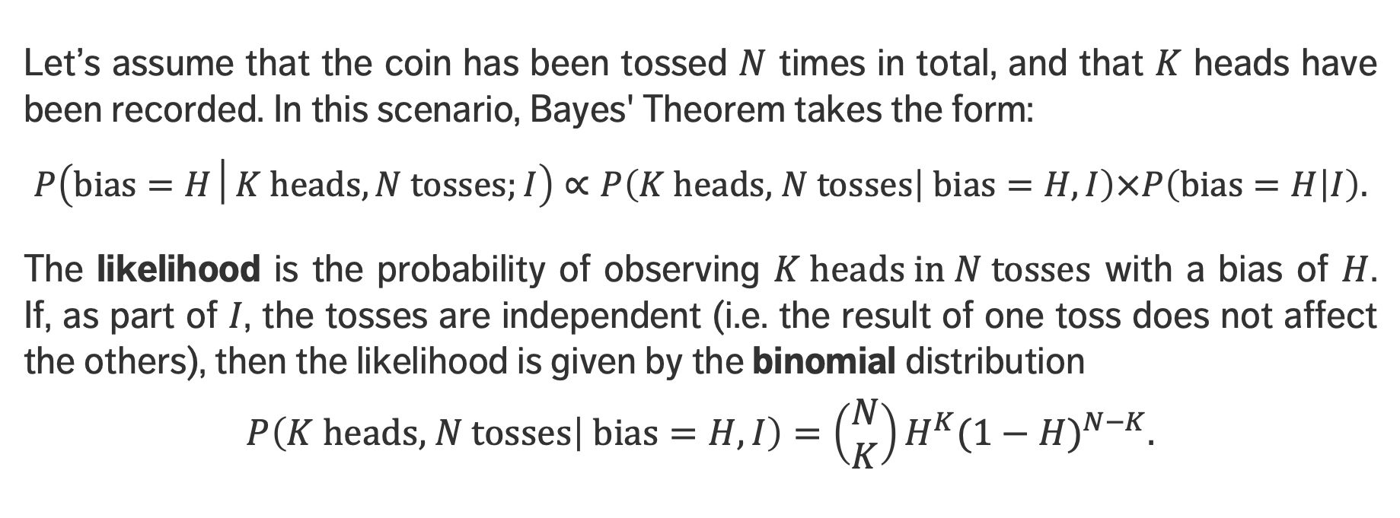
THE FAIR (?) COIN – LIKELIHOOD
Let’s assume that the coin has been tossed $N$ times in total, and that $K$ heads have been recorded. In this scenario, Bayes' Theorem takes the form:
$$P\left(\text{bias}=H│K \text{heads},N \text{tosses};I\right)∝P\left(K \text{heads}\text{,} N \text{tosses} | \text{bias}=H,I\right)×P\left(\text{bias}=H | I\right).$$
The likelihood is the probability of observing $K \text{heads} \text{in} N \text{tosses}$ with a bias of $H$.
If, as part of $I$, the tosses are independent (i.e. the result of one toss does not affect the others), then the likelihood is given by the binomial distribution
$$P\left(K \text{heads}\text{,} N \text{tosses} | \text{bias}=H,I\right)=\left(\begin{matrix}N \\ K\end{matrix}\right)H^{K}{(1−H)}^{N−K}.$$

Slide 48
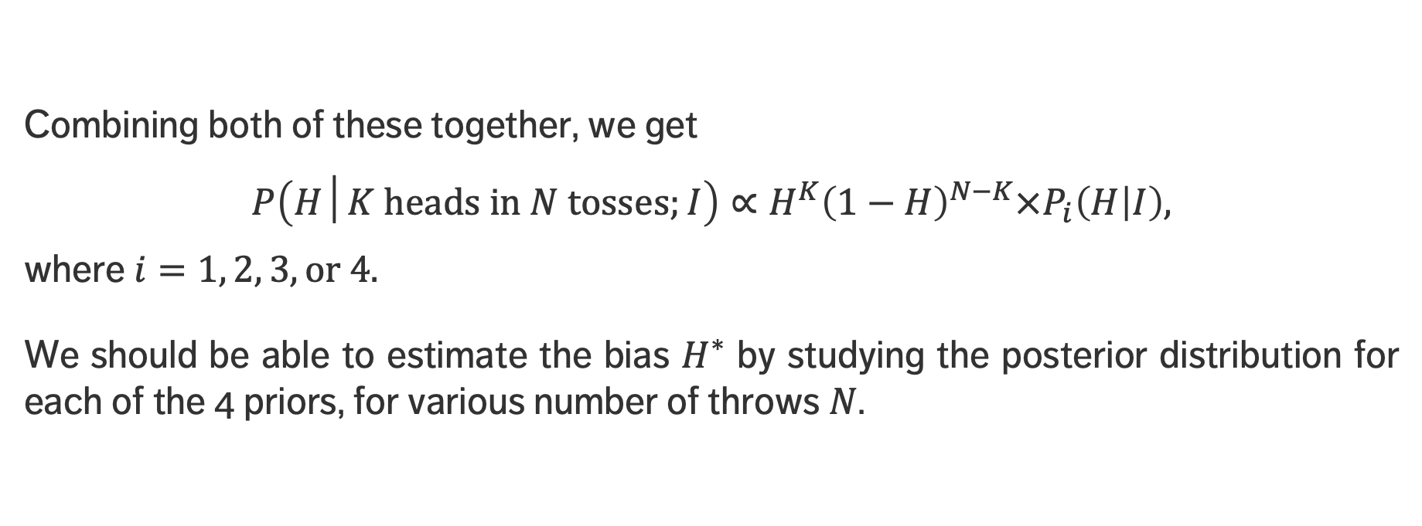
THE FAIR (?) COIN – POSTERIOR(S)
Combining both of these together, we get
$$P\left(H│K \text{heads} \text{in} N \text{tosses};I\right)∝H^{K}{\left(1−H\right)}^{N−K}×P_{i}\left(H | I\right),$$
where $i=1, 2, 3, or 4.$
We should be able to estimate the bias $H^{∗}$ by studying the posterior distribution for each of the 4 priors, for various number of throws $N$.

Slide 49
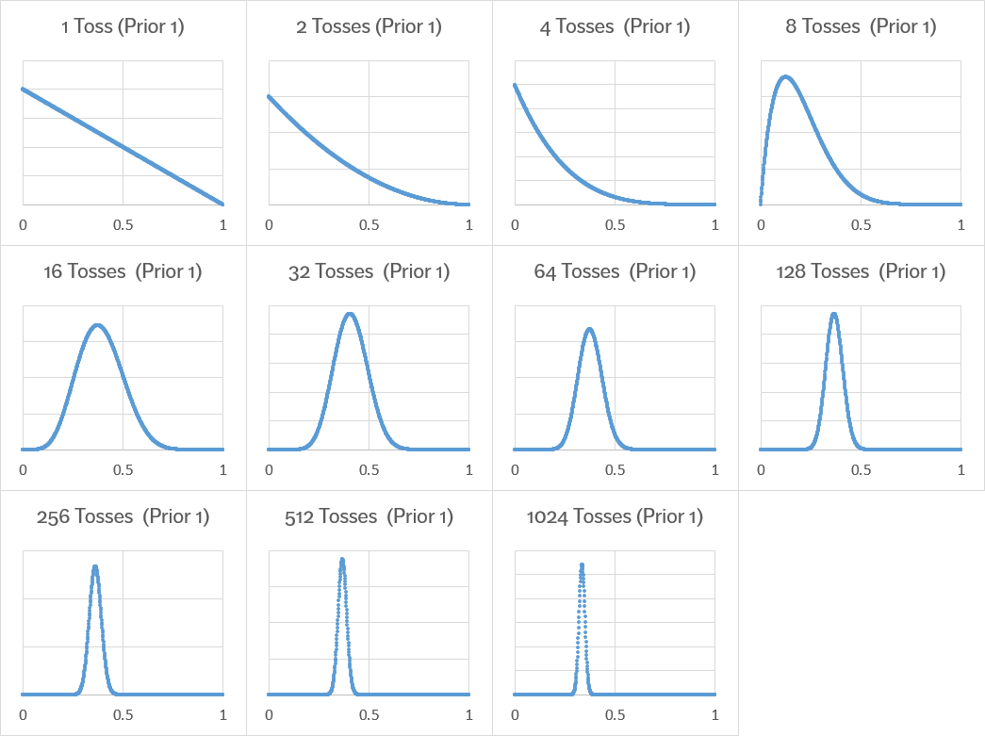
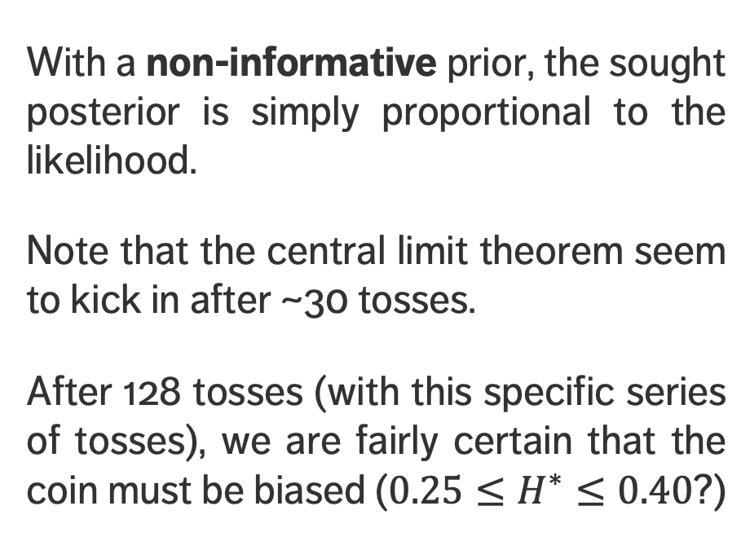
THE FAIR (?) COIN – POSTERIORS – NoN-INFORMATIVE PRIOR
With a non-informative prior, the sought posterior is simply proportional to the likelihood.
Note that the central limit theorem seem to kick in after ~30 tosses.
After 128 tosses (with this specific series of tosses), we are fairly certain that the coin must be biased (${0.25≤H}^{∗}≤0.40$?)

Slide 50
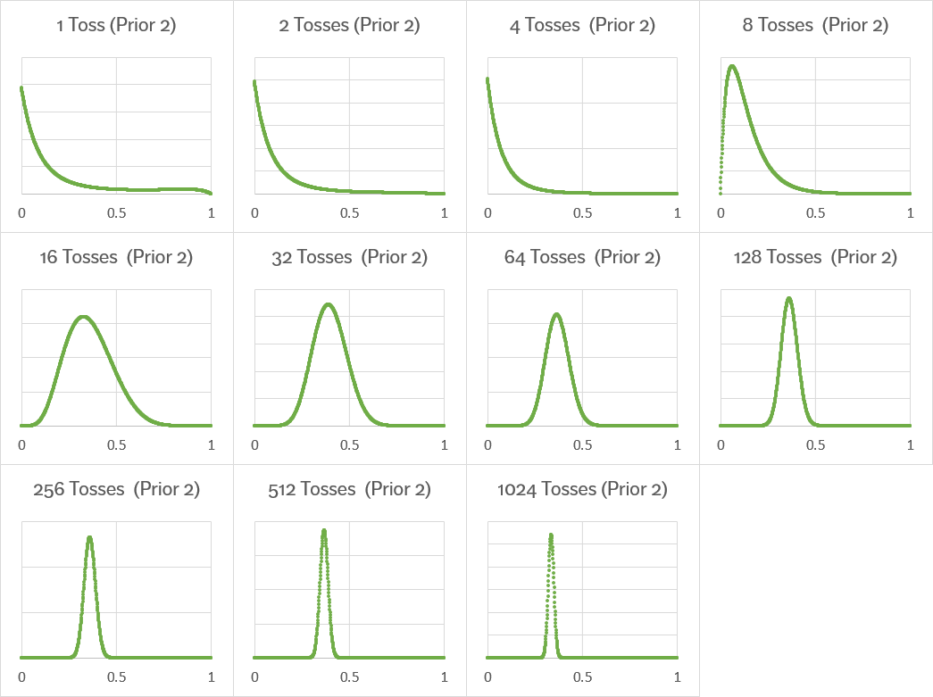
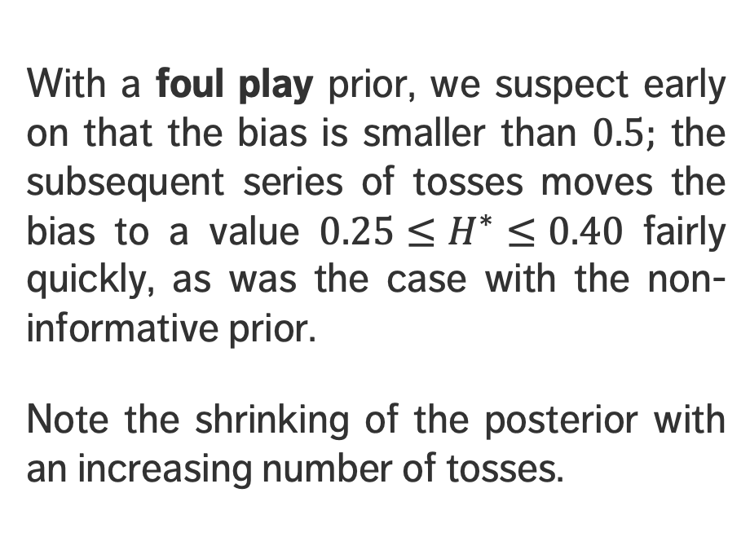
THE FAIR (?) COIN – POSTERIORS – FOUL PLAY PRIOR
With a foul play prior, we suspect early on that the bias is smaller than $0.5;$ the subsequent series of tosses moves the bias to a value ${0.25≤H}^{∗}≤0.40$ fairly quickly, as was the case with the non-informative prior.
Note the shrinking of the posterior with an increasing number of tosses.

Slide 51
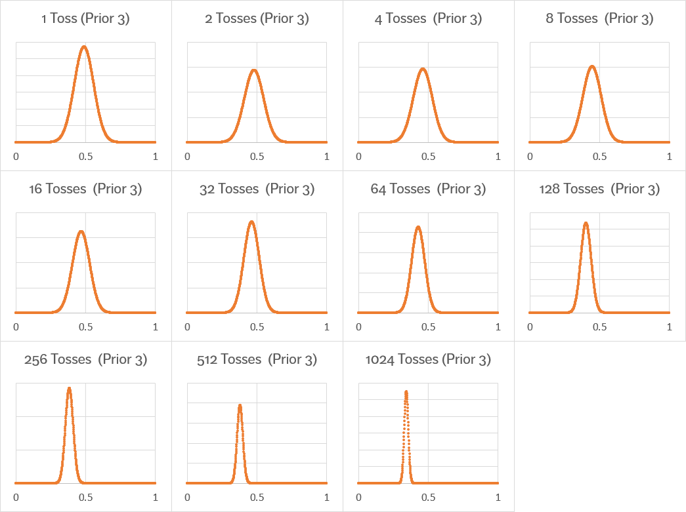
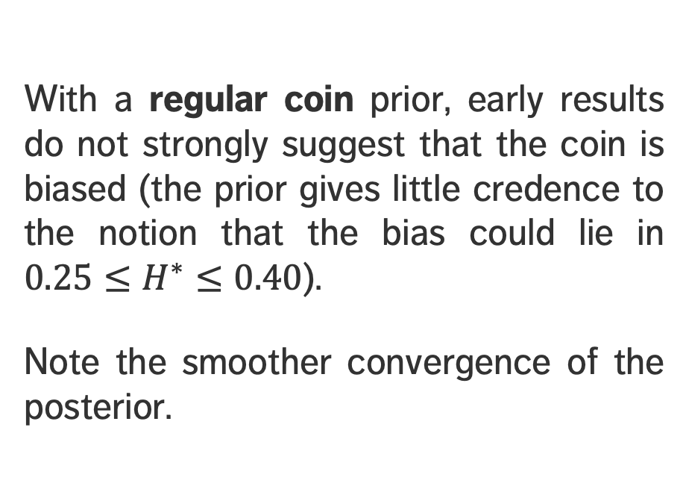
THE FAIR (?) COIN – POSTERIORS – REGULAR COIN PRIOR
With a regular coin prior, early results do not strongly suggest that the coin is biased (the prior gives little credence to the notion that the bias could lie in ${0.25≤H}^{∗}≤0.40$).
Note the smoother convergence of the posterior.

Slide 52
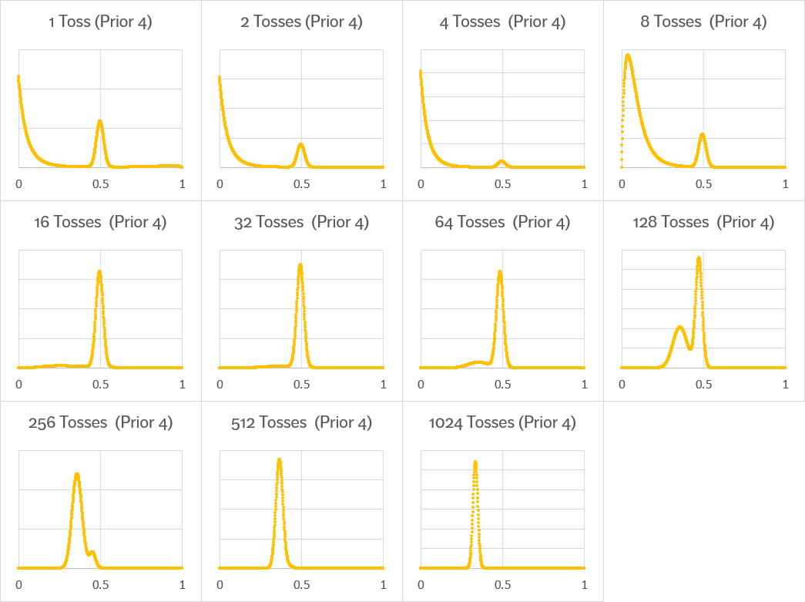
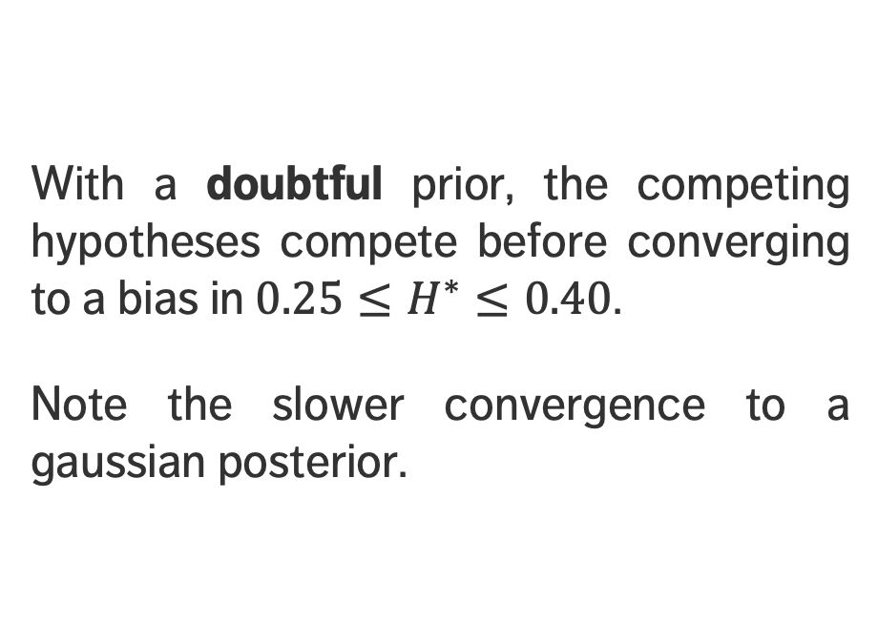
THE FAIR (?) COIN – POSTERIORS – DOUBTFUL PRIOR
With a doubtful prior, the competing hypotheses compete before converging to a bias in ${0.25≤H}^{∗}≤0.40$.
Note the slower convergence to a gaussian posterior.

Slide 53
EXAMPLE: THE SALARY QUESTION
A CURSORY GLANCE AT BAYESIAN DATA ANALYSIS

Slide 54
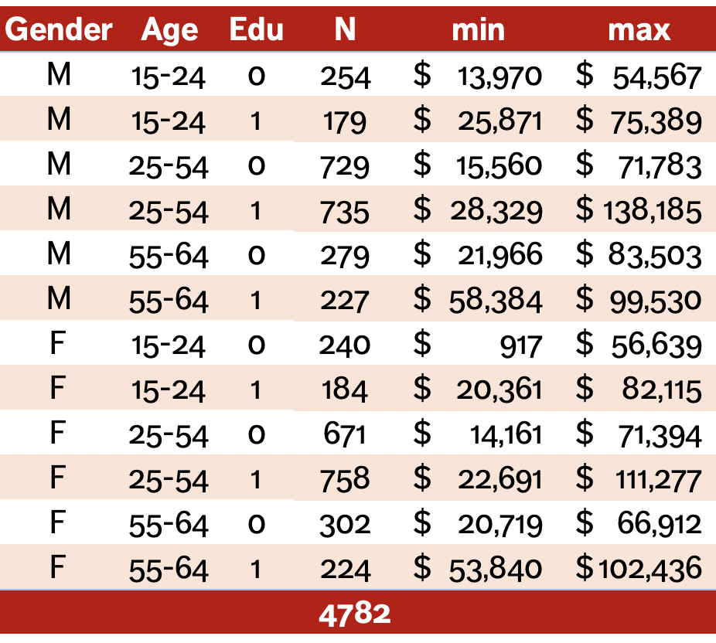
THE SALARY QUESTION – SET-UP
Income information has been collected for 4782 individuals, with demographics.
The table to the right shows some of the summary statistics for the dataset.
Question: is there a link between the demographic information and income?

Slide 55
THE SALARY QUESTION – SET-UP
How could you answer this question?

Slide 56
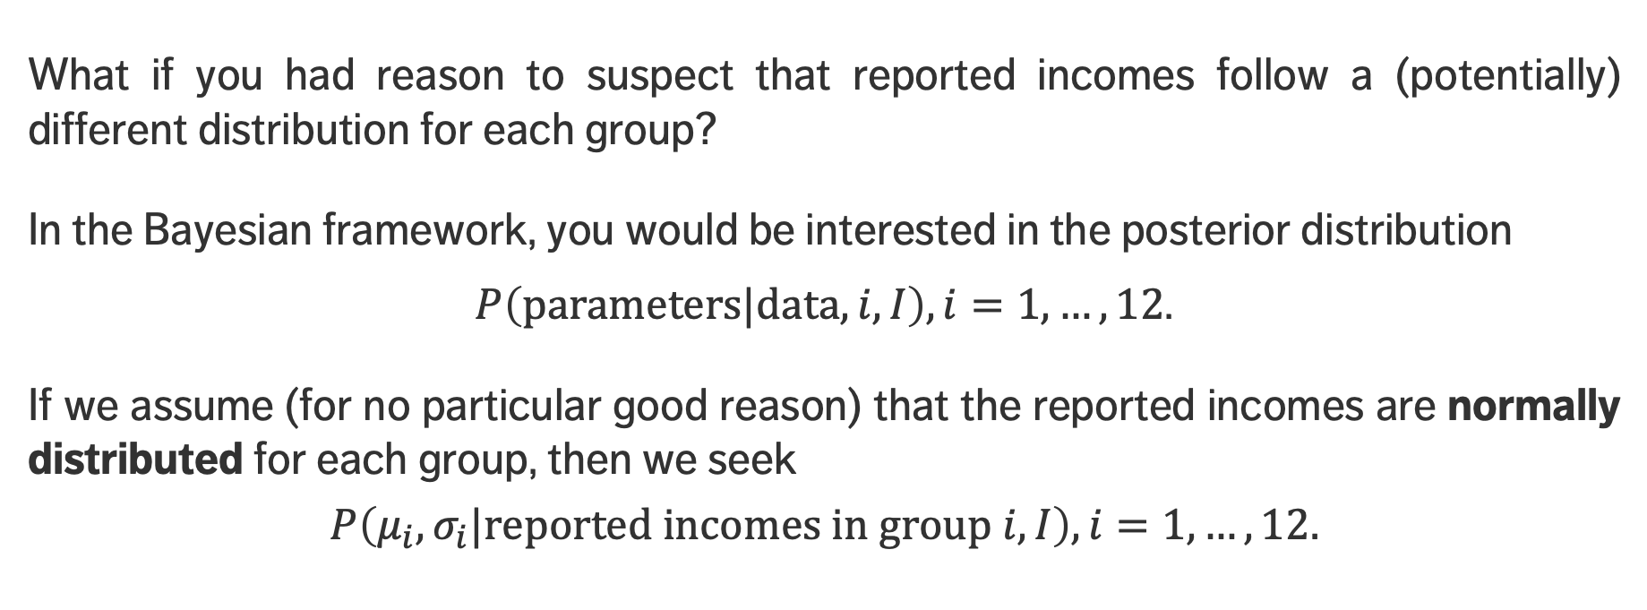
THE SALARY QUESTION – SET-UP
What if you had reason to suspect that reported incomes follow a (potentially) different distribution for each group?
In the Bayesian framework, you would be interested in the posterior distribution
$P\left(\text{parameters}|\text{data},i,I\right), i=1,…,12$.
If we assume (for no particular good reason) that the reported incomes are normally distributed for each group, then we seek
$$P\left(μ_{i},σ_{i}|\text{reported} \text{incomes} \text{in} \text{group} i,I\right), i=1,…,12.$$

Slide 57
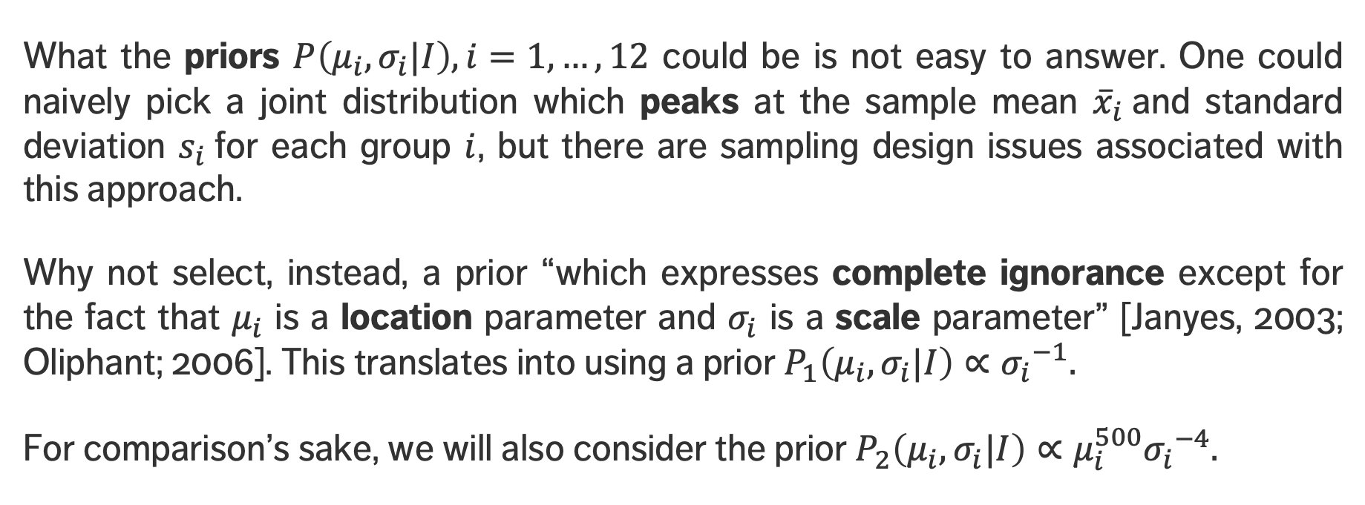
THE SALARY QUESTION – PRIORS
What the priors $P\left(μ_{i},σ_{i}|I\right), i=1,…,12$ could be is not easy to answer. One could naively pick a joint distribution which peaks at the sample mean ${\overline{x}}_{i}$and standard deviation $s_{i}$for each group $i$, but there are sampling design issues associated with this approach.
Why not select, instead, a prior “which expresses complete ignorance except for the fact that $μ_{i}$ is a location parameter and $σ_{i}$ is a scale parameter” [Janyes, 2003; Oliphant; 2006]. This translates into using a prior $P_{1}\left(μ_{i},σ_{i}|I\right)∝{σ_{i}}^{−1}.$
For comparison’s sake, we will also consider the prior $P_{2}\left(μ_{i},σ_{i}|I\right)∝μ_{i}^{500}{σ_{i}}^{−4}.$

Slide 58
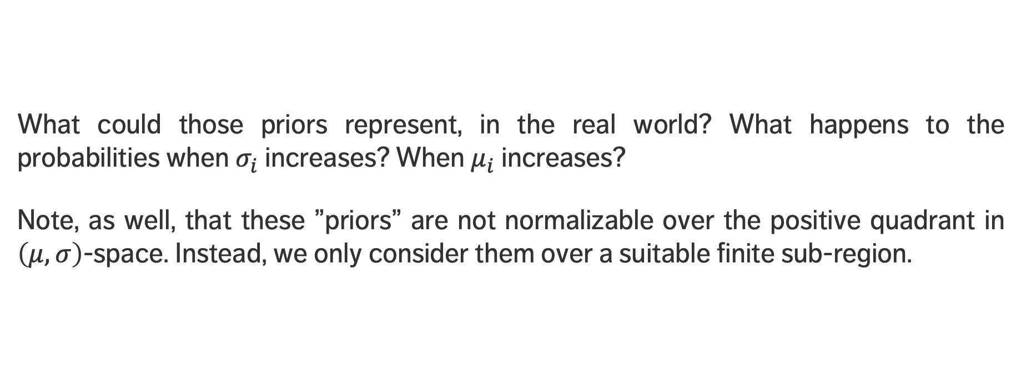
THE SALARY QUESTION – PRIORS
What could those priors represent, in the real world? What happens to the probabilities when $σ_{i}$ increases? When $μ_{i}$ increases?
Note, as well, that these ”priors” are not normalizable over the positive quadrant in $\left(μ,σ\right)$-space. Instead, we only consider them over a suitable finite sub-region.

Slide 59








The SALARY QUESTION – PRIORS
*green: high, red: low
$$P_{1}\left(μ_{i},σ_{i}|I\right)$$
$$P_{2}\left(μ_{i},σ_{i}|I\right)$$
$$μ_{i}$$
$$μ_{i}$$
$$σ_{i}$$
$$σ_{i}$$

Slide 60
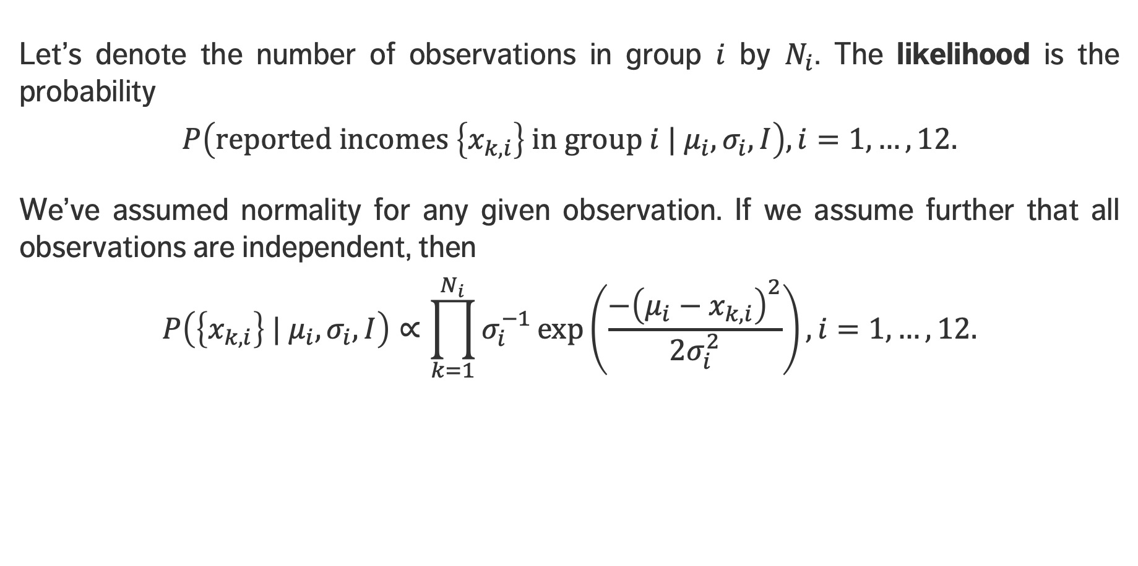
THE SALARY QUESTION – LIKELIHOOD
Let’s denote the number of observations in group $i$ by $N_{i}$. The likelihood is the probability
$$P\left(\text{reported} \text{incomes} \left\{x_{k,i}\right\} \text{in} \text{group} i | μ_{i},σ_{i},I\right), i=1,…,12.$$
We’ve assumed normality for any given observation. If we assume further that all observations are independent, then
$$P\left(\left\{x_{k,i}\right\} | μ_{i},σ_{i},I\right)∝\prod_{k=1}^{N_{i}}{σ_{i}^{−1}\exp\left(\frac{−{\left(μ_{i}−x_{k,i}\right)}^{2}}{2σ_{i}^{2}}\right)}, i=1,…,12.$$

Slide 61
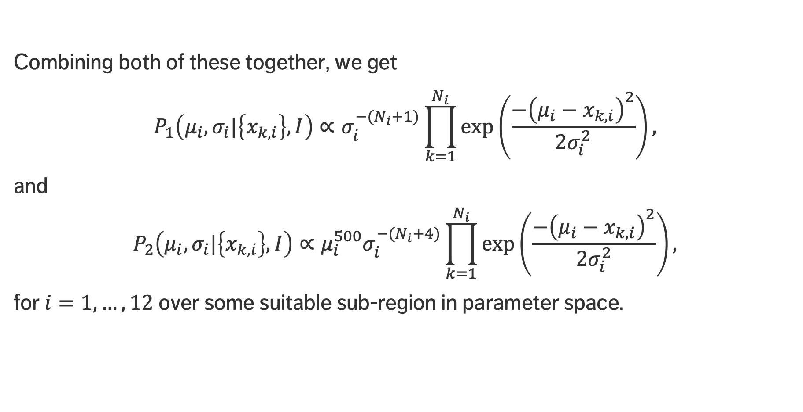
THE SALARY QUESTION – POSTERIOR(S)
Combining both of these together, we get
$$P_{1}\left(μ_{i},σ_{i}|\left\{x_{k,i}\right\},I\right)∝σ_{i}^{−{(N}_{i}+1)}\prod_{k=1}^{N_{i}}{\exp\left(\frac{−{\left(μ_{i}−x_{k,i}\right)}^{2}}{2σ_{i}^{2}}\right)},$$
and
$$P_{2}\left(μ_{i},σ_{i}|\left\{x_{k,i}\right\},I\right)∝μ_{i}^{500}σ_{i}^{−{(N}_{i}+4)}\prod_{k=1}^{N_{i}}{\exp\left(\frac{−{\left(μ_{i}−x_{k,i}\right)}^{2}}{2σ_{i}^{2}}\right),}$$
for $i=1,…,12$over some suitable sub-region in parameter space.

Slide 62
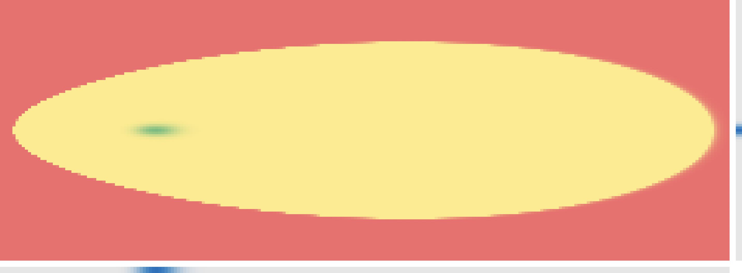
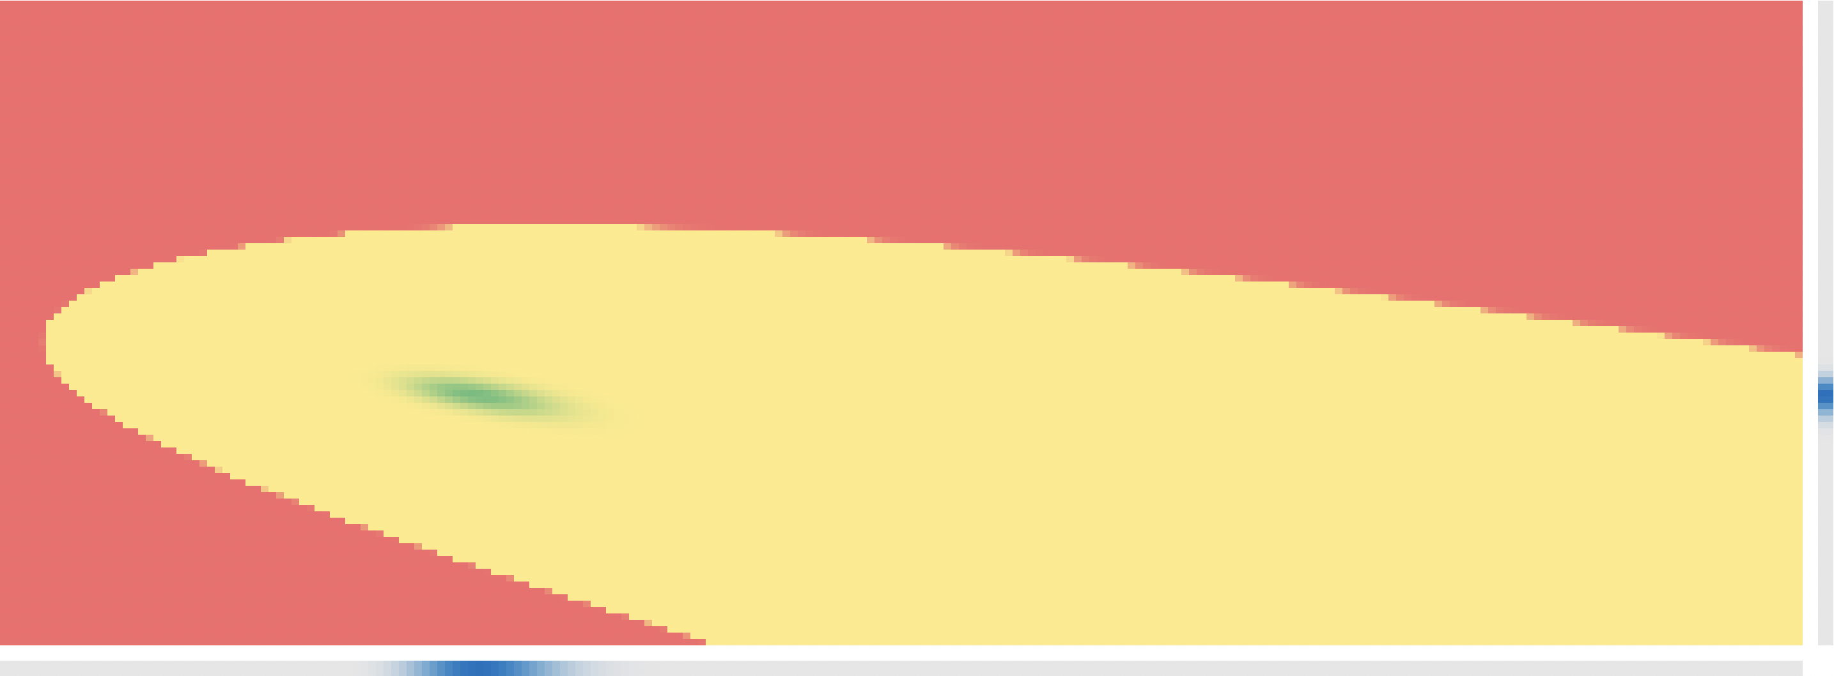






The SALARY QUESTION – POSTERIORS – GROUP 1
*green: high, red: low
$$P_{1}\left(μ_{1},σ_{1}|\left\{x_{k,1}\right\},I\right)$$
$$P_{2}\left(μ_{1},σ_{1}|\left\{x_{k,1}\right\},I\right)$$
$$μ_{1}$$
$$μ_{1}$$
$$σ_{1}$$
$$σ_{1}$$

Slide 63
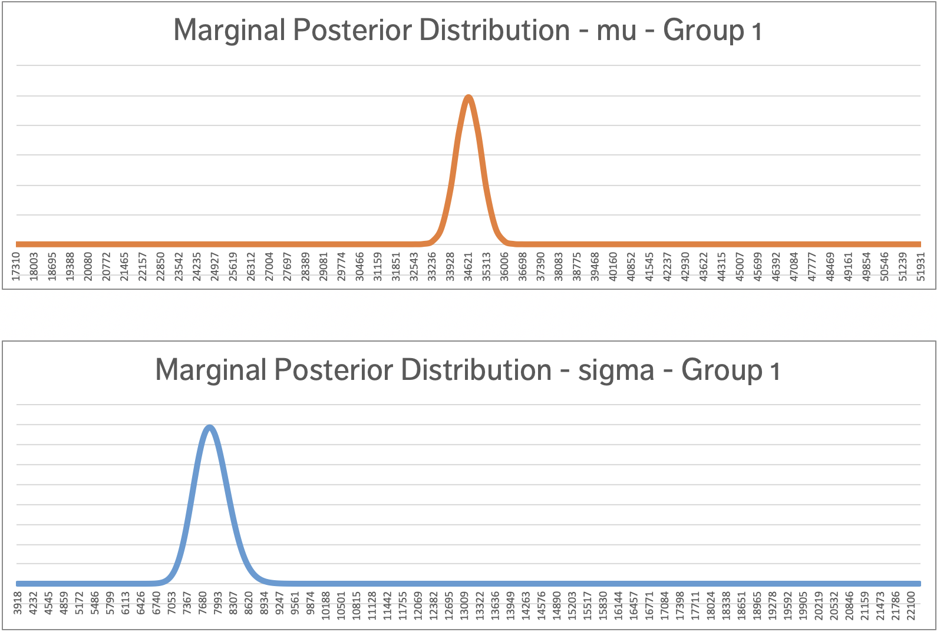
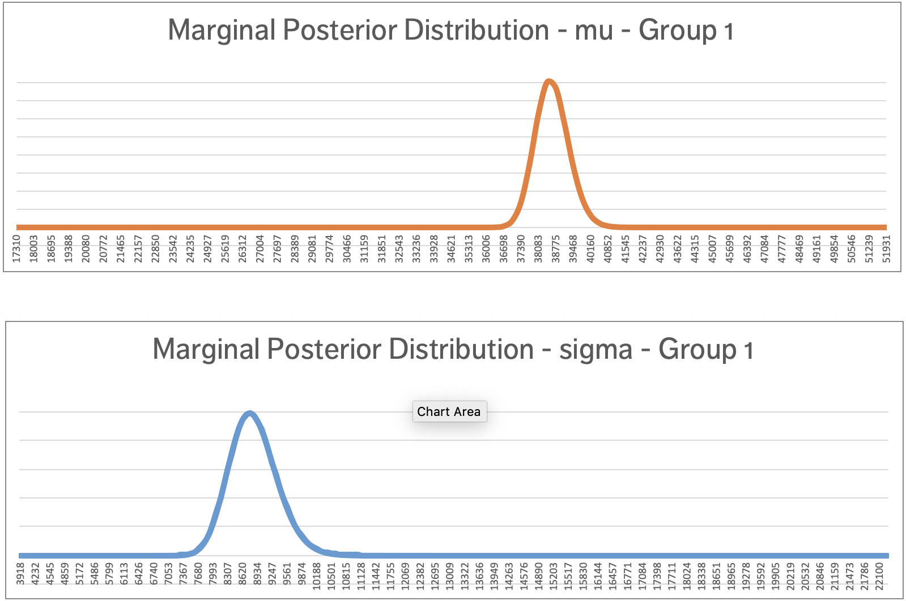







The SALARY QUESTION – POSTERIORS – GROUP 1
*green: high, red: low
$$P_{1}\left(μ_{1}|\left\{x_{k,1}\right\},I\right)$$
$$P_{2}\left(μ_{1}|\left\{x_{k,1}\right\},I\right)$$
$$μ_{1}$$
$$μ_{1}$$
$$P_{1}\left(σ_{1}|\left\{x_{k,1}\right\},I\right)$$
$$P_{2}\left(σ_{1}|\left\{x_{k,1}\right\},I\right)$$
$$σ_{1}$$
$$σ_{1}$$

Slide 64

The SALARY QUESTION – EXERCISE
*green: high, red: low
Using the Excel spreadsheet, estimate the parameters $\left(μ_{i},σ_{i}\right), i=1,…,12$.

Slide 65
EXAMPLE: MONEY ($ BILL Y’ALL)
A CURSORY GLANCE AT BAYESIAN DATA ANALYSIS

Slide 66
MONEY ($ BILL Y’ALL) – THE SET-UP
[based on Bååth, Introduction to Bayesian Data Analysis with R]
The question: how many 5$ dollar bills are there in circulation?
The problem: we cannot count them all.

Slide 67
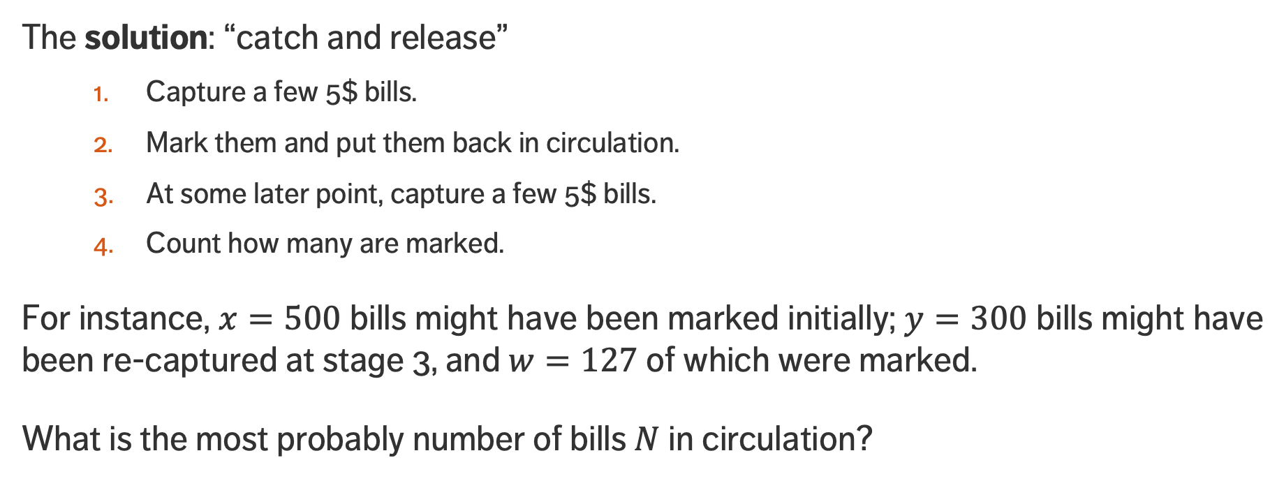
MONEY ($ BILL Y’ALL) – THE SET-UP
[based on Bååth, Introduction to Bayesian Data Analysis with R]
The solution: “catch and release”
  Capture a few 5$ bills.
  Mark them and put them back in circulation.
  At some later point, capture a few 5$ bills.
  Count how many are marked.
For instance, $x=500$ bills might have been marked initially; $y=300$ bills might have been re-captured at stage 3, and $w=127$ of which were marked.
What is the most probably number of bills $N$ in circulation?

Slide 68
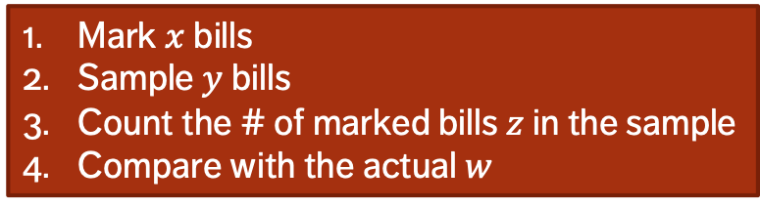



MONEY ($ BILL Y’ALL) – FITTING THE MODEL
[based on Bååth, Introduction to Bayesian Data Analysis with R]
Unlike in the previous examples when we were trying to estimate the parameters from the data using a generative model, in this example we are trying to estimate data from parameters.
Generate a # of bills $N$
through some distribution
$$𝔇\left(a,b, c,…\right)$$
Mark $x$ bills
Sample $y$ bills
Count the # of marked bills $z$ in the sample
Compare with the actual $w$
Repeat to get a distribution of $z$’s
$x, y, w$ are given; $z,N$ to be found

Slide 69

MONEY ($ BILL Y’ALL) – FITTING THE MODEL (SIMPLE)
[based on Bååth, Introduction to Bayesian Data Analysis with R]
Draw a large random sample of # of bills $N$ from an acceptable “prior” distribution on the parameters.
Using the $N$’s and the generative model (with $x$ and $y$ given), produce a (synthetic) # of marked bills $z$ in each sample.
Retain only those values of $N$ values for which $z=w$.

Slide 70







MONEY ($ BILL Y’ALL) – FITTING THE MODEL (SIMPLE)
Prior
Posterior
$$500$$
$$1500$$
$$500$$
$$1175$$
$$1500$$

Slide 71
MONEY ($ BILL Y’ALL) – FITTING THE MODEL (SIMPLE)
Prior
Posterior
$$500$$
$$1500$$
$$500$$
$$1175$$
$$1500$$
$$P\left(N=1000 | z=127,I\right)∝P\left(z=127 | N=1000,I\right)×P\left(N=1000 | I\right)$$

Slide 72




MONEY ($ BILL Y’ALL) – MARKED BILLS ARE BRITTLE (?)
[based on Bååth, Introduction to Bayesian Data Analysis with R]
It may be the case that the process of marking the bills might damage them somehow, so that they may be retired sooner than one would expect (with prob. $90\%$, say).
Mark $x$ bills
Sample $y$ bills, where there is a $u\%$ chance of sampling a marked bill compared to an unmarked bill
Count the # of marked bills $z$ in the sample
Compare with the actual # $w$
Generate a # of bills $N$
through some distribution
$$𝔇\left(a,b, c,…\right)$$
Repeat to get a distribution of $z$’s
$x, y, u,w$ are given; $z,N$ to be found

Slide 73

MONEY ($ BILL Y’ALL) – MARKED BILLS ARE BRITTLE (?)
[based on Bååth, Introduction to Bayesian Data Analysis with R]
Draw a large random sample of # of bills $N$ from an acceptable “prior” distribution on the parameters.
Using the $N$’s and the generative model (with $x,y$ and $u$ given), produce a (synthetic) # of marked bills $z$ in each sample.
Retain only those values of $N$ values for which $z=w$.

Slide 74



MONEY ($ BILL Y’ALL) – MARKED BILLS ARE BRITTLE (?)
Prior
Posterior
$$500$$
$$1500$$
$$500$$
$$1125$$
$$1500$$

Slide 75
MONEY ($ BILL Y’ALL) – MARKED BILLS ARE BRITTLE (?)
Prior
Posterior
$$500$$
$$1500$$
$$500$$
$$1125$$
$$1500$$
$$P\left(N=1000 | z=127,I\right)∝P\left(z=127 | N=1000,I\right)×P\left(N=1000 | I\right)$$

Slide 76

MONEY ($ BILL Y’ALL) – LISTEN TO THE BANKER
[based on Bååth, Introduction to Bayesian Data Analysis with R]
An old banker thinks that there should be about 1000 bills in circulation. How can we incorporate this piece of information?
Mark $x$ bills
Sample $y$ bills, where there is a $u\%$ chance of sampling a marked bill compared to an unmarked bill
Count the # of marked bills $z$ in the sample
Compare with the actual # $w$
Generate a # of bills $N$
through another distribution
$$𝔇\left(a,b, c,…\right)$$
Repeat to get a distribution of $z$’s
$x, y, u,w$ are given; $z,N$ to be found

Slide 77

MONEY ($ BILL Y’ALL) – LISTEN TO THE BANKER
[based on Bååth, Introduction to Bayesian Data Analysis with R]
Draw a large random sample of # of bills $N$ from a negative binomial distribution.
Using the $N$’s and the generative model (with $x,y$ and $u$ given), produce a (synthetic) # of marked bills $z$ in each sample.
Retain only those values of $N$ values for which $z=w$.

Slide 78



MONEY ($ BILL Y’ALL) – LISTEN TO THE BANKER
Prior
Posterior
$$500$$
$$1500$$
$$500$$
$$1075$$
$$1500$$

Slide 79
MONEY ($ BILL Y’ALL) – LISTEN TO THE BANKER
Prior
Posterior
$$500$$
$$1500$$
$$500$$
$$1075$$
$$1500$$
$$P\left(N=1000 | z=127,I\right)∝P\left(z=127 | N=1000,I\right)×P\left(N=1000 | I\right)$$

Slide 80
OUTLINE
Part 1
Part II
Plausible Reasoning
The Rules of Probability
Bayes’ Theorem
Example: the Fair (?) Coin
Example: the Salary Question
Example: Money ($ Bill Y’All)
Marginalization (coming soon)
Prior Distributions
Model Selection (coming soon)
Naïve Bayes (coming soon)
Bayesian Inference (coming soon)
MCMC and Numerical Methods

Slide 81
PRIOR DISTRIBUTIONS
A CURSORY GLANCE AT BAYESIAN ANALYSIS

Slide 82

PRIOR DISTRIBUTIONS
Specifying a model necessarily means providing a prior distribution for the unknown parameters.
Prior plays a crucial role in Bayesian inference through the updating statement
$$p(θ|D)∝p(θ)×p(D|θ)$$
Choice of prior is subjective (decision to use a prior is left entirely up to the analyst).

Slide 83
PRIOR DISTRIBUTIONS
But the choice of prior is no more subjective than the choice of likelihood, the selection of a sample, the estimation framework, or the statistic used for data reduction.
Choice of prior can affect posterior conclusions, in particular when the sample size is small.

Slide 84

CONJUGATE PRIORS
In general: posterior distribution for vector $θ$ has no simple analytical representation.
Posterior distributions must be estimated numerically (not exact).
Exceptions: conjugate priors
  joint property of a prior and a likelihood $⟹$ posterior has same form as prior (but with different parameters)

Slide 85


CONJUGATE PRIORS
Example:
  likelihood = Binomial $P\left(s,n | q\right)=\left(\begin{matrix}n \\ s\end{matrix}\right)q^{s}{(1−q)}^{n−s}$, prior = $\text{Beta}(α,β)$
  posterior = $\text{Beta}(α+s,β+n−s)$

Slide 86
CONJUGATE PRIORS
Conjugate priors are mathematically convenient, and they can be quite flexible, depending on the specific hyperparameters we use; but they reflect very specific prior knowledge and should be eschewed unless we truly possess that prior knowledge.
Alternatives:
  uninformative priors
  informative priors
  maximum entropy (MaxEnt) priors

Slide 87

UNINFORMATIVE PRIORS
Uninformative priors intentionally provide very little specific information about the unknown parameter(s).
Rationale: 'to let the data speak for itself,' so that inferences are unaffected by information external to the current data.
Classic Example: uniform prior
  for data following a Bernoulli($θ$) distribution, a uniform prior on $θ$is $P(θ) =1$on $0≤θ ≤1$.
  for data following a normal $N(μ,1)$distribution, the uniform prior on the support of $μ$is improper however, such a choice could still be acceptable as long as the resulting posterior is normalizable.

Slide 88
INFORMATIVE PRIORS
Informative priors are those that deliberately insert information that researchers have at hand into the analysis.
Reasonable since prior scientific knowledge should play a role in statistical inference.
2 important requirements:
  overt declaration of prior specification
  detailed sensitivity analysis to show the effect of these priors relative to uninformed types.
Transparency is required to avoid the common pitfall of data fishing; sensitivity analysis can provide a sense of exactly how informative the prior is.

Slide 89
INFORMATIVE PRIORS
Where do informative priors come from, in the first place?
  past studies, published work, researcher intuition
  interviewing domain experts
  convenience with conjugacy
  non-parametric and other data-derived sources.
Prior information from past studies need not be in agreement.
Useful strategy: construct prior specifications from competing school-of-thoughts to contrast resulting posteriors and produce informed statements about the relative strength of each of them.

Slide 90

INFORMATIVE PRIORS
Example: Bernouilli likelihoods and Beta priors form conjugate priors.
Start with a prior distribution that expresses some uncertainty that a coin is fair: $\text{Beta}(θ |4, 4)$ – a coin was recorded with 4H in 8 tosses, perhaps. Flip the coin once; assume that H is obtained. What is the posterior distribution of the uncertainty in the coin's fairness $θ$?
Solution: use post=BernBeta(c(4,4),c(1)) from Example 4.R

Slide 91


INFORMATIVE PRIORS
Use the posterior parameters from the previous flip as the prior for the next flip. Suppose we flip again and get a H. What is the new posterior on the uncertainty in the coin's fairness $θ$?
Solution: use post=BernBeta(post,c(1)) from Example 4.R

Slide 92


INFORMATIVE PRIORS
Using the most recent posterior as the prior for the next flip, flip a third time and obtain yet again a H. What is the new posterior?
Solution: in this case, we know that the posterior for the coin's fairness $θ$ follows a $\text{Beta}(θ |7, 4)$ distribution. Does 3H in a row give you pause? Is there enough evidence to suggest that the coin is not fair? What if you flipped 18 H in a row from this point on?

Slide 93

INFORMATIVE PRIORS
Suppose that a friend has a coin that we know comes from a magic store; as a result, we believe that the coin is strongly biased in either of the two directions (it could be a trick coin with both sides being H, for instance), but we don't know which one it favours. We will express the belief of this prior as a Beta distribution.
Let's say that our friend flips the coin five times; resulting in 4H and 1T. What is the posterior distribution of the coin's fairness $θ$?

Slide 94

MAXIMUM ENTROPY PRIORS
Whether the priors are uninformative or informative, we search for the distribution that best encodes the prior state of knowledge from a set of trial distributions.
Let $X$ be discrete, of cardinality $M$, with probability density $p(X)=(p_{1},…,p_{M})$. The entropy $H(p)$ of $p$ is
$$H\left(p\right)=−\sum_{i=1}^{M}{p_{i}\log{p_{i}},} \text{with} 0×\log{0=0}$$

Slide 95

MAXIMUM ENTROPY PRIORS
The maximum entropy principle (MaxEnt) states:
given a class of trial distributions with constraints, the optimal prior is the trial distribution with the largest entropy.
As an example, the most basic constraint is for $p$ to lie in the probability simplex, that is, $p_{1}+…+p_{M}=1$ and $p_{i}≥0$for all $i$.
With those basic constraints, the maximum entropy prior is the uniform distribution.

Slide 96
MCMC AND NUMERICAL METHODS
A CURSORY GLANCE AT BAYESIAN ANALYSIS

Slide 97

POSTERIOR DISTRIBUTIONS
Posteriors are used to estimate a variety of model parameters of interest:
  mean, median, mode, etc.
It is possible to construct credible intervals/regions directly from the posterior.
Because the posterior is a full distribution on the parameters, it is possible to make all sorts of probabilistic statements about their values, such as:
  “I am 95% sure that the true parameter value is bigger than 0.5”
  “There is a 50% chance that $θ_{1}$ is larger than $θ_{2}$”
  etc.

Slide 98

POSTERIOR DISTRIBUTIONS – HDI
The best approach is to build a $1−α$ credible interval of $θ$-values using the highest density interval (HDI):
  a region $C_{k}$ in the parameter space
  $C_{k}=\{θ:p(θ|D)≥k\}$
  $k$ is the largest number such that $\int_{C_{k}}{p(θ|D)}dθ=1−α$
The value $k$ is the height of a horizontal line (or hyperplane, in the case of multivariate posteriors) overlaid on the posterior and for which the area under the curve bounded by the intersections with the hyperplane is $1−α.$ In most cases, $k$ can be found numerically.

Slide 99

POSTERIOR DISTRIBUTIONS – HDI
Example: It is an election year and you are interested in knowing whether the general population prefers candidate $A$ or candidate $B$. A recently published poll states that of 400 randomly sampled people, 232 preferred candidate $A$, while the remainder preferred candidate $B$.
Suppose that before the poll was published, your prior belief was that the overall preference follows a uniform distribution. What is the 95% HDI on your belief after learning of the poll result?
(Hint: what parameters would you use in BernBeta()?)

Slide 100

POSTERIOR DISTRIBUTIONS – HDI
Based on the poll, is it credible to believe that the population is equally divided in its preferences among candidates?
Assume that a subsequent poll of 100 individuals is published. How many people would have to say that they prefer candidate $B$ for you to change the answer you gave in 2.?

Slide 101


POSTERIOR DISTRIBUTIONS – HDI

Slide 102
MCMC METHODS
When posteriors that cannot be manipulated analytically, it is usually possible to recreate a synthetic (or simulated) set of values that share the properties of the posterior (Monte Carlo simulations).
A Markov chain is an ordered, indexed set of random variables (a stochastic process) in which the values of the quantities at a given state depends probabilistically only on the values of the quantities at the preceding state.
Markov chain Monte Carlo (MCMC) methods are a class of algorithms for sampling from a probability distribution based on the construction of a Markov chain with the desired distribution as its equilibrium distribution.

Slide 103

MCMC METHODS
MCMC techniques are often applied to solve integration and optimization problems in large-dimensional spaces. For instance, given variables $θ ∈Θ$ and data $D$, the following (typically intractable) integration problems are central to Bayesian inference:
  normalisation: $p\left(θ | D\right)=\frac{p(θ)p(D|θ) }{\int{p(θ)p(D|θ)}dθ}$
  marginalisation: $p\left(θ | D\right)=\int{p\left(θ,x | D\right)dx}$
  expectation: $E\left[f\left(θ\right)\right]=\int_{Θ}{f\left(θ\right)p\left(θ | D\right)}dθ$ for functions of interest (i.e. $f\left(θ\right)=θ$ (mean), or $f\left(θ\right)= {\left(θ−E[θ]\right)}^{2}$ (variance)).

Slide 104

METROPOLIS-HASTINGS (MH) ALGORITHM
MH is a specific type of MCMC; it generates a random walk (a succession of posterior samples) so that each step in the walk is completely independent of the preceding steps; the decision to reject or accept the proposed step is also independent of the walk's history.
MH uses a candidate or proposal distribution for the posterior and constructs a Markov Chain by proposing values from this candidate distribution, and then either accepting or rejecting this value (with a certain probability).
The proposal distributions can be nearly anything, but in practice it is recommended that (really) simple ones be selected: a normal if the parameter of interest can be any real number (e.g. $μ$) or a log-normal if it has positive support (e.g., $σ^{2}$).

Slide 105

METROPOLIS-HASTINGS (MH) ALGORITHM

Slide 106
METROPOLIS-HASTINGS (MH) ALGORITHM
Example: go through Example 9, pp. 10-12 in A Soft Introduction to Bayesian Data Analysis (DRAFT). The R file is provided in Example 9.R

Slide 107
BAYESIAN A/B TESTING
Example: go through Example 12, pp. 14-15 in A Soft Introduction to Bayesian Data Analysis (DRAFT). The R file is provided in Example 12.R

Slide 108
REFERENCES
A CURSORY GLANCE AT BAYESIAN DATA ANALYSIS

Slide 109
References
Sivia, D.S., Skilling, J. [2006], Data Analysis: A Bayesian Tutorial (2nd ed.), Oxford Science.
Silver, N. [2012], The Signal and the Noise, Penguin.
Jaynes, E.T. [2003], Probability Theory: the Logic of Science, Cambridge Press.
Kruschke, J.K. [2011], Doing Bayesian Data Analysis: a Tutorial with R, JAGS, and Stan (2nd ed.), Academic Press
Barber, D. [2012], Bayesian Reasoning and Machine Learning, Cambridge Press.
Gelman, A., Carloin, J.B., Stern, H.S., Dunson, D.B., Vehtari, A., Rubin, D.B. [2013], Bayesian Data Analysis (3rd ed.), CRC Press.
Bååth, R. [2015], Introduction to Bayesian Data Analysis with R, UseR!
Oliphant, T.E. [2006], A Bayesian perspective on estimating mean variance, and standard-deviation from data, All Faculty Publications 278, BYU.

