Slide 1
Analytics for Decision-Making: Module 2 Supplemental Material
Instructor: Patrick Boily with Stephen Davies, Jen Schellinck, John Stroud
Slides: P. Boily (IACS, DAL, uOttawa), J. Schellinck (Sysabee, DAL, AI Guides), J. Stroud (AI Guides) S. Davies (DAVHILL, DAL), B. Conway-Smith (Sysabee), M. Kashef (datascience2go)

Slide 2
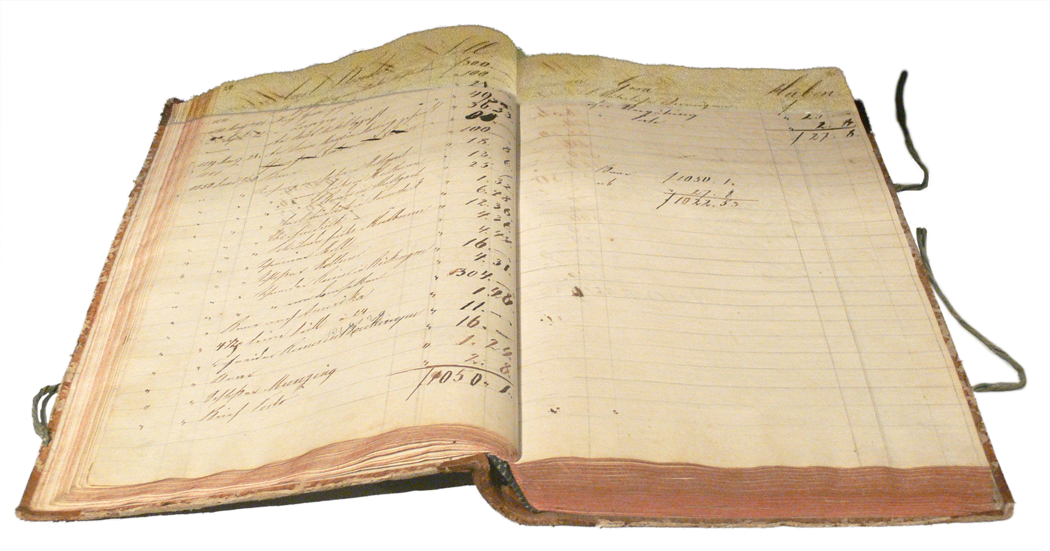
Accountability
Accountable - two meanings:
To be responsible
To be countable
Responsibility through counting?

Slide 3
Social-Historic Origins of Metrics
Record keeping more generally has been around as long as 'civilization' has been around (Against the Grain, James C. Scott)
1860’s - England – Finance - school performance metrics
1900s – Taylor – Engineering - Scientific Management
1950's -Robert McNamara the concept of the 'general manager’ - objective numbers could help with this!
1980's - the rise of IT, and with it an increasing ability to track and collect data to generate metrics

Slide 4
Metrics, KPIs, OKRs
Metric: In a business context, a metric is a value built up out of more basic measures (or variable values)
Key Performance Metrics (KPIs): A type of measure that “evaluate[s] the success of an organization or of a particular activity (such as projects, programs, products and other initiatives) in which it engages” (Wikipedia)
Objectives and Key Results (OKRs): “a goal-setting framework used by individuals, teams, and organizations to define measurable goals and track their outcomes” (Wikipedia)

Slide 5
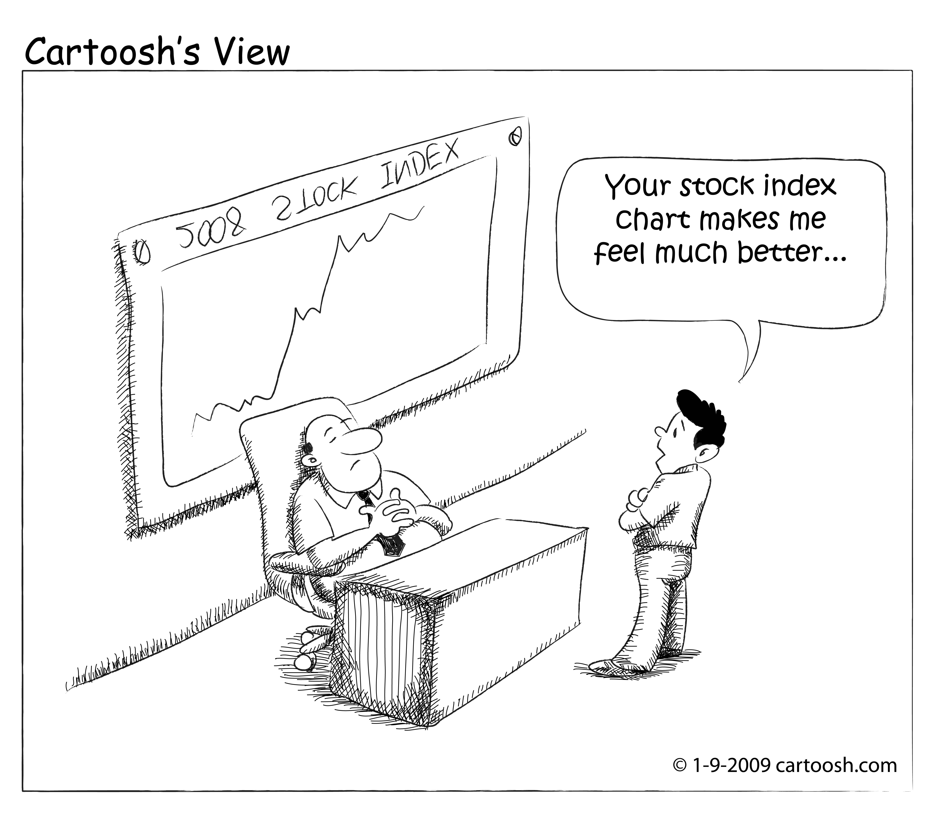
SOME MORE TERMINOLOGY
Indicator: An observed (measured) value relevant to a concept of interest. Compare proxy measure.
Index: An aggregation of multiple indicators. Compare metric.
Example: Human Development Index.
(https://commons.wikimedia.org/wiki/File:20090109_stock_index-01.jpg)

Slide 6
Building Metrics from Measures
Measures:
Concrete properties
come from taking measurements
Metrics:
Built up out of measures
Quantifies a more abstract concept
+
/
=

Slide 7

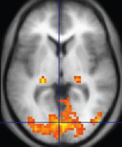
An Example Metric
How do you measure happiness?
Proxy measures
Operationalization
Happiness Metric: a combination of these types of measures

Slide 8
Conceptual Building Blocks
Metrics are conceptually useful - they seemingly provide a useful high level summary of some element of an otherwise complex system.
It can be an interesting intellectual challenge to take a collection of of raw measures and combine them to better understand something more conceptually abstract.
In this respect, we can almost view a metric as a higher level concept that we are building out of more fundamental concepts.

Slide 9
Repurposing Science (AGAIN)
In a sense, we are trying to move scientific behaviors - in this case measurement - out into the non-scientific realm - "Scientific Management” - there can be many pitfalls!
Example- the issue of edge cases - our metric or proxy measure might work very well for the 'middle' cases, but very poorly for the edge cases.
We want everything to be 'data-driven’ - this presupposes that we can get data or evidence on everything.

Slide 10
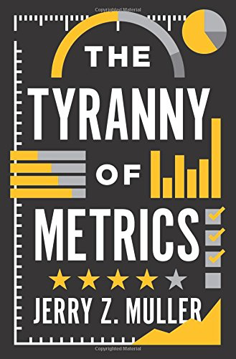
The Tyranny of Metrics
The Tyranny of Metrics by Jerry Z. Muller discusses:
Recurring flaws seen in metrics construction
Origin of "Metric Fixation'
Case Studies
Issues with and strategies for avoiding ‘Metric Fixation'

Slide 11
Are Metrics redeemable?
"The problem is not measurement, but excessive measurement and inappropriate measurement... while they are a potentially valuable tool, the virtues of accountability metrics have been oversold and their costs are often under appreciated."
"...[T]here are many situations where decision making based on standardized measurement is superior to judgment based upon personal experience and expertise... Used judiciously, then, measurements of the previously unmeasurable can provide real benefits.”
So when are metrics good and when are they problematic? Muller spends the rest of his book spelling this out.

Slide 12
Goodhart’s + CampBell’s Law
"When a measure becomes a target, it ceases to be a good measure.”
(Goodhart’s Law)
"The more any quantitative social indicator is used for social decision-making, the more subject it will be to corruption pressures and the more apt it will be to distort and corrupt the social processes it is intended to monitor.”
(Campbell’s Law)

Slide 13
Metric Fixation
‘Metric Fixation’ is a term coined by Muller to describe:
The belief that it is possible and desirable to replace judgment, acquired by personal experience and talent, with numerical indicators of comparative performance based upon standardized data (metrics);
The belief that making such metrics public (transparent) assures that institutions are actually carrying out their purposes (accountability)
The belief that the best way to motivate people within these organizations is by attaching rewards and penalties to their measured performance, rewards that are either monetary (pay-for-performance) or reputational (rankings).

Slide 14
Functional Issues with Metrics (I)
Distortion of information:
Measuring the most easily measurable
Measuring the simple when the desired outcome is complex
Measuring inputs rather than outcomes (e.g. measuring resources provided to a project rather than the outcome of the project)
Degrading information quality through standardization

Slide 15
Functional Issues with Metrics (II)
Gaming the metrics:
Gaming through creaming
Improving numbers by lowering standards
Improving numbers through omission or distortion of data
Cheating

Slide 16
Out With All Metrics?
Muller's main point: Don't use metrics for reward or punishment.
He sites a number of examples (e.g. in education, medicine, policing) where metrics were indeed effective in improving a situation that needed improving.

Slide 17
Considerations when Designing Metrics (I)
Mueller's checklist of questions and points to consider:
What kind of information are you thinking of measuring?
How useful is the information?
How useful are more measurements?
What are the costs of not relying on standardized measurements?
To what purpose will the measurement be put/to whom will information be made transparent?

Slide 18
Considerations when Designing Metrics (II)
Mueller's checklist of questions and points to consider (cont.):
What are the costs of acquiring the metric?
Why are people demanding this metric?
How and by whom are the measures of performance being developed?
Remember that even the best measures are subject to corruption and goal diversion.
Recognizing the limits of the possible is the beginning of wisdom.

