Slide 1
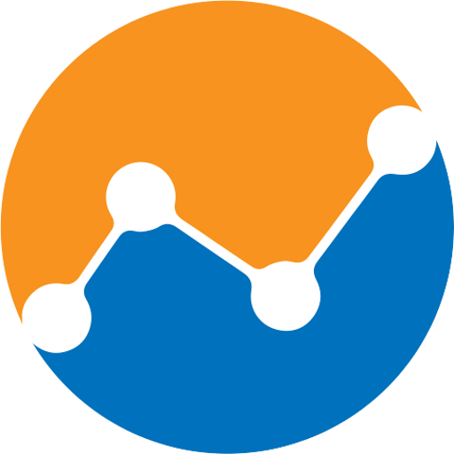
Orientation and Introduction
CT ACADEMY | DATA ACTION LAB
data-action-lab.com

Slide 2
Hello!
Welcome to the CT Academy – Data Track!
The CT Academy model is a multi-step, multi-modal, cohort-based approach to learning that puts cohorts of 10-16 people through 40 hours of training across an 8-10 week timeline.
In the data track, we will work with financial analysts and auditors seeking to improve their skills in:
data foundations
data analysis and data science
business intelligence
visual storytelling
decision-making and evaluation

Slide 3
FIRST THINGS FIRST
The training material is available at: https://data-action-lab.com/ct-academy
Supplementary data training course notes: https://idlewyldanalytics.com/dudads

Slide 4
Learning Outcomes
This training course is addressed to members of the CT Community and aims to introduce them to the fundamentals of data literacy, to empower them to become effective data stewards, and to present them with a path towards insightful data analysis.
Participants are expected to have some Power BI proficiency (other analytical tools are also acceptable) prior to the start of the training.

Slide 5
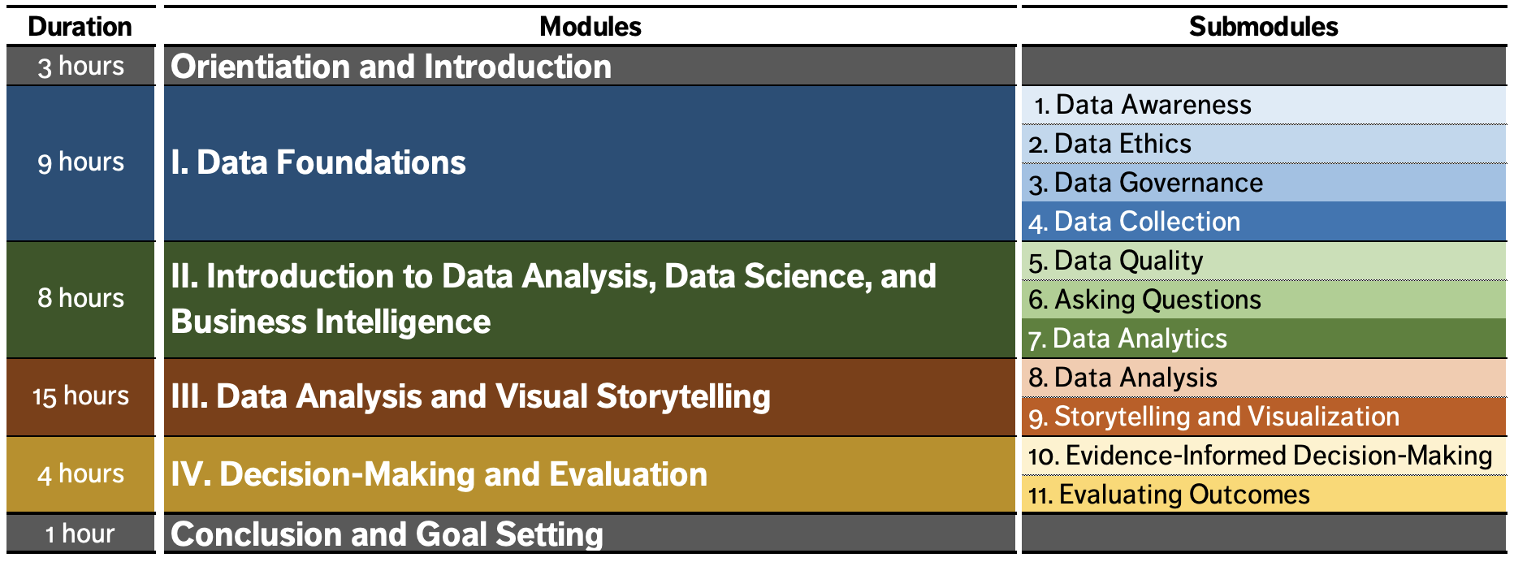
OUTLINE

Slide 6
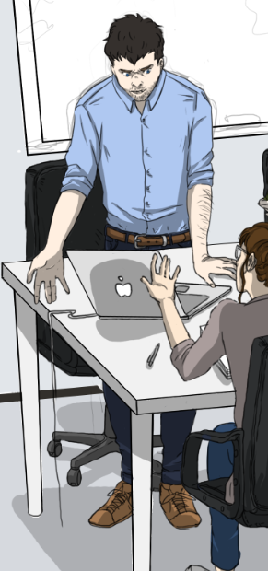
Instructor – Patrick Boily
Employment
Professor Math/Stat [‘19 – now, uOttawa]
President [‘16 – now, Idlewyld Analytics]
Manager and Senior Consultant [’12 – ‘19, CQADS, Carleton]
Public Service [’08 – ’12, ASFC | StatCan | TC | TPSGC]
60+ uni course; 250+ workshop days
Projects
GAC; NWMO; CATSA; etc.
40+ projects
Specialization
Data visualization; data cleaning (… unfortunately)
Application of wide breadth of techniques to all kinds of data
Mathematical/statistical modeling

Slide 7
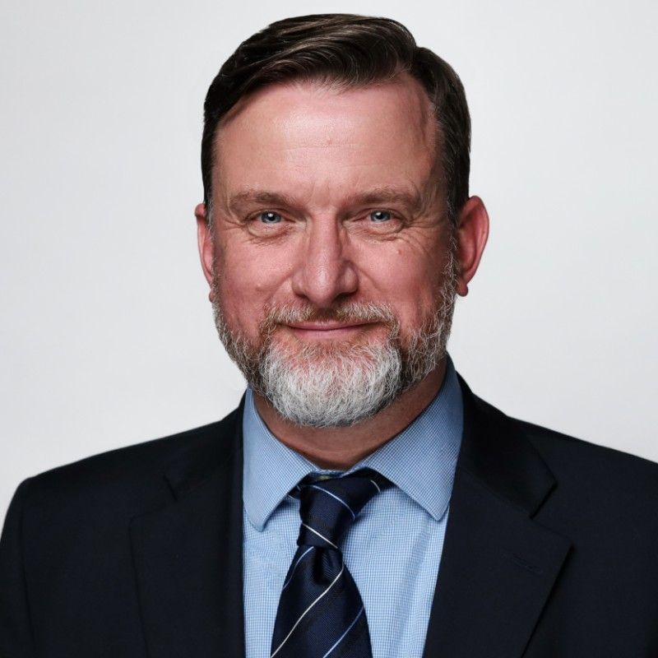
Instructor – STEPHEN DAVIES
Employment
CEO [DAVHILL Group | GoC & Aviation]
M. Sc. [Systems Engineering]
Lecturer [Sprott School of Business, Carleton]
Former executive in High Tech & Manufacturing
20+ years consulting and training
Projects
All major GoC departments
Pearson Airport, Porter, Sunwing, Flightstar, First Air, ICAO
Specialization
Data visualization, business intelligence, data engineering
Process transformation, risk management

Slide 8
Course Components
Live Training: follow along with the instructors
Asynchronous Training: viewing/reading list
In-Class Exercises: a selection of exercises to reinforce the concepts discussed
Asynchronous Exercises: more (optional) exercises
Data Labs: the main event!

Slide 9
Let’s HEAR ABOUT YOU
We will be working in teams throughout the training – what are your data interests and skill sets? Your data needs at work/for your career?
Are there things you want to focus on, specifically?

Slide 10
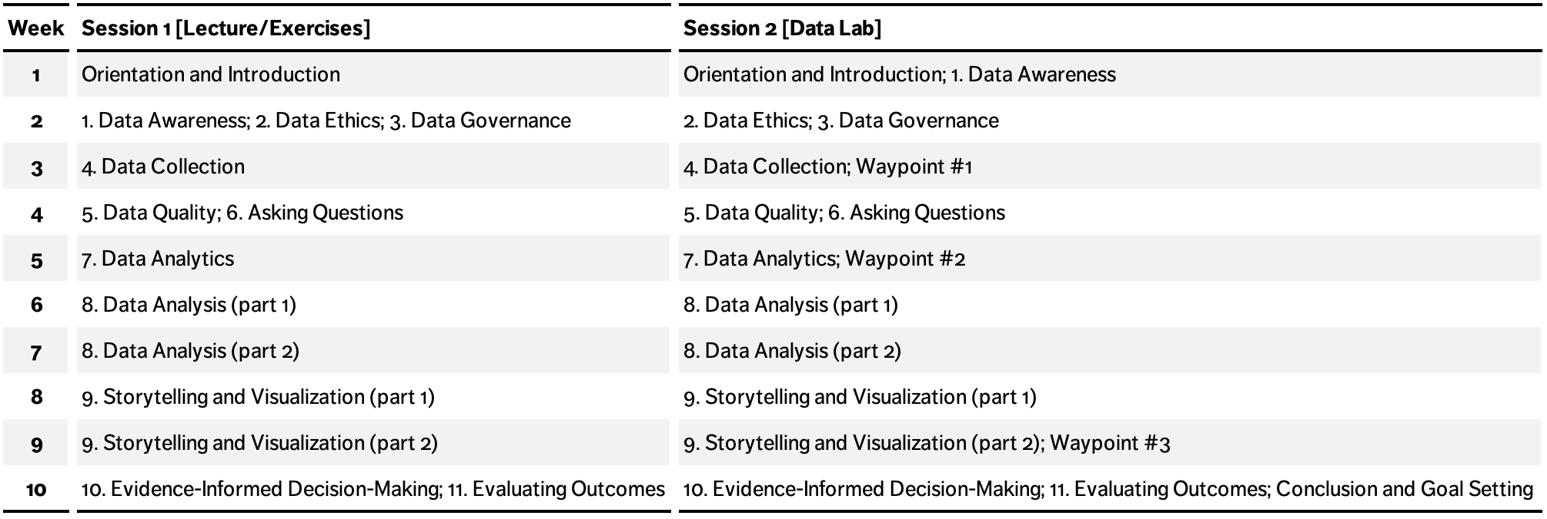
SCHEDULE

Slide 11
DATA LABS: Borealis Terraformers
Borealis Terraformers LLC is a terraforming company.
It does business, it transacts with consultants, it has employees, it pays them, it delivers products, it records its transactions.
It also has projects (Major Capital MC, Minor Capital MIC, Operations and Management O&M, and Salary SA), and departments.

Slide 12
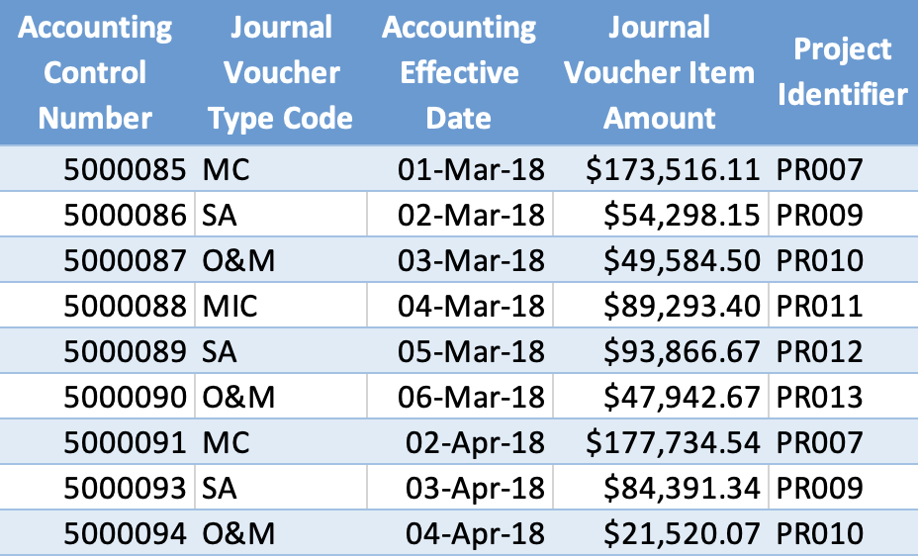
DATA LABS: Borealis Terraformers
Let’s take a look at one dataset that we are going to use:
Data Set - Accounting.xlsx
Download it to your hard drive (you may need to rename the file).
Tab – Journal Voucher Type Code
Tab – Accounting Transactions

Slide 13
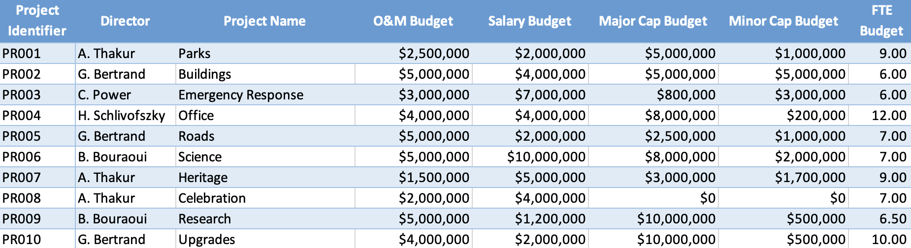
DATA LABS: Borealis Terraformers
Let’s take a look at the other dataset that we are going to use:
Data Set - Projects.xlsx
Download this one to your hard drive too, in the same location (you may also need to rename the file).
Tab – Project Tombstone
Tab – Project FTE Count

Slide 14
