Slide 1
Module 1: DATA FOUNDATIONS
CT ACADEMY | DATA ACTION LAB

Slide 2

1. Data awareness
Data Foundations
data-action-lab.com

Slide 3
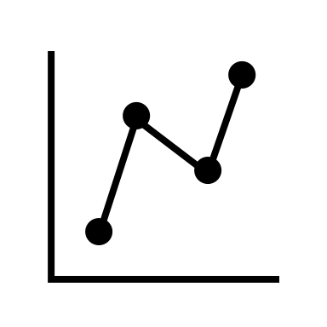
What is (are) data?
Should we say, “is data” vs “are data”?
The word data is technically a plural, so “are” is appropriate; the singular is the word datum (for a “data point”).
In common usage the word data is used interchangeably (datum has become passé): “are” is technically correct but “is” is used all the time!
Being pedantic, if “data” is used as a mass noun, then “is” IS appropriate!

Slide 4
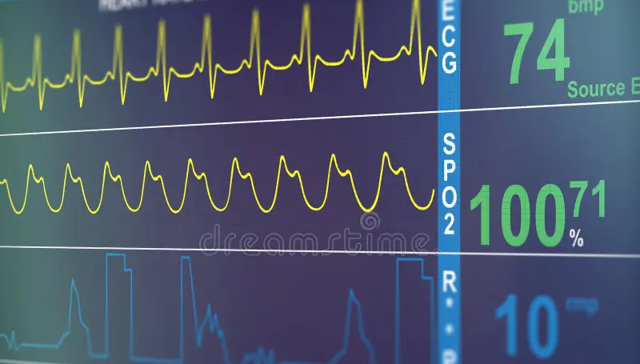
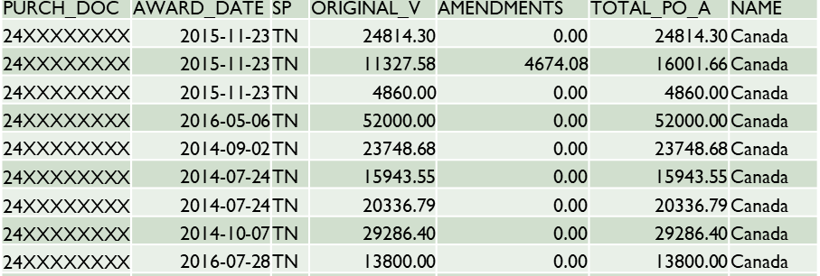

What is (are) data?
Data can be thought of as raw “numbers”.
It is often defined as “a collection of facts from which conclusions may be drawn”.
Data comes in many different forms and underpins all analyses.
(We will revisit these notions)

Slide 5
Data is a foundation
Wisdom
Knowledge
Information
Data
DIKW Pyramid
represents structure or functional relationship between elements
we acquire data
organizing data gives us information
using information in context yields knowledge
the correct (and/or incorrect) application of information over time makes us wise!

Slide 6
Data is a foundation
Wisdom
Knowledge
Information
Data
DIKW Pyramid Example
Data – individual bank transactions
Information – organizing the transactions into monthly groups (what are my monthly spendings?)
Knowledge – comparing the “spend per month” to a budget
Wisdom – understanding that if I am under budget (over time) I can save up for a vacation!

Slide 7
How We use data
We analyse data to tell stories that help us make decisions.
This requires data integrity.
Most departments have data stewards who manage the data lifecycle (how to acquire, manage, and use data).
Data stewards keep the data in data assets and make them available for people to use as they require.
Analysts must contextualize the data to help them make effective decisions.
Let’s get some data
We need to clean the data
Let’s store it somewhere
Make it private and safe
Tell people how to use it

Slide 8

How We use data
What do you do once you have data?
identify what decisions you, or your team (or your boss) needs to make
identify the data that you need to make that decision
get the data, check it to make sure it’s ok
you can then do one of more of the following: analyze the data, visualize the data, summarize the data
turn the data into information and knowledge
make your decisions or provide your outputs to the stakeholders who need them

Slide 9
Data related Terminology
Here are a few common data buzzwords:
Term | Description | Example(s)
metadata | data about data | a document that describes what column titles mean in a spreadsheet
data asset | a system or program that stores data | Excel spreadsheets, SAP, PeopleSoft, Access Databases, Web Tables
reference data | data that is common across data assets | list of Provinces, list of countries, list of branches in a department
master data | data that we use to run our business | employee names, transaction amounts
data inventory | a list of data assets | tools like Microsoft Purview maintain lists of data assets
data catalog | descriptions of data | precisely defines words the business uses, e.g., “FTE”, “Headcount”
data model | how data interrelates | “linking” together financial and HR data through a PRI

Slide 10
INTRODUCING Roles & Responsibilities
Who uses data?
if you are using data, you are a data consumer
if you a responsible for the integrity of the data you are a data steward
data trustees are accountable for the data
If you input data into a system, or acquire it from somewhere and add it to a data asset you are known as a data contributor
if you help to manage the systems in which the data resides, you are a data custodian

Slide 11
Example : Use of data – how much money do we have?
We need to see how much money is available in the department (“free balance”). We run a report from the relevant data asset, getting the data on what we:
have spent up to this time (the “actuals”);
have committed to spend (the “commitments”), and
think we should have spent (the “budget”).
Data stewards check if there are any problems with the data and fix them any such problems.
Finance asks business to validate the amounts to see if they are accurate and that nothing is missing.
Finance then applies the following formula and stores the result for its financial reporting obligations:
Free Balance = Budget – (Actuals + Commitments)

Slide 12
Example: Use of data – making Departments safer
The occupational health and safety group at a department wants to make our environment safer.
Every time a health and safety incident occurs, the details are recorded (type of incident, when/ where/how it happened, etc.).
This data is tracked and analyzed.
If trends are seen in the data (for example a lot of slips and trips happen at a particular location) then the team decides to intervene, and steps are taken to mitigate the issue (e.g., coating the floor with a non-slip surface, etc.).
More data is collected after mitigation so that the group can measure “improvements”.

Slide 13
Data and Information Life Cycles
Data and information “life cycles” describe all the steps that happen between data collection and data not being needed anymore.
As data gets turned into information, we need to really understand both of these life cycles (they are different).

Slide 14
Data and Information Life Cycles
Data
Acquisition
Storage
Preparation
Staging
Presentation
Data is consumed in order to produce information
Information
Authoring
Storage
Retrieval
Usage
Retirement

Slide 15
Data as a Strategic Asset
In a previous version of the Privy Council Data Strategy, “data as an asset” was a foundational pillar, defined as:
“The government has the data it needs, which are fit for use, discoverable, and available. Includes, for example:
planning and stewardship;
use;
quality;
storage, and
sharing and access.”

Slide 16
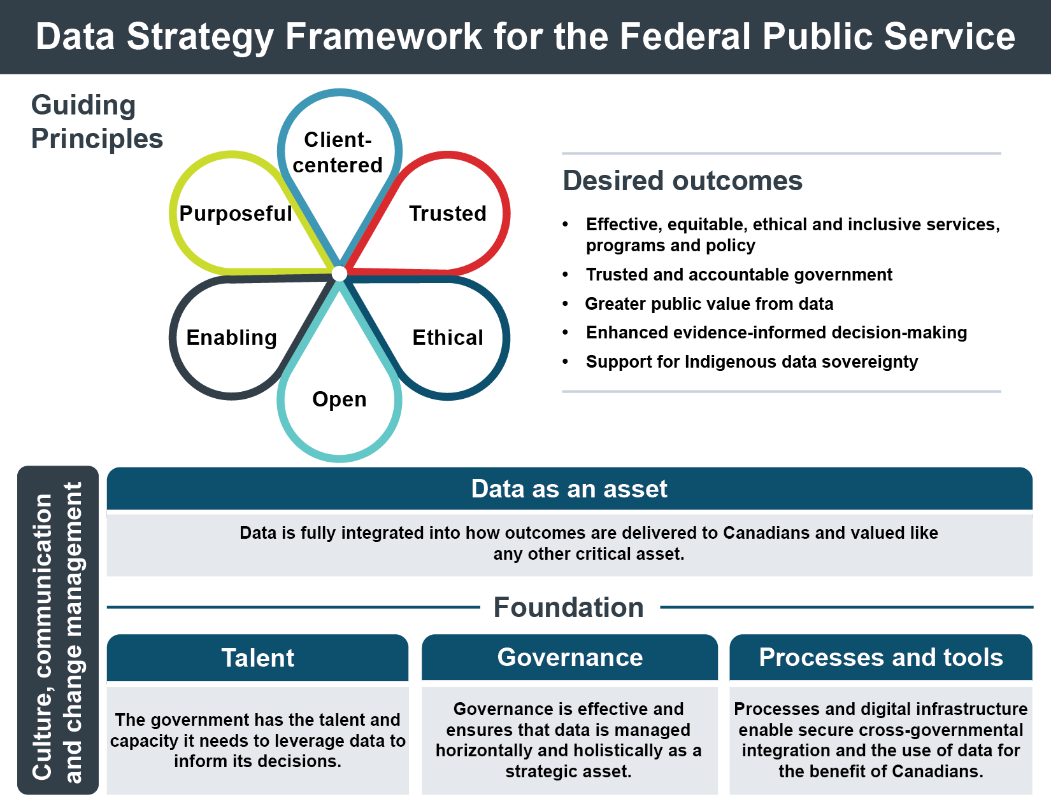
Government of Canada data Picture
The GoC has released a refresh on their original 2018 data strategy.
All departments are required to implement its policies, directives, and procedures.
This is typically the responsibility of a “Chief Data Steward”.
In this new model “Data as a Strategic Asset” is now an output of the implementation of the guiding principles.

Slide 17
Data Literacy
To support the data strategy, the GoC requires that GoC employees be data literate. Supporting data literacy is the GoC Data Competency Framework that this set of courses is built around.
“Having a data literate workforce is at the core of modernization efforts. This Data Competency Framework is meant to support conversations and aims to advance data literacy by creating a shared understanding and language about data competencies for all federal public servants.”
A department’s level of data literacy is usually identified through surveys; gaps are addressed through training, education, mentorship, and other learning methods.

Slide 18
Data Literacy
The Data Competency Framework consists of four sections that are divided into three proficiency levels:
Sections:
Data Concepts and Culture
Data Governance, Collection, and Stewardship
Analytics and Evaluation
Data Systems and Architecture
Proficiency Levels:
Foundational: defining the core level of understanding and awareness
Intermediate: putting theory into practice
Advanced: applications and enabling others

Slide 19
Data Roles & Responsibilities
Data roles and responsibilities are “required” by TBS as part of GoC Data Strategy.
They align business operations with data governance activities, helping managers and supervisors to define and assign accountability & responsibility to employees.
Explicit R&R help GoC employees understand how they fit in with their department’s data activities.
Note that one person can be assigned multiple R&R at the same time (it is possible to be both a data contributor and a data consumer simultaneously!)

Slide 20


High level review of different R&R
Data Trustees
ensure strategic management of assigned data assets as well as compliance with departmental and enterprise data (related strategies, regulations, policies, directives, and standards)
executives with business accountability and intermediate level of technical knowledge (typically at director level)
Data Stewards
advise on, enact, and help enforce data policies and standards
operations-focused
they have a mix of business and technical background (branch representatives)

Slide 21


High level review of different R&R
Data Custodians
ensure the safe custody and integrity of hosted data, and safeguard the enterprise data repository
normally operations-focused, with a technical background (IT-focused)
Data Contributors
ensure that the data they provide to the Department (including third-party data) aligns with all technical and business policies, procedures, and standards
operations-focused, with a “business” background and some technical expertise for the systems they typically use

Slide 22

High level review of different R&R
Data Consumers
ensure that usage of data supports departmental and government objectives and mandates
anyone within the organization can play that role, typically with a “business” background

Slide 23
WHERE DO YOU FALL?
Where do you fit? You may have been assigned a specific role (e.g., data steward), but regardless of role assignment it is highly probable that you are a data consumer. If you do any of the following you can count yourself as part of that role:
exporting data from any system;
create a spreadsheet that people use to make decisions;
get data from outside of the department and use it in internal or external reports, etc.
You may also be a data contributor if you do things like:
do research and gather data that adds to corporate knowledge;
enter data into a system (e.g., call center employee entering case data);
entering overtime into a salary system, etc.
Some roles are assigned, some are inherited (based on what you do).

Slide 24

EXAMPLES: R&R
Example: Call Center Agent
You take your first call of the day, the information from the call is entered in the call center system (data contributor).
A list of calls appears on your screen. You prioritize the callers on the list and select your next call (data consumer).
You realized that you entered a wrong piece of data that you can’t overwrite, you call your data steward for them to fix it (data consumer).
You have a responsibility to review your team call performance for the day and provide feedback to your supervisor. You download a system extract and do the calculations in Excel before forwarding the results (data contributor).

Slide 25

EXAMPLES: R&R
Example: Program Director
You are providing a new service as part of the program you run. You review and approve a new database to track the program data (data trustee).
Once the database is up and running, you start to review and make decisions on the reports obtained from it (data consumer).
Your data steward identifies a major issue that is escalated to you for approval (data trustee).
You request that the system be integrated into an existing system (data trustee).
You use the reports from the new integrated system to help you administer your program (data consumer).

Slide 26

EXAMPLES: R&R
Example: IT Support Technician
You get a call from a data steward wanting you to update a business rule in a database (data custodian).
You get the information you need and apply the rule (data custodian).
You then export data from the database into a report so you can check that the change was correctly implemented (data consumer, data steward).
You then update the system with the information and close the ticket (data contributor).

Slide 27
2. Data Ethics
Data Foundations
data-action-lab.com

Slide 28
Motivation and Policy Drivers
Unethical and irresponsible handling of data assets and A.I. can have a broad range of consequences:
Decision-making and policies resulting in harms (e.g., stigma, financial loss, etc.) to individuals and communities
Violations of personal privacy
A.I. models that are difficult to understand and can behave in unintended manners
Loss of public trust, hindering the ability to meaningfully engage with Canadians
Policy drivers for ethical handling of data:
Federal Data Strategy Roadmap / 2023–2026 Data Strategy for the Federal Public Service
Departmental Data Strategy – Ethical use of data as an asset
Canada’s Digital Ambition 2022
Policy drivers for ethical handling of Indigenous data:
UNDRIP / UNDA / UNDA Action Plan
Departmental Reconciliation Strategy
2023–2026 Data Strategy for the Federal Public Service
Policy drivers for responsible use of A.I.:
Federal Responsible A.I. Guiding Principles
TBS Directive on Automated Decision-Making
Government of Canada Digital Standards: Playbook
28

Slide 29
Principles and Standards
Privacy Act
Statistics Act
Policy on Government Security
Policy on Privacy Protection
Privacy Impact Assessments
Levels of Security
Gender-Based Analysis+
Tri-Council Policy Statement: Ethical Conduct for Research Involving Humans
Model Policy on Scientific Integrity
Directive on Automated Decision-Making
Disaggregated Data

Slide 30
Commonly used terms
Data ethics
Governance
Consent
Bias and discrimination
Inclusiveness
Fairness
Accountability

Slide 31

What are Ethics?
Broadly speaking, ethics refers to the study and definition of right and wrong conducts.
We all have a personal ethical system, don’t we?
be honest
be fair
be objective
be responsible
be compassionate
etc.
data-action-lab.com

Slide 32
What Are Ethics?
Influential Western ethical theories:
Kant's golden rule (do unto others as you would have them do unto you),
consequentialism (the ends justify the means)
utilitarianism (act in order to maximize positive effect)
Influential Eastern ethical theories:
Confucianism (virtue from people and motives, not from outcomes)
Taoism (case-by-case appropriateness of action determines morality)
Buddhism (harmony and self-restraint to avoid causing harm)

Slide 33
What Are Ethics?
Ubuntu ethical tradition:
tension between individual and universal rights
global context of life
solidarity
Maori tikanga:
connection with spiritual realm
respect for all things
self-determination and reciprocity

Slide 34
What Are Data Ethics?
Data ethics is a branch of ethics that evaluates data practices, including the collection, generation, analysis, and dissemination of data, that have the potential to adversely impact people and society.
Mission 3 (Enabling Data-Driven Services) of the 2023-26 data strategy refresh from TBS, states that GoC entities will ensure…
”… the responsible, ethical and transparent sharing and use of data are key to enabling the delivery of better services to people in Canada.”

Slide 35
The Need for Ethics
When large scale data collection first became possible, there was to some extent a “Wild West” mentality to data collection and use. Whatever wasn’t proscribed from a technological perspective was allowed (if not mandatory).
Now, however, professional codes of conduct are being devised, for example, for data scientists, which outline responsible ways to practice data science – i.e., ways that are legitimate rather than fraudulent, as well as ethical, rather than unethical.

Slide 36
The Need for Ethics
Although this puts some extra responsibility onto data scientists, it also provides them with protection from people who hire them to carry out data science in questionable ways – they can refuse on the grounds that it is against their professional code of conduct.
Does your organization have a code of ethics for its data scientists or other data professionals? For its employees?

Slide 37

Guiding Principles
The Cambridge Dictionary defines a “Guiding Principle” as:
“an idea that influences you very much when making a decision or considering a matter.”
For example:
“Equality of opportunity has been the government's guiding principle in its hiring policies.”

Slide 38
Example of Guiding Principles
A robot may not injure a human being or, through inaction, allow a human being to come to harm.
A robot must obey the orders given to it by human beings, except where such orders would conflict with the First Law.
A robot must protect its own existence as long as such protection does not conflict with the First or Second Law.
Isaac Asimov’s 3 Laws of Robotics

Slide 39
Best Practices
“Do No Harm”: data collected from an individual should not be used to harm the individual. This may be difficult to apply in practice.
Informed Consent: covers a wide variety of ethical questions, but mainly:
individuals must agree to the collection and use of their data
individuals must have a real understanding of what they are consenting to, and of possible consequences for them and others.

Slide 40
Best Practices
Respect “Privacy”: dearly-held principle. Excessively hard to maintain in the age of constant trawling of the Internet for personal data.
Keep Data Public: another aspect of data privacy – some (all? most? any?) data should be kept public.
Opt-In/Opt-Out: informed consent requires the ability to not consent (to opt out).
tacit vs. stated consent

Slide 41
Best Practices
Anonymize Data: removal of identifying fields from the dataset prior to analysis.
“Let the Data Speak”:
no cherry picking
importance of validation
correlation and causation
repeatability

Slide 42
“And yes, transparency is also the trick to protecting privacy, if we empower citizens to notice when neighbors infringe upon it. Isn’t that how you enforce your own privacy in restaurants, where people leave each other alone, because those who stare or listen risk getting caught?”
David Brin, The Transparent Society

Slide 43
Bias
A cognitive bias is a systematic error in thinking that occurs when people get information in the world around them, and their processing and interpreting of this information affects the decisions and judgments that they make.
The human brain is powerful but subject to imperfections. Cognitive biases are often a result of the brain's attempt to simplify information processing. They often work as rules of thumb that help us make sense of the world and reach decisions with relative speed.

Slide 44

During WWII, mathematician A. Wald undertook a study to help protect Allied bombers flying over enemy territory.
Data included: the number and location of bullet holes on returning aircraft, and the goal was to use this information to determine where to add armor to best protect the plane’s structure.
A chart was created to show where the maximum number of bullet holes were located on returning aircraft. This chart showed greatest damage on the aircraft extremities, not on the main wing and tail spars, engines, and core fuselage areas.
data-action-lab.com

Slide 45
Bias
As such, the Air Ministry wanted to add armor to the extremities. Wald suggested they were dead wrong.
To avoid “survivorship bias”, armor should be added to the areas with the fewest holes: if no returning planes had holes in their wing spars and engines, then even a few holes in those locations were deadly.
Take-Away: the data that is missing may be as important to story than the data that is there. Storytelling is not always an obvious endeavour.

Slide 46
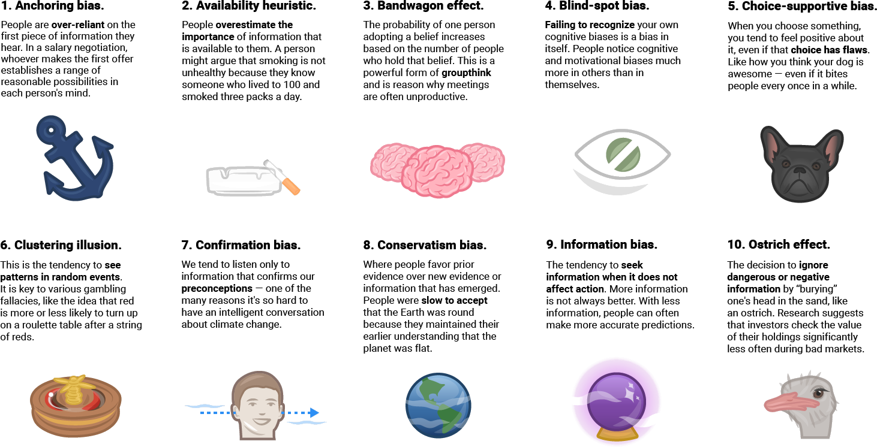
Cognitive Biases
[20 Cognitive Biases That Screw Up Your Decisions, Business Insider]

Slide 47
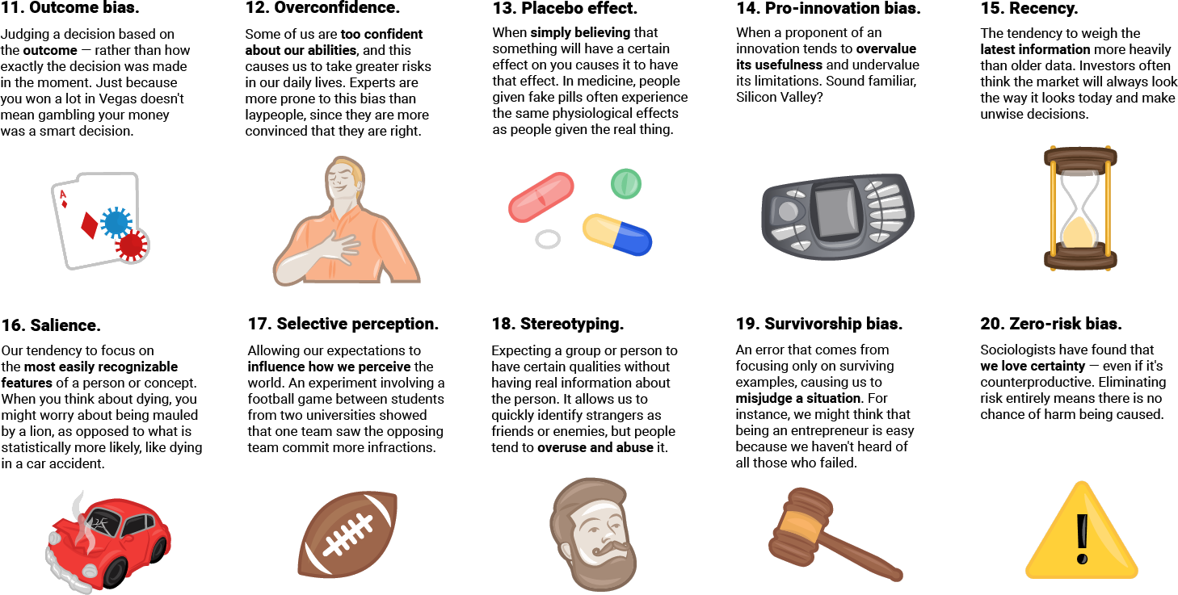
Cognitive Biases
[20 Cognitive Biases That Screw Up Your Decisions, Business Insider]

Slide 48

Ethics in A.I.
The explosion in the use of “Artificial Intelligence” has required the creation of GoC guidance on the responsible use of A.I.
The GoC policy also includes the Directive of Automated Decision-Making and the Guide on the use of generative A.I.

Slide 49
Case Study: Hiring
Your company is always looking for the most talented people, especially for technical positions.
Corporate policy supports diversity and inclusion.
The hiring process is time-consuming, and you are concerned about personal biases of panel members influencing the decisions.
With the help of an outstanding A.I. team, you automate this process.
The A.I.-assisted processes finds talented people, who fit into the organizational culture, and who like their jobs (low turnover).

Slide 50
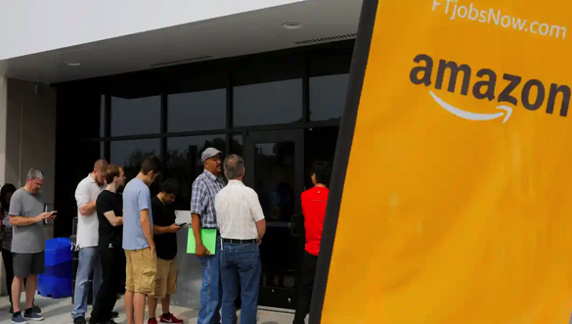
Case Study: Amazon Hiring A.I.
But… more likely to get hired if your name was Jared and you played lacrosse.
A.I. was behaving in a biased manner, not recommending women be hired.
Amazon was not confident they could remove the bias or identify biased behaviours in the future, so they project was scrapped.

Slide 51
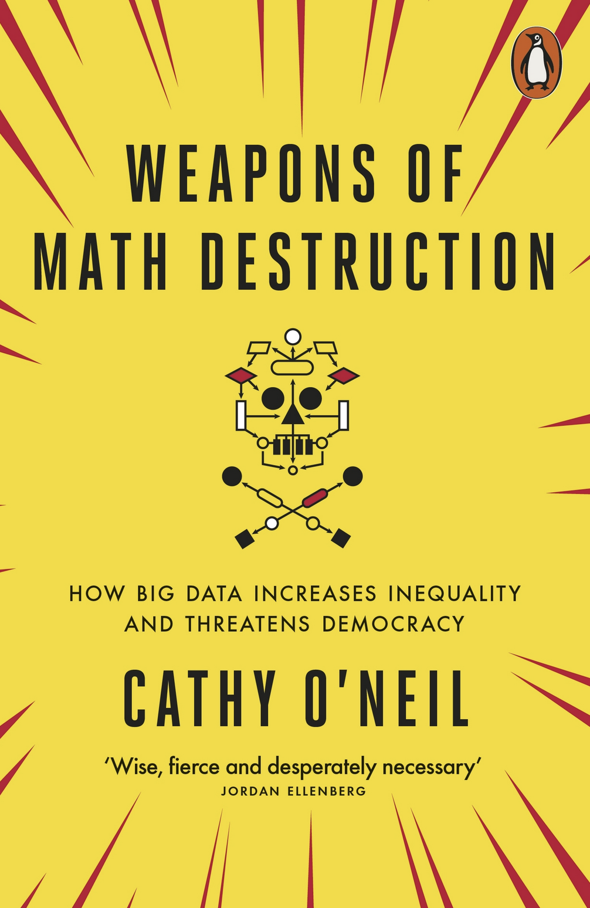
The Threat
In her book about data power, Dr. Cathy O’Neil presents several cautionary examples and tales.
“A computer program could speed through thousands of résumés […] and sort them into neat lists […]. This not only saved time but also was marketed as fair and objective. After all, it didn’t involve prejudiced humans digging through reams of paper, just machines processing cold numbers. […]
The math-powered applications driving the data economy were based on choices made by fallible human beings. Some of these choices were no doubt made with the best intentions. Nevertheless, many of these models and algorithms encoded human prejudice, misunderstanding and bias into the software systems that increasingly managed our lives.”

Slide 52

A.I. Ethics Guiding Principles
Uses:
privacy and security
transparency
accountability
methodology and data quality
model fairness
model explainability
indigenous data sovereignty

Slide 53
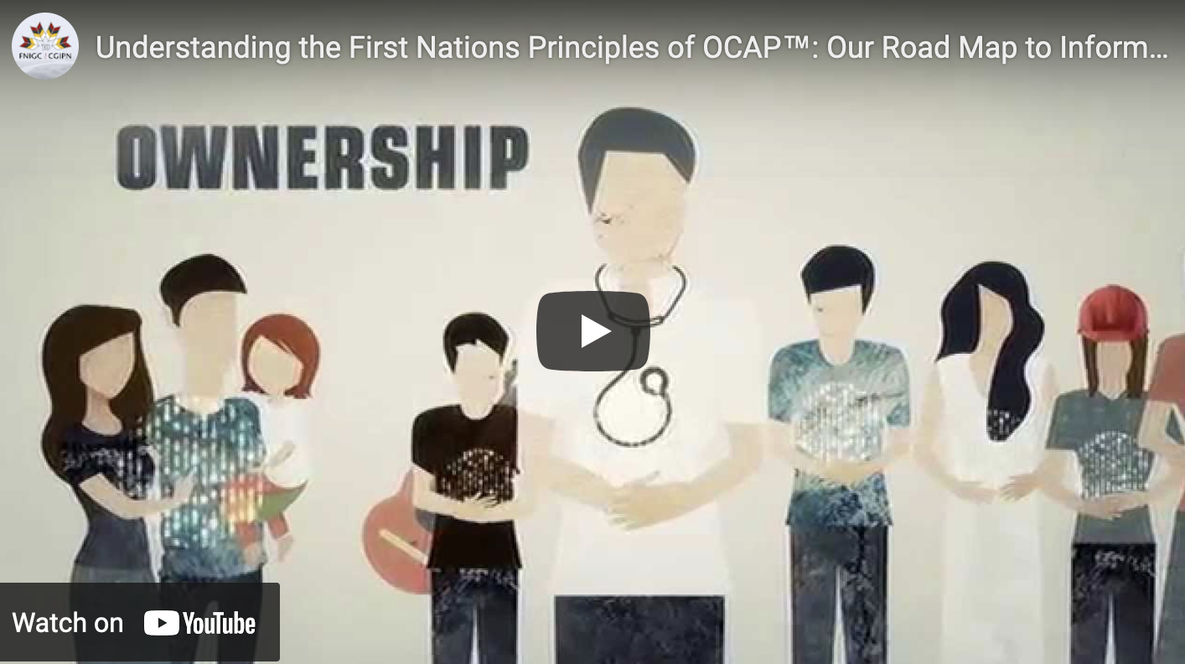
Data Ethics
Data ethics questions:
Who, if anyone, owns data?
Are there limits to how data can be used?
Are there value-biases built into certain analytics?
Are there categories that should not be used in analyzing personal data?
Should some data be publicly available to all researchers?
Are there lessons to be learned from the First Nations Principles of OCAP®? (ownership, control, access, possession)

Slide 54
First Nations Data
[https://fnigc.ca/ocap-training]
First Nations Principles of OCAP®:
Ownership: cultural knowledge, data, and information is owned by First Nations communities
Control: First Nations communities have the right to control all aspects of research and information management that impact them
Access: First Nations communities must have access to information and data about themselves no matter where it is held
Possession: First Nations communities must have physical control of relevant data
[OCAP® is a registered trademark of the First Nations Information Governance Centre (FNIGC), fnigc.ca/OCAP]
Notes:
Email story? Smart phone story?

Slide 55
Data Ethics
[https://datascience.virginia.edu/center-data-ethics-and-justice]
Some examples of data science ethics questions (University of Virginia's Centre Data Ethics and Justice):
who, if anyone, owns data?
are there limits to how data can be used?
are there value-biases built into certain analytics?
are there categories that should never be used in analyzing personal data?
should some data be publicly available to all researchers?
Notes:
Email story? Smart phone story?

Slide 56
Legal Considerations Using Data
Profiling:
are you using personal data to draw inferences that are unfair, unethical or discriminatory?
Surveillance:
are people being placed in a perpetual line-up?
Liability:
are you liable for what an A.I. does?

Slide 57
Emerging Legal Trends
Canada
GoC: Algorithmic Impact Assessment prior to the production of any Automated Decision System
Privacy Commissioner (Personal Information Protection and Electronic Documents Act):
Defines automated decision systems any tech that assists or replaces the judgment of humans.
Need to give people an explanation of the prediction/recommendation, and how their personal info was used.
Europe
General Data Protection Regulation (GDPR)
Article 22: not subject to a decision based solely on automated processing (with exceptions)
Article 15: if subject to such a decision, have right to meaningful information about the logic involved.

Slide 58
Data Ethics Guiding Principles
Public Benefit
Privacy and Security
Transparency
Accountability
Methodology and Data Quality
Indigenous Data Sovereignty

Slide 59
Codes of Conduct
A code of conduct is a set of rules outlining the norms, rules, and responsibilities or proper practices of an individual party or an organization (in medicine, we have the Hippocratic Oath).
Many professional organizations are starting to integrate data ethics into their professional designation's codes of conduct.
The Government of Canada has a general “Values and Ethics Code for the Public Sector” in which the use of data is implied.
The 2023-2026 Data Strategy explicitly identifies ethical use of data as a guiding principle.
There are other subject-specific policies such as the Tri-Council Policy on Ethical Conduct for Research Involving Humans, depending on areas of expertise.

Slide 60
Protecting and Sharing Confidential Data
Privacy is protected by laws and other measures including the Statistics Act, the Privacy Act, the Directive on Security Management and by GoC Levels of Security.
In short, the data in documents/information with a higher classification rating than “unclassified” can only be shared with personnel with the relevant level of screening and on a “need to know” basis, with documents being held at a site with the appropriate organization screening.
Type | Information and assets | Organization screening | Personnel screening
Classified | Top Secret | Facility security clearance (Top Secret) | Top Secret
Classified | Secret | Facility security clearance (Secret) | Secret
Classified | Confidential | Facility security clearance (Confidential) | Secret
Protected | Protected C | Designated organization screening | Enhanced reliability status
Protected | Protected B | Designated organization screening | Enhanced reliability status
Protected | Protected A | Designated organization screening | Reliability status

Slide 61
Decision-Making
Ethical research groups have identified different approaches to ethical decision making. The simplest being the Blanchard-Peale framework which is summarized as:
Is it legal?
Is it fair?
How does it make me feel?
Other approaches: Markkula Centre framework (utilitarianism, rights approach, fairness, common good approach, virtue approach), issue-contingent model (recognize issue, make judgement, establish moral intent, engage in behaviour).
The key concept is that decision-making for the organization must first be analyzed – however decisions are made, guidance is provided to help decision makers if issues must be addressed.

Slide 62
Ethics and the Data Lifecycle
If we remember from the Data Awareness module that there are a number of steps in the data lifecycle. We need to consider ethics at each stage
Acquisition
Storage
Preparation
Staging
Presentation
Do we acquire data in an ethical and unbiased manner? It is stored safely? When we prepare it do we introduce biases? Is it staged safely and when we present, are we representing all the actors in a fair and ethical manner?

Slide 63
3. Data Governance
Data Foundations
data-action-lab.com

Slide 64

What is Data Governance?
Data governance is a concept that enables an organization to ensure that high data quality exists throughout the complete life cycle of the data.
Focusing on data governance allows the organization to have data that:
is available when needed;
is usable when accessed;
is consistent when analyzed;
has integrity and is of high quality, and
is secure and trustworthy.

Slide 65
What is Data Governance?
Data governance encompasses:
people;
processes, and
information technology.
It is required to create a consistent and proper handling of an organization's data, across the enterprise.
It provides the foundation, strategy, and structure to ensure that data is managed as an asset and transformed into meaningful information.

Slide 66
Data Governance
[https://dama.org/content/body-knowledge]
Data Governance
Data Architecture
Data Modeling & Design
Data Storage & Operations
Data Security
Data Integration & Interoperability
Document & Content Management
Reference & Master Data
Data Warehousing & BI
Metadata
Data Quality
Data Management Association (DAMA)
DMBOK 2 (Data Management Body of Knowledge)
well-detailed & thorough
sections “reasonably” aligned with GoC approach
backed by a professional organization
but ... not government focused

Slide 67
Data Governance
Placeholder – go through each of the sections in a little more detail. It’s going to be especially important for things like metadata, reference data etc.

Slide 68
Data Governance
Data Governance and Ownership
Data Classification
Data Quality and Integrity
Data Privacy and Security
Terms and Definitions

Slide 69

Data Governance in the GoC
Central point of reference for GoC (Digital Government website):
Strategic plans, policies, standards and guidelines related to government digital services
Report to the Clerk of the Privy Council:
A Data Strategy Roadmap for the Federal Public Service
Treasury Board Secretariat (selection):
Policy on Service and Digital and Digital Operations Strategic Plan: 2018-2022
Government of Canada Strategic Plan for Information Management and Information Technology 2017 to 2021
Government of Canada Cloud Adoption Strategy: 2018 update
Industry Canada:
Canada’s Digital Charter in Action: A Plan by Canadians, for Canadians

Slide 70

Accountability and Responsibility
 | Data Trustee | Data Steward | Data Custodian | Data Contributor | Data Consumer
Definition | A person who has governance and compliance responsibility for a set of data assets | A person who has business accountability for a set of data assets | A person who has technical accountability for a set of data assets | A person who creates or collects data that is relevant to the organization | A person who uses data to enable business outcomes
Accountability summary | Compliance Risk Oversight Approval Champion Issue resolution | Accuracy Consistency Business requirements Metadata definition and management Data Quality Data Curation Fitness for Purpose Governance Inventory RDM Role Management | Security Access Management Availability Capacity Continuity Safeguarding Implementation Technical standards Configuration Control Modeling Versioning Change Management | Data Acquisition and entry Data Quality Metadata Preparation Ethical and secure gathering of data Identification of issues Identification of new data sources | Ethical use Report on Data Quality Report on fitness for purpose Identification of business and data rules Identification and reporting of data control Use in line with governance

Slide 71
Goals of Data Governance
1
5
Create self-service data culture
Increase value of data
2
6
Establish internal rules for data use
Reduce costs
3
7
Implement compliance requirements
Continually manage risks
4
8
Improve internal and external comms
Ensure continued existence
Notes:
Facebook vs day-to-day company

Slide 72

Common IssueS with Data Governance
Pioneered, planned, and projected by the most technical resources.
Verbiage is all over the place.
‘Donut meetings’...
Notes:
Facebook vs day-to-day company

Slide 73
Possible Structure
[Informatica]
Executive
Data Governance Steering Committee
Managerial
Data Governance Committee
Data Stewardship Committee
Domain Specific
Operational
Metadata Working Group
Reference Data Working Group
Data Quality Working Group
Data Stewardship Network
E.g., Corporate Services
E.g., Geospatial
E.g., Maintenance
Notes:
Facebook vs day-to-day company

Slide 74
4. Data COLLECTION
Data Foundations
data-action-lab.com

Slide 75
THE GOAL OF GOOD STUDY/SAMPLING DESIGN
We need data that can:
provide legitimate insight into our system of interest;
provide correct, accurate answers to relevant questions;
support the drawing of legitimate, valid conclusions, with the ability to qualify these conclusions in terms of scope and precision.
This starts with study design – what data to collect and how it should be collected

Slide 76

“A Dartmouth graduate student used an MRI machine to study the brain activity of a salmon as it was shown photographs and asked questions. The most interesting thing about the study was not that a salmon was studied, but that the salmon was dead. Yep, a dead salmon purchased at a local market was put into the MRI machine, and some patterns were discovered. There were inevitably patterns—and they were invariably meaningless.”

Slide 77
PATTERN FISHING / NON-PROBABILISTIC SAMPLING
Two separate issues can be combined to cause problems with data analysis:
drawing conclusions (inferences) from a sample about a population that are not warranted by the sample collection method (symptomatic of NPS);
looking for any available patterns in the data and then coming up with post hoc explanations for these patterns.
Alone or in combination, these lead to poor (and potentially harmful) conclusions.

Slide 78
STUDIES AND SURVEYS
A survey is any activity that collects information about characteristics of interest:
in an organized and methodical manner;
from some or all units of a population;
using well-defined concepts, methods, and procedures, and
compiles such information into a meaningful summary form.

Slide 79
SAMPLING MODELS
A census is a survey where information is collected from all units of a population, whereas a sample survey uses only a fraction of the units.
When survey sampling is done properly, we may be able to use various statistical methods to make inferences about the target population by sampling a (comparatively) small number of units in the study population.

Slide 80

DECIDING FACTORS
In some instances, information about the entire population is required in order to answer questions, whereas in others it is not necessary.
The survey type depends on multiple factors:
the type of question that needs to be answered;
the required precision;
the cost of surveying a unit;
the time required to survey a unit;
size of the population under investigation, and
the prevalence of the attributes of interest.

Slide 81
STUDY/SURVEY STEPS
data processing and imputation
estimation
data analysis
dissemination
documentation
Studies or surveys follow the same general steps:
statement of objective
selection of survey frame
sampling design
questionnaire design
data collection
data capture and coding
The process is not always linear, but there is a definite movement from objective to dissemination.

Slide 83
SURVEY FRAMES
The ideal frame contains identification data, contact data, classification data, maintenance data, and linkage data, and must minimize the risk of undercoverage or overcoverage, as well as the number of duplications and misclassifications (although some issues that arise can be fixed at the data processing stage).
\A statistical sampling approach is contraindicated unless the selected frame is
relevant (that is, it corresponds, and permits accessibility to, the target population),
accurate (the information it contains is valid),
timely (it is up-to-date), and
competitively priced.

Slide 84
Modes of Data Collection
Paper-based vs. computer-assisted
self-administered questionnaires are used when the survey requires detailed information to allow the units to consult personal records; associated with high non-response rate.
interviewer-assisted questionnaires use well-trained interviewers to increase the response rate and overall quality of the data; face-to-face vs. telephone.
computer-assisted interviews combine data collection and data capture, which saves time.
unobtrusive direct observation
diaries to be filled (paper or electronic)
omnibus surveys, email, Internet, and social media

Slide 85
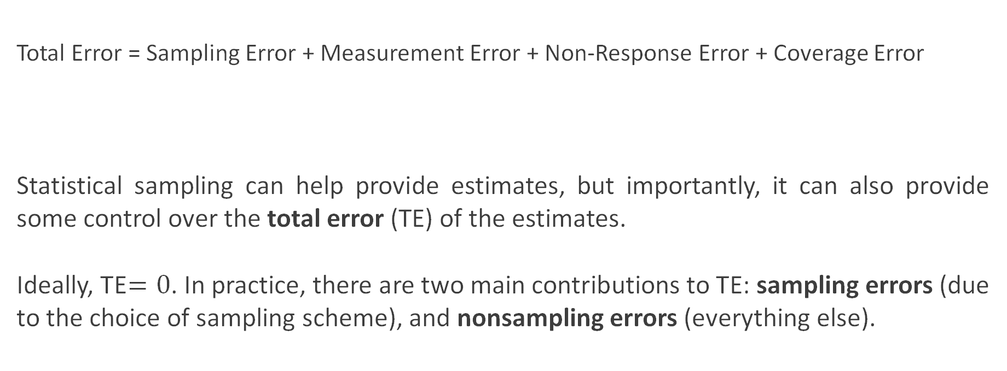
SURVEY ERROR
Total Error = Sampling Error + Measurement Error + Non-Response Error + Coverage Error
Statistical sampling can help provide estimates, but importantly, it can also provide some control over the total error (TE) of the estimates.
Ideally, TE$=0$. In practice, there are two main contributions to TE: sampling errors (due to the choice of sampling scheme), and nonsampling errors (everything else).
survey, not census
observations not measured accurately
non-respondents having systematic observation differences
frame decay and/or corruption

Slide 86
NONSAMPLING ERROR
Nonsampling error can be controlled, to some extent:
coverage error can be minimized by selecting high quality, up-to-date survey frames;
non-response error can be minimized by careful choice of the data collection mode and questionnaire design, and by using “call-backs” and “follow-ups”;
measurement error can be minimized by careful questionnaire design, pre-testing of the measurement apparatus, and cross-validation of answers.
In practice, these suggestions are not that useful in modern times (landline-based survey frames are becoming irrelevant due to demographics, response rates for surveys that are not mandated by law are low, etc.).

Slide 87
NONPROBABILISTIC SAMPLING
Nonprobabilistic sampling (NPS) methods (designs) select sampling units from the target population using subjective, non-random approaches
NPS are quick, relatively inexpensive and convenient (no survey frame required).
NPS methods are ideal for exploratory analysis and survey development.
Unfortunately, NPS are often used instead of probabilistic designs (problematic)
the associated selection bias makes NPS methods unsound when it comes to inferences (they cannot be used to provide reliable estimates of the sampling error, the only component of TE under the analyst’s direct control);
automated data collection often fall squarely in the NPS camp – we can still analyze data collected with a NPS approach, but may not generalize the results to the target population.

Slide 88
NPS METHODS
Haphazard
man on the street, depends on availability of units and interviewer bias
Volunteer
self-selection bias
Judgement
biased by inaccurate preconceptions about the target population
Quota
exit polling, ignores non-response bias

Slide 89
NPS METHODS
Modified
starts probabilistic, switches to quota as a reaction to high non-response rates
Snowball
“pyramid” scheme
There are contexts where NPS methods might fit a client’s or an organization’s need (and that remains their decision to make, ultimately), but they must be informed of the drawbacks, and presented with some probabilistic alternatives.

Slide 90
PROBABILISTIC SAMPLING
Probabilistic sample designs are usually more difficult and expensive to set-up (due to the need for a quality survey frame) and take longer to complete.
They provide reliable estimates for the attribute of interest and the sampling error, paving the way for small samples being used to draw inferences about larger target populations (in theory, at least; the non-sampling error components can still affect results and generalisation).

Slide 91
SAMPLING DESIGNS
Different sampling designs have distinct advantages and disadvantages.
They can be used to compute estimates
for various population attributes: mean, total, proportion, ratio, difference, etc.
for the corresponding 95% CI.
We might also want to compute sample sizes for a given error bound (an upper limit on the radius of the desired 95% CI), and how to determine the sample allocation (how many units to be sampled in various sub-population groups).

Slide 92
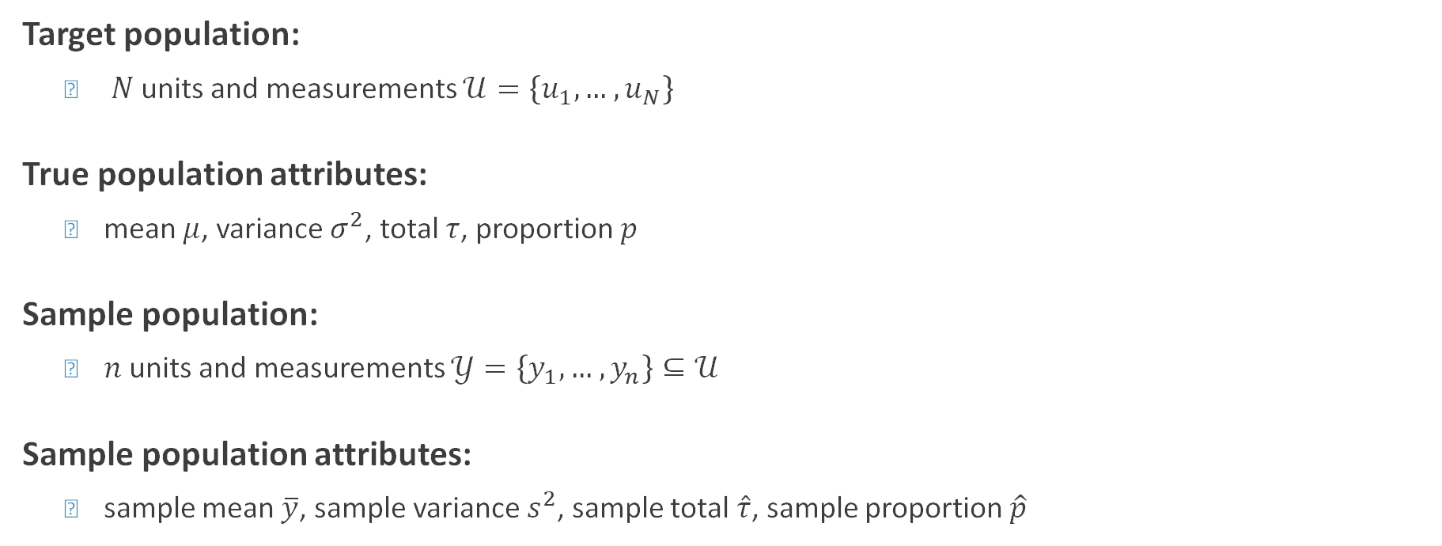
SAMPLING UNIVERSE
Target population:
$N$units and measurements $𝒰=\left\{u_{1},…,u_{N}\right\}$
True population attributes:
mean $μ$, variance $σ^{2}$, total $τ$, proportion $p$
Sample population:
$n$units and measurements $𝒴=\left\{y_{1},…,y_{n}\right\}⊆𝒰$
Sample population attributes:
sample mean $\overline{y}$, sample variance $s^{2}$, sample total $\hat{τ}$, sample proportion $\hat{p}$

Slide 93
PROBABILISTIC SAMPLING DESIGNS
Simple random sampling (SRS)
Stratified random sampling (StS)
Systematic sampling (SyS)
Cluster sampling (ClS)
Replicated sampling (ReS)
Multi-stage sampling (MSS)
Multi-phase sampling (MPS)
Probability proportional-to-size sampling (PPS)

Slide 94

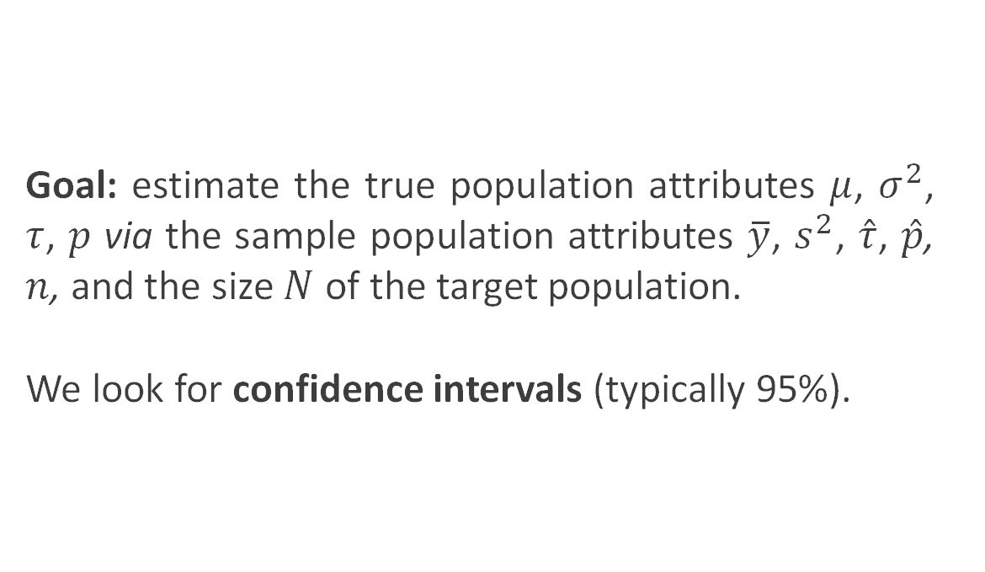
SAMPLING UNIVERSE
Goal: estimate the true population attributes $μ$, $σ^{2}$, $τ$, $p$ via the sample population attributes $\overline{y}$, $s^{2}$, $\hat{τ}$, $\hat{p}$, $n$, and the size $N$ of the target population.
We look for confidence intervals (typically 95%).

Slide 95
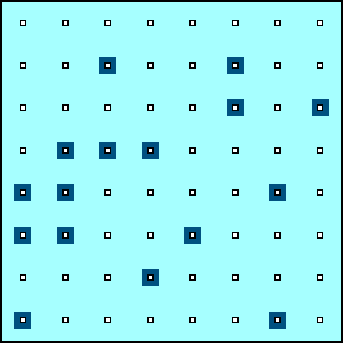
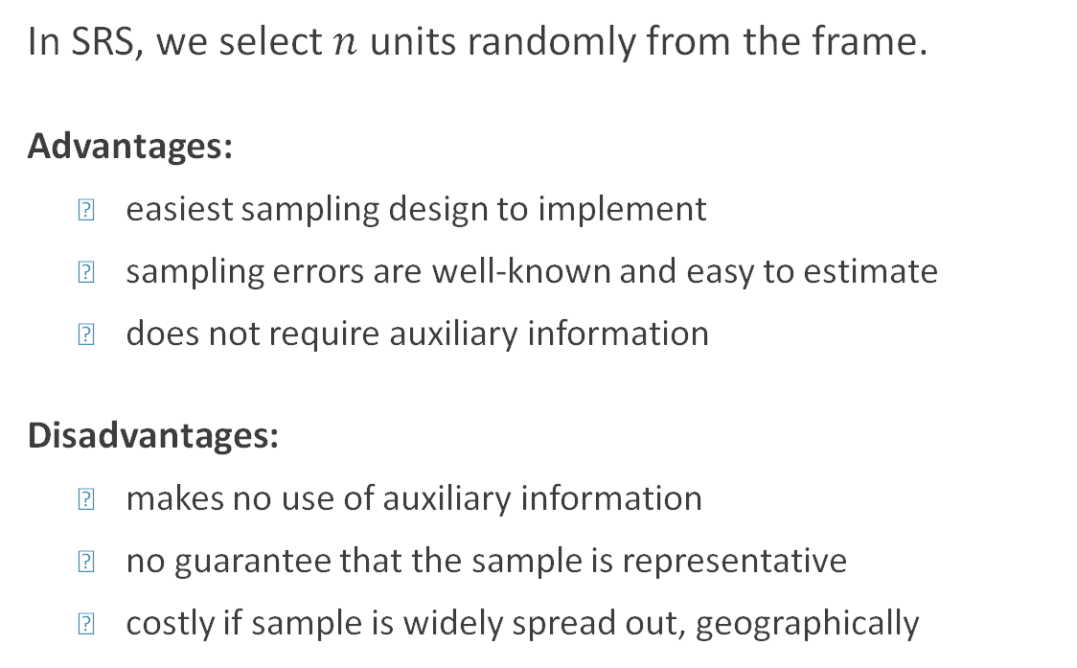
SIMPLE RANDOM SAMPLING (SRS)
In SRS, we select $n$ units randomly from the frame.
Advantages:
easiest sampling design to implement
sampling errors are well-known and easy to estimate
does not require auxiliary information
Disadvantages:
makes no use of auxiliary information
no guarantee that the sample is representative
costly if sample is widely spread out, geographically

Slide 96
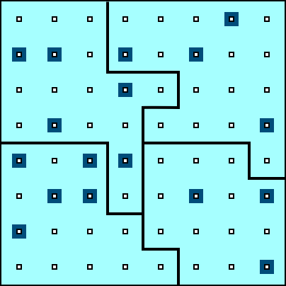
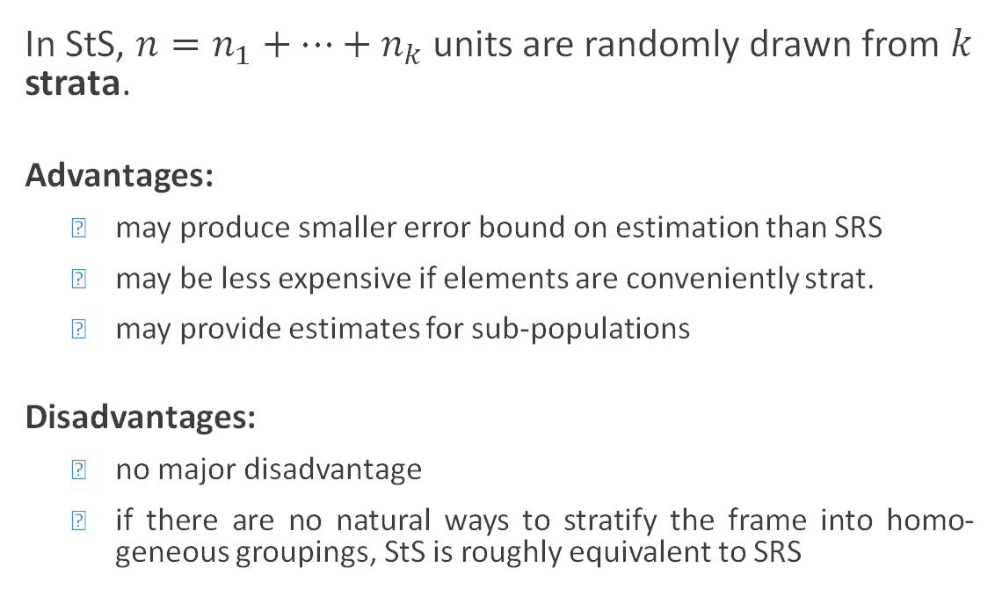
STRATIFIED RANDOM SAMPLING (StS)
In StS, $n=n_{1}+⋯+n_{k}$ units are randomly drawn from $k$ strata.
Advantages:
may produce smaller error bound on estimation than SRS
may be less expensive if elements are conveniently strat.
may provide estimates for sub-populations
Disadvantages:
no major disadvantage
if there are no natural ways to stratify the frame into homo-geneous groupings, StS is roughly equivalent to SRS

Slide 97
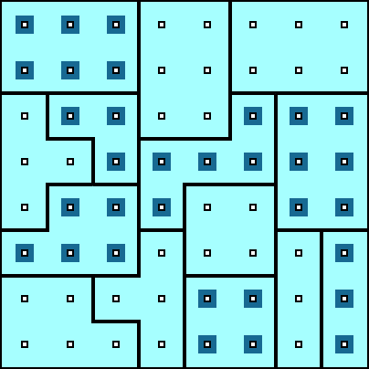
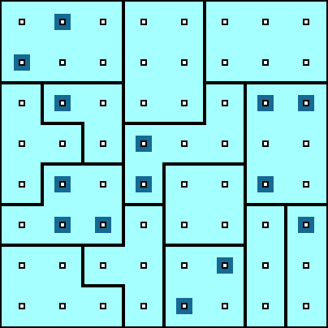
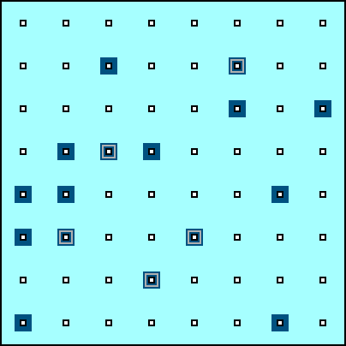
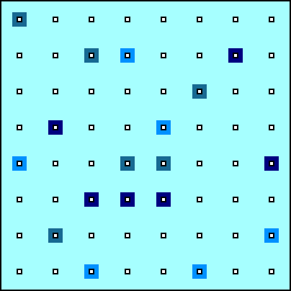
OTHER PROBABILISTIC SAMPLING DESIGNS
Cluster Sampling (ClS)
Multi-Stage Sampling (MSS)
Multi-Phase Sampling (MPS)
Replicated Sampling (ReS)

Slide 98
World Wide Web
The way we share, collect, and publish data has changed over the past few years due to the ubiquity of the World Wide Web (WWW).
Private businesses, government, and individual users are posting and sharing all kinds of data and information.
At every moment, new channels generate vast amounts of data on human behaviour.

Slide 99
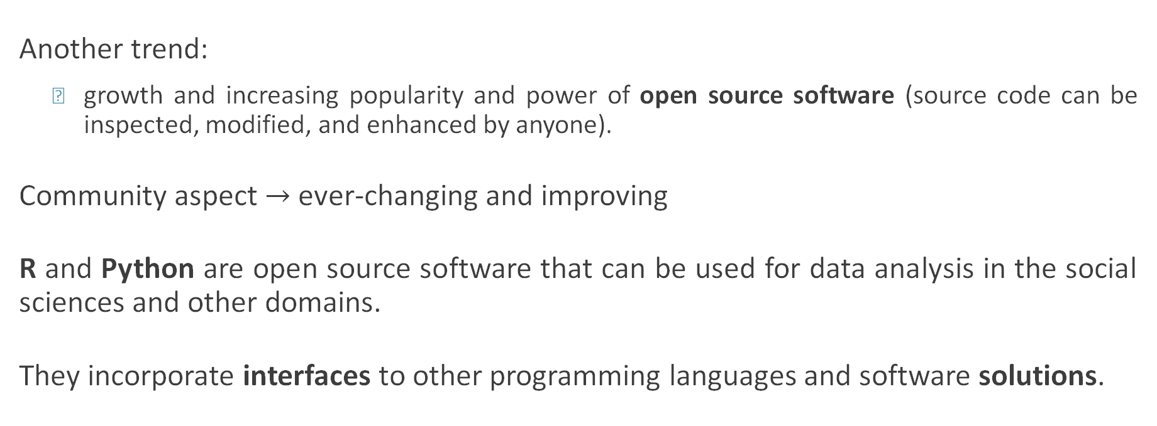
Open Source Software
Another trend:
growth and increasing popularity and power of open source software (source code can be inspected, modified, and enhanced by anyone).
Community aspect $→$ ever-changing and improving
R and Python are open source software that can be used for data analysis in the social sciences and other domains.
They incorporate interfaces to other programming languages and software solutions.

Slide 100
World Wide Web
There was a time in the recent past where both scarcity and inaccessibility of data was a problem for researchers and decision-makers. That is emphatically not the case anymore.
Data abundance carries its own set of problems:
tangled masses of data;
traditional data collection methods and classical (small) data analysis techniques may not be sufficient anymore.

Slide 101
Data Sources (Trade-Offs)
Automated vs. Traditional
Accuracy vs. Completeness
Coverage vs. Validity
Speed vs. Cost
etc.

Slide 102
Web Data Scraping Example – New Phone
Let’s say you want to know what people think of a new phone. Standard approach: market research (e.g. telephone survey, reward system, etc.)
Pitfalls:
unrepresentative sample: the selected sample might not represent the intended population
systematic non-response: people who don’t like phone surveys might be less (or more) likely to dislike the new phone
coverage error: people without a landline can’t be reached, say
measurement error: are the survey questions providing suitable info for the problem at hand?

Slide 103
Web Data Quality – New Phone
These solutions can be costly, time-consuming, ineffective.
Proxies – indicators that are strongly related to the product’s popularity, without measuring it directly.
If popularity is defined as large groups of people preferring one product over a competitor, then sales statistics on a commercial website may provide a proxy for popularity.
Rankings on Amazon could provide a more comprehensive view of the phone market vs. traditional survey.

Slide 104
Potential Issues – New Phone
Representativeness of the listed products
Are all phones listed?
If not, is it because that website doesn’t sell them?
Is there some other reason?
Representativeness of the customers
Are there specific groups buying/not-buying online products?
Are there specific groups buying from specific sites?
Are there specific groups leaving/not-leaving reviews?
Truthfulness of customers and reliability of reviews.

Slide 105
Data Collection Process (5 Steps)
1. Know exactly what kind of information you need
Specific: GDP of all OECD countries for last 10 years; sales of top 10 shoe brands in 2017
Vague: people’s opinion on shoe brand X
2. Find out if there are any web data sources that could provide direct or indirect information on your problem
Easier for specific facts: shoe store’s webpage will provide information about shoes that are currently in demand i.e. sandals, boots, etc.
Tweets may contain opinion trends on anything
Commercial platforms can provide information on product satisfaction

Slide 106
Data Collection Process (5 Steps)
3. Develop a theory of the data generation process when looking into potential sources
When was the data generated?
When was it uploaded to the Web?
Who uploaded the data?
Are there any potential areas that are not covered? consistent? accurate?
How often is the data updated?

Slide 107
Data Collection Process (5 Steps)
4. Balance advantages and disadvantages of potential data sources
Validate the quality of data used
Are there other independent sources that provide similar information to crosscheck against
Can you identify original source of secondary data
5. Make a decision
Choose data source that seems most suitable
Document reasons for this decision
Collect data from several sources to validate data sources

Slide 108
Is Web Scraping Legal?
Ethical Guidelines:
Work as transparently as possible
Document data sources at all time
Give credit to those who originally collected and published the data
If you did not collect the information, you probably need permission to reproduce it
Don’t do anything illegal.
Crawling another company’s information to process and resell it is a common complaint.

Slide 109
Is Web Scraping Legal?
What is a spider?
Programs that graze or crawl the web for information rapidly
Jumps from one page to another, grabbing the entire page content
Scraping is taking specific information from specific websites (which is the goal): how are these different?
“Scraping inherently involves copying, and therefore one of the most obvious claims against scrapers is copyright infringement.”

Slide 110
Legal Cases – Web Scraping
eBay vs. Bidder’s Edge (BE)
BE used automated programs to crawl information from different auction sites.
Users could search listings on the BE webpage instead of going to individual auction sites.
BE accessed eBay’s sites ~100 000 times / day (1.53% of # of requests, 1.1% of total data transferred by eBay) in 1999.
eBay alleged damages of up to $45k- $62K in a 10 month period.
BE didn’t steal information that wasn’t public, but excessive traffic was demanding on eBay’s servers.
Your verdict?

Slide 111
Friendly Cooperation with API
Application program interface (API) are sets of routines, protocols, and tools for building software applications.
Many APIs restrict the user to a certain amount of API calls per day (or some other limits).
These limits should be obeyed.

Slide 112
Lessons Learned
It is not clear which scraping actions are illegal and which are legal.
Re-publishing content for commercial purposes is considered more problematic than downloading pages for research/analysis.
Robots.txt: Robots Exclusion Protocol is a file that tells scrapers what information on the site may be harvested.
Be friendly! Not everything that can be scraped needs to be so. Scraping programs should behave “nicely”, provide the data you seek, and be efficient, in this order.

Slide 113
Contact Data Providers
Any data accessed by HTTP forms is stored in some sort of database.
Ask proprietors of the data first if they will grant access to the database or files.
The larger the amount of data you want, the better it is for both parties to communicate before starting to harvest data.
For small amounts of data, that’s less important.

Slide 114
Scraping Do’s and Don’t’s
1. Stay identifiable
2. Reduce traffic
Accept compressed files
If scraping the same resources multiple times, check first if it has changed before accessing again
Retrieve only parts of a file

Slide 115
Scraping Do’s and Don’t’s
3. Do not bother server with multiple requests
Many requests per second can bring smaller servers down
Webmasters may block you if your scraper behaves this way
One or two request per second is fine
4. Write modest scraper (efficient and polite)
No reason to scrape pages daily or repeat same task over and over; make your scraper as efficient as possible
Do not over-scrape pages
Select resources you want to use and leave the rest untouched

