Slide 1

Module 2: Data ANALYSIS, DATA SCIENCE, AND BUSINESS INTELLIGENCE
CT ACADEMY | DATA ACTION LAB
data-action-lab.com

Slide 2
5. Data Quality
DATA ANALYSIS, DATA SCIENCE, AND BUSINESS INTELLIGENCE
data-action-lab.com

Slide 3
Drivers for Data Quality
GoC data governance policies/directives
Departmental data policies
Departmental data directives
Facilitates move towards GoC Open Data
But, it’s mostly just good business practice!
  Ability to utilize data more efficiently and effectively
  More timely access to data
  Increased confidence in decision making
  Preparation for advanced analytics such as AI and Machine Learning

Slide 4
“Improving data quality leads to improved decision-making throughout the enterprise. The more high-quality data you have, the more confidence you will have in your decision-making.”

Slide 5
What is Data Quality?
Data quality (DQ) is the degree to which data meets or exceeds business requirements (i.e., the extent to which data is “fit for purpose”).
It involves the planning and implementation of quality management techniques to measure, assess, and improve the fitness of data for use within an organization.

Slide 6
Why is Data Quality Important?
Data has intrinsic value due to its information content. The impacts of poor-quality data can include:
Bad decisions, wasted resources, lowered performance chasing after issues.
Escalating costs to remediate if issues are not caught early.
Lack of trust in data for decision-making.
Outdated and meaningless data bloat.
Challenges with data sharing, integration and access to historical data.
Poor-quality data is detrimental to analytics.
Data is the currency of control: we can’t control what we don’t know.

Slide 7

Data Quality is Reactive and Proactive
Quality Assurance
Preventing data quality issues before they impact operations and programs
Proactive
Quality Control
Identifying and fixing data quality issues after they occur
Reactive
A data quality program needs elements of both control and assurance to be fully effective.

Slide 8
Data Quality Dimensions
To implement data quality, we typically introduce categories called “dimensions”.
These dimensions are measurement attributes of data, which can be individually assessed, interpreted, and improved.
We can use them to help build data quality dashboards.
They can also help us group issues and risks, helping us:
  perform trend analyses;
  identify underlying, systemic issues;
  set-up data quality testing programs, etc.

Slide 9
Data Quality Dimensions
Accessibility
Timeliness
Business processes and consumers can access and use the data asset
Data values are sufficiently up-to-date for business processes and consumers needs
Accuracy
Data accurately represents a real-world entity, object, concept, etc.
Completeness
Data asset has no missing data values
Interdependency
Relationships between data elements are preserved within or across data assets
Uniqueness
Data representations are not duplicated within or across data assets
Relevance
Data asset is of value to and used by business processes and data consumers
Consistency
Data representations are the same within and across data assets and repositories
Typical set of data quality dimensions

Slide 10
Data Quality Dimensions
Accuracy
Increase trust in data
Relevance
Improve business value of data
Accessibility
Address availability of data
Accuracy
Completeness
Interdependency
Uniqueness
Relevance
Consistency
Improved data quality
All data quality dimensions
Accessibility
Timeliness

Slide 11
Data Quality is a process
There are three focus areas in addressing data quality:
identify and mitigate existing data quality issues through quality control (e.g., testing a database to identify incorrect values then replacing them);
identify sources of high risk that could create quality issues and mitigate those risks through quality assurance (e.g., replacing a free form text field on a new software app with a dropdown list), and
track and monitor all known data quality issues and report them on a regular basis through quality monitoring (e.g., creating a list of all known issues and monitoring when they get fixed).

Slide 12
Data Quality is a process
We cannot implement a data quality program all at once, so we typically break it down to 5 stages:
  preparation
  issue and risk identification
  issue and risk evaluation
  issue and risk mitigation
  ongoing monitoring

Slide 13
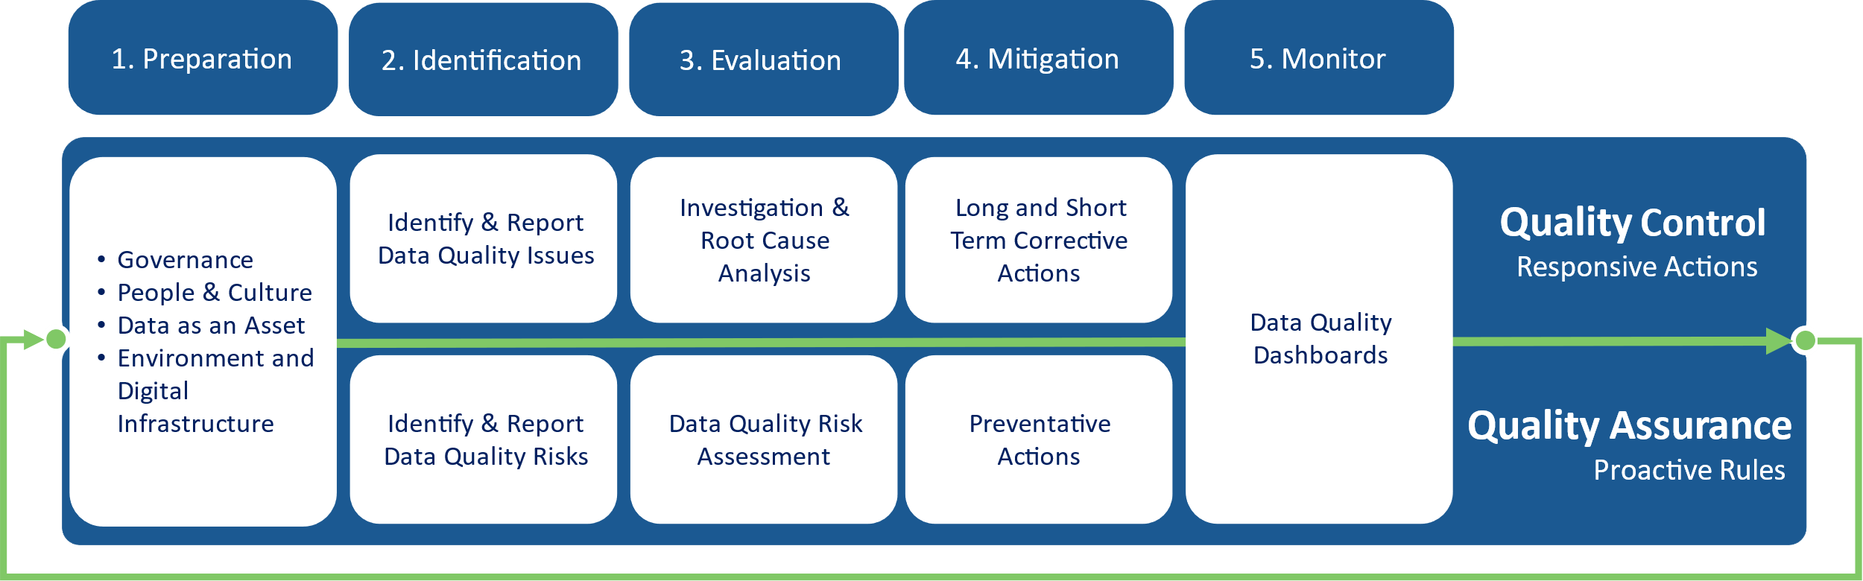
Data Quality is a process

Slide 14

Stage 1: Preparation
We can improve data quality by implementing programs such as:
  People & Culture (data literacy, culture, and communication)
  Environment & Digital Infrastructure (tools, data asset catalogue)
  Data Management (metadata, reference/master data, dimensions & rules)
  Governance (roles & responsibilities, DQ planning, process definition)
Although it isn’t critical to have all the above activities in place before starting on Data Quality, they do make a significant impact on the effectiveness of all DQ activities.
data-action-lab.com

Slide 15
Step 2: Identification
The second step in the process is to identify data quality issues. Currently-existing issues are called data quality non-conformances; issues that are yet to appear are known as data quality risks.
  DQ dimensions identify data attributes that can be used to measure data quality (often defined in an organization’s Data Quality Framework).
  Business rules define the business requirements for data and how data quality tests are performed.
  Data quality metrics track the results of these tests over time.
Availability
Accessibility
Timeliness
Value
Relevance
Consistency
Trust
Accuracy
Completeness
Interdependency
Uniqueness

Slide 16
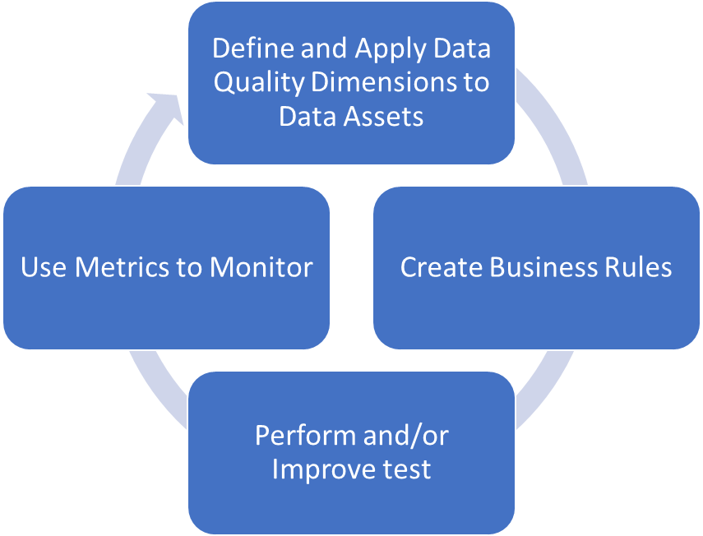
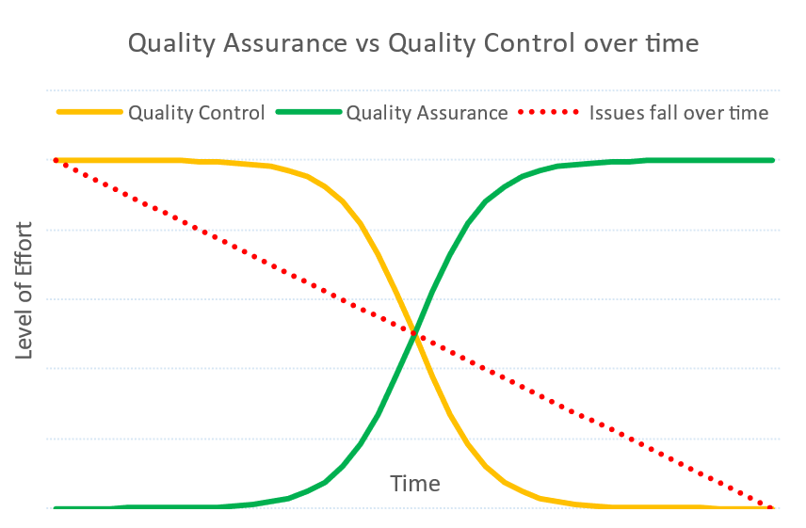
Stage 2: Identification Methods
Methods for identifying DQ non-conformances and DQ risks include:
Quality Control
  DQ testing using software
  systems, process, and procedure auditing
  data consumer feedback
Quality Assurance
  creation of risk register
data-action-lab.com

Slide 17

Stage 2: Identification example
We perform data quality tests by applying business rules and dimensions, for example:
HR has identified that an employee surname is a critical pieces of data.
We use completeness as a dimension (missing values for this field are important).
The business rule that we define is the "surname" column in the corresponding data table should be 100% complete (no missing values).
The corresponding metric is implemented in Power BI; it counts the total number of rows in the column and the total number of non-missing entries. We then divide the entries by the total rows to calculate the percentage of completion.
The table fails the DQ test as only 97.2% of the records have a surname value.
This is reported to the right group, and we move to the next DQ process phase.

Slide 18
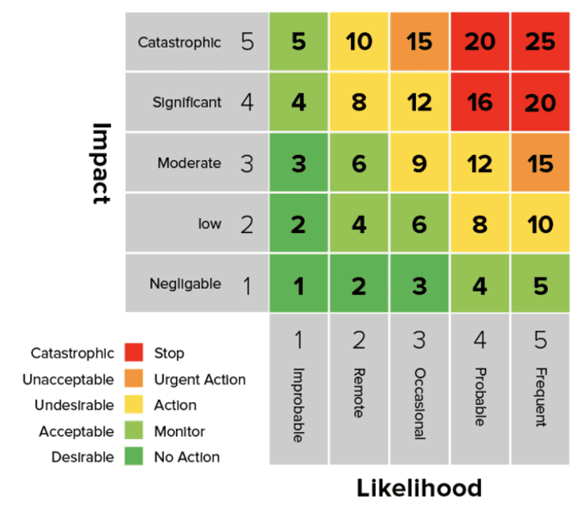
Stage 3: Evaluation
Cause 1
DQ Issue
Root Cause 1
Cause 2
Once a DQ issue has been identified, we must evaluate it to prioritize mitigation activities. Evaluation methods typically include:
Quality Control
  formally investigate DQ Issues
  perform a root cause analysis to evaluate causes not symptoms
Quality Assurance
  evaluate and prioritize risks regarding impact
Root Cause 2
Cause 3
data-action-lab.com

Slide 19

Stage 3: Evaluation example
From the previous example, the failed DQ test for completeness of the “surname” column has a metric value of 97.2%.
Next, the appropriate line of business evaluates the situation to find how critical it is to fix the problem.
As the database in question is related to pay, the 2.8% of missing values is seen as a HIGH priority, to be fixed as soon as practicable.
An investigation and root cause analysis is then carried out to find out what happed and what were the root causes of the issue.
It was determined that the root cause was an automated process used to copy surnames from another database, which failed because of a software update; we can now move to the next DQ process phase.

Slide 20
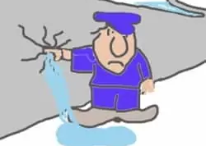

Stage 4: Mitigation
Once a DQ issue has been evaluated it may then require mitigation (fixing the issue). The actual fix will vary depending on the issue itself, but they fall into different categories.
Quality Control
  short term corrective actions to immediately fix the issue
  long term corrective actions ensure the issue does not recur
Quality Assurance
  preventative actions ensure that high risks do not turn into DQ issues

Slide 21

Stage 4: Mitigation example
From the previous example the following mitigation activities may be carried out.
A short-term corrective action is to re-run the data transfer process manually to ensure that the column is updated and 100% complete.
A long-term corrective action is to implement an automated DQ test once the transfer is complete to ensure that all records had been transferred between data assets.
We can now move to the next DQ process phase.

Slide 22
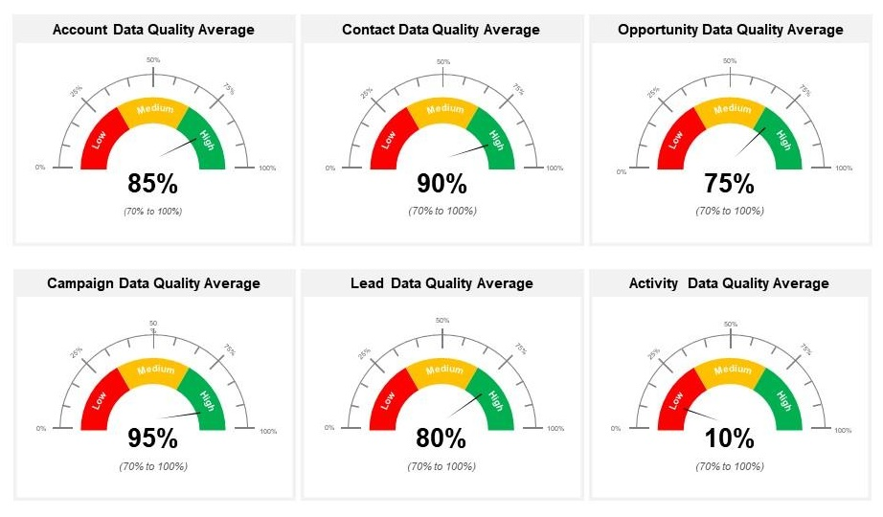
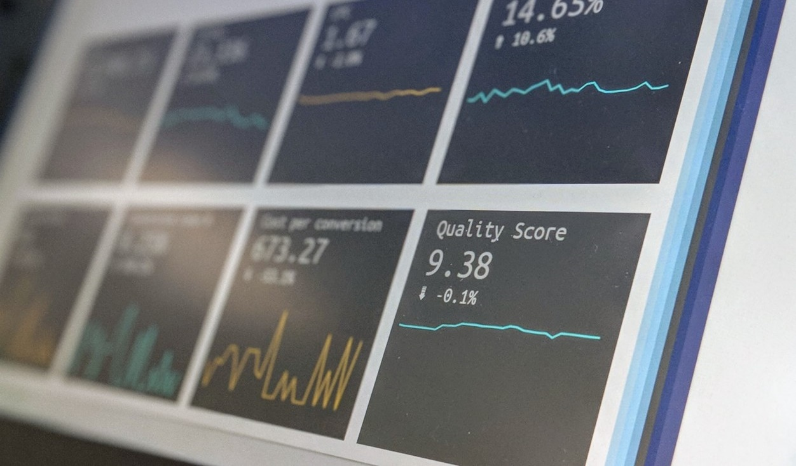
Stage 5: Monitor
It is best practice to monitor DQ on an ongoing basis.
Quality Control & Quality Assurance
  status of DQ issues (non-conformances and risks)
  status of DQ investigations and root cause analysis
  status of internal quality audits
  status of corrective actions and preventative actions
data-action-lab.com

Slide 23

Stage 5: Monitor example
As an issue had occurred in the “surname” column, the following items were recorded and included in the ongoing monitoring of DQ:
  the date the issue was identified;
  the criticality of the issue (high priority);
  the type of issue (“completeness” non-conformance);
  the actual test result (97.2%);
  the date the short-term corrective action was completed;
  the date the long-term corrective action was completed, and
  a measure of the effectiveness of the long-term corrective action (“highly effective”).
As the line of business continues to monitor non-conformances and risks, a profile of the health of the data asset is created which shows improvement over time (?)
This is replicated for all onboarded assets for aggregated monitoring & reporting.

Slide 24
“Any substantial improvement must come from action on the system and is the responsibility of management. Wishing and pleading and begging the workers to do better is totally futile.”
(W. Edwards Deming, Out of the Crises)

Slide 25
Data Quality IS ENACTED BY PEOPLE
Role | Description | Focus on Data Quality
Chief Data Officer | Responsible for all data related activities at department | Accountable for DQ program
Branch/Regional/ Program Heads | Responsible for Branch/Regional/Programs | Participation in the DQ program
Data Trustee | Strategically manages data assets and ensures compliance with data-related strategies, regulations, policies, directives | Creates a proactive, risk-based approach to the reduction of DQ issues
Data Steward | Advises, enacts, and enforces data policies and standards | Performs testing, risk assessment, investigations and auditing. Implements ongoing monitoring of DQ
Data Custodian | Ensures safe custody and integrity of hosted data | Provides technical support for corrective and preventative actions
Data Contributor | Ensures the data they provide aligns with technical and business policies, procedures, and standards | Ensures quality of data prior to inclusion in data asset
Data Consumer | Ensures usage of data supports all objectives and mandates | Reports on data issues found when using data

Slide 26
6. ASKING QUESTIONS & NON-TECHNICAL ASPECTS OF DATA WORK
DATA ANALYSIS, DATA SCIENCE, AND BUSINESS INTELLIGENCE
data-action-lab.com

Slide 27
Asking the Right Questions
Data science is about asking and answering questions:
  Analytics: “How many clicks did this link get?”
  Data Science: “Based on this user’s previous purchasing history, can I predict what links they will click on the next time they access the site?”
  Data mining/science models are usually predictive (not explanatory): they show connections, but don't reveal why these exist.
  Warning: not every situation calls for data science, artificial intelligence, machine learning, statistics, or analytics.

Slide 28
The Wrong Questions
Too often, analysts are asking the wrong questions:
  questions that are too broad or too narrow
  questions that no amount of data could ever answer
  questions for which data cannot reasonably be obtained
  The best-case scenario is that stakeholders will recognize the answers as irrelevant.
  The worst-case scenario is that they will erroneously implement policies or make decisions based on answers that have not been identified as misleading or useless.

Slide 29

Roadmap to Framing Questions
Understand the problem (opportunity vs. problem)
What initial assumptions do I have about the situation?
How will the results be used?
What are the risks and/or benefits of answering this question?
What stakeholder questions might arise based on the answer(s)?
Do I have access to the data necessary to answering this question?
How will I measure my ‘success’ criteria?
Notes:
Facebook vs day-to-day company

Slide 30
Yes/No Trap
Examples of bad questions:
  Are our revenues increasing over time? Has it increased year-over-year?
  Are most of our customers from this demographic?
  Does this project have valuable ambitions to the broader department?
  How great is our hard-working customer success team?
  How often do you triple check your work?
Examples of good questions:
  What’s the distribution of our revenues over the past three months?
  Where are our top 5 high-spending cohorts from?
  What are the different benefits of pursuing this project?
  What are three good and bad traits of our customer success team?
  Do you tend to do quality assurance testing on your deliverables?
Notes:
Facebook vs day-to-day company

Slide 31
Question Audit Checklist
Did I avoid creating any yes/no questions?
Would anyone in my team/department understand the question irrespective of their backgrounds?
Does the question need more than one sentence to express?
Is the question ‘balanced’ – scope is not too broad that the question will never truly be answered, or too small that the resulting impact is minimal?
Is the question being skewed to what may be easier to answer for my/my team’s particular skillset(s)?

Slide 32
Multiple I’s Approach to Data Work
Session 1
Technical and quantitative proficiency (or expertise) is necessary to do good quantitative work in the real world, but it is not sufficient – optimal real-world solutions may not always be the optimal academic or analytical solutions.
This might be the biggest surprise for those transitioning out of academia.
What works for one person, one job application, one project, one client, etc. may not work for another – beware the tyranny of past success!
The focus of quantitative work must include the delivery of useful analyses/ products (Multiple “I”s).

Slide 33
Multiple I’s Approach to Data Work
  intuition
  understanding context
  initiative
  establishing an analysis plan
  innovation
  new ways to obtain results, if required
  insurance
  trying multiple approaches
  interpretability
  providing explainable results
  inquisitiveness
  not only asking the same questions repeatedly
  integrity
  staying true to objectives and results
  independence
  self-learning and self-teaching
  interactions
  strong analyses through teamwork
  interest
  finding and reporting on interesting results
  intangibles
  thinking “outside the box”
  insights
  providing actionable results

Slide 34
Multiple I’s Approach to Data Work
Prospective employees/analysts are not solely gauged on technical know-how, but also on the ability to contribute positively to the workplace/project:
  communication
  team work and multi-disciplinary abilities
  social niceties and flexibility
  non-technical interests
Employers rarely chose robots when human beings are available; stakeholders are more likely to accept data recommendations from well-rounded people.
You should also evaluate eventual employers/clients on these axes.

Slide 35
Roles and Responsibilities
Session 1
A data analyst or a data scientist (in the singular) is unlikely to get meaningful results – there are simply too many moving parts to any data project.
Successful projects require teams of highly-skilled individuals who understand the data, the context, and the challenges.
Team size could vary from a few to several dozens; typically easier to manage small-ish teams (with 1-4 members, say, with role overlaps).
Domain Experts / SMEs
  are authorities in a particular area or topic
  guide team through unexpected complications and knowledge gaps

Slide 36
Roles and Responsibilities
Session 1
Project Managers / Team Leads
  understand the process enough to recognize whether what is being done makes sense
  provide realistic estimates of the time and effort required to complete tasks
  act as intermediary between team and clients/stakeholders
  responsible for project deliverables.
Data Translators
  have a good grasp on the data and the data dictionary
  help SMEs transmit the underlying context to the data science team
Data Engineers / Database Specialists
  work with clients and stakeholders to acquire useable data sources
  may participate in the analyses, but are not necessarily specialists

Slide 37
Roles and Responsibilities
Data Analysts
  clean and process data
  prepare initial visualizations
  have a decent understanding of quantitative methods (at most 1 area of expertise)
  conduct preliminary analyses
Data Scientists
  work with processed data to build sophisticated models
  focus on actionable insights
  have a sound understanding of algorithms/quantitative methods (2 or 3 areas of expertise)
  can apply them to a variety of data scenarios
  can be counted on to catch up on new material quickly

Slide 38
Roles and Responsibilities
Session 1
Computer Engineers
  design and build computer systems and pipelines
  are involved in software development and deployment of data science solutions
AI/ML Quality Assurance/Quality Control Specialists
  design testing plans for solutions that implement AI/ML models
  help the team determine whether the models are able to learn
Communication Specialists
  communicate actionable insights to managers, policy analysts, decision-makers, stake holders
  may participate in the analyses, but are not necessarily specialists (often data translators)
  keep abreast of popular accounts of quantitative results and developments

Slide 39

The Digital/Analog DATA Dichotomy
Humans have been collecting data for a long time; J.C. Scott argues that data collection was a major enabler of the modern nation-state.
For most of the history of data collection, we have lived in the analogue world (understanding grounded in continuous experience of physical reality).
Our data collection activities were the first steps towards a different strategy for understanding and interacting with the world.
Data leads us to conceptualize the world in a way that is more discrete than continuous..

Slide 40

The Digital/Analog Data Dichotomy
Translating our experiences into numbers and categories, we create sharper and more definable boundaries than experience might suggest.
This discretization strategy leads to the digital computer (1;0), which is surprisingly successful at representing our physical world: the digital world takes on a reality as pervasive and important as the physical one.
This digital world is built on top of the physical world, but it does not operate under the same set of rules:
    in the physical world, the default is to forget; in the digital world, it is to remember;
    in the physical world, the default is private; in the digital world, the default is public;
    in the physical world, copying is hard; in the digital world, it is easy.

Slide 41

The Digital/Analog Data Dichotomy
Digitization is making things that were once hidden, visible; once veiled, transparent.
Data scientists are scientists of the digital world. They seek to understand:
  the fundamental principles of data
  how these fundamental principles manifest themselves in different digital phenomena
Ultimately, data and the digital world are tied to the physical world. What is done with data has repercussions in the physical world; and it is crucial for data scientists to have a solid grasp of the fundamentals and context of data work before leaping into the tools and techniques that drive it forward.

Slide 42
Analysis Cheat Sheet
Session 1
Business solutions are not always academic solutions.
Data and models don’t always support the stakeholder’s hopes, wants, needs.
Timely communication is key – externally and internally.
Data scientists need to be flexible (within reason), and willing and able to learn something new, quickly.
Not every problem calls for data science methods.
We should learn from both our good and our bad experiences.

Slide 43
Analysis Cheat Sheet
Manage projects and expectations.
Maintain a healthy work-life balance.
Respect the stakeholders, the project, the methods, and the team.
Data science is not about how smart we are; it is about how we can provide actionable insight.
When what the client wants can’t be done, offer alternatives.
“There ain’t no such thing as a free lunch.”

Slide 44
From: Science isn’t broken - It’s just a hell of a lot harder than we give it credit for. [Christie Aschwanden, 2015]

Slide 45
Data in the News
Here is a sample of headlines and article titles showcasing the growing role of data science (DS), machine learning (ML), and artificial/augmented intelligence (AI) in different domains of society.
While these demonstrate some of the functionality/capabilities of DS/ML/AI technologies, it is important to remain aware that new technologies are always accompanied by emerging social consequences (not always positive).

Slide 46
Data in the News
  “Robots are better than doctors at diagnosing some cancers, major study finds”
  “Deep-learning-assisted diagnosis for knee magnetic resonance imaging: Development and retrospective validation of MRNet”
  “Google AI claims 99% accuracy in metastatic breast cancer detection”
  “Data scientists find connections between birth month and health”
  “Scientists using GPS tracking on endangered Dhole wild dogs”
  “These AI-invented paint color names are so bad they’re good”
  “We tried teaching an AI to write Christmas movie plots. Hilarity ensued. Eventually.”
  “Math model determines who wrote Beatles’ "In My Life": Lennon or McCartney?”

Slide 47
Data in the News
  “Scientists use Instagram data to forecast top models at New York Fashion Week”
  “How big data will solve your email problem”
  “Artificial intelligence better than physicists at designing quantum science experiments”
  “This researcher studied 400,000 knitters and discovered what turns a hobby into a business”
  “Wait, have we really wiped out 60% of animals?”
  “Amazon scraps secret AI recruiting tool that showed bias against women”
  “Facebook documents seized by MPs investigating privacy breach”
  “Firm led by Google veterans uses A.I. to ‘nudge’ workers toward happiness”
  “At Netflix, who wins when it’s Hollywood vs.the algorithm?”

Slide 48
Data in the News
  “AlphaGo vanquishes world’s top Go player, marking A.I.’s superiority over human mind”
  “An AI-written novella almost won a literary prize”
  “Elon Musk: Artificial intelligence may spark World War III”
  “A.I. hype has peaked so what’s next?”
Opinions on the topic are varied – to some, DS/ML/AI provide examples of brilliant successes, while to others it is the dangerous failures that are at the forefront.
What do you think?
Are you a glass half-full or glass half-empty sort of person when it comes to data and applications?

Slide 49
7. Data Analytics (Foundational)
DATA ANALYSIS, DATA SCIENCE, AND BUSINESS INTELLIGENCE
data-action-lab.com

Slide 50
Quantitative Skills
Out-of-academia context:
  apply quantitative methods to (business) problems in order to obtain actionable insight
  difficult for any given individual to have expertise in every field of mathematics, statistics, computer science, data science, data engineering, etc.
With a graduate degree in math/stats, for instance:
  expertise in 2-3 areas
  decent understanding of related disciplines
  passing knowledge in various domains
Flexibility is an ally, perfectionism… only up to a point.

Slide 51
Quantitative Skills
Session 1
Suggestions:
  keep up with trends
  become conversant in your non-expertise areas
  know where to find information
In many instances (70%?), only the basics (2nd–3rd year mandatory courses at uOttawa, say) are sufficient to meet government/industry needs.
Focus: make sure you really understand the basics, stepping stones.
In the rest of the cases, more sophisticated knowledge is required.

Slide 52
Quantitative Skills
  survey sampling and data collection
  data processing and data cleaning
  data visualization
  mathematical modelling
  statistical methods
  regression analysis
  queueing models
  machine learning
  deep learning
  reinforcement learning
  stochastic modelling (MC simulations)
  optimization and operations research
  survival analysis
  Bayesian data analysis
  anomaly detection and outlier analysis
  feature selection/dimensions reduction
  trend extraction and forecasting
  cryptography and coding theory
  design of experiment
  graph and network theory
  text mining/natural language processing
  etc.

Slide 53
Software and Tools
Session 1
Modern quantitative work typically involves programming (or the use of point-and-click software, at the very least).
But programming languages go in and out of style.
It is important not just to understand the syntax of a particular language, but also how computer languages and computing infrastructure work in general.
ALSO: avoid getting caught up in programming/tool wars … they’re more or less all functionally equivalent!

Slide 54
Software and Tools
Session 1
Programming (and Related)
  Python, R, C/C++/C#, Perl, Julia, regexps (, Visual Basic?), Java, Ruby, etc.
Database Management
  SQL and variants, ArangoDB, MongoDB, Redis, Amazon DynamoDB (, Access?), Big Query, Redshift, Synapse, etc.
Data Visualization
  ggplot2, seaborn, plot.ly, Power BI, Tableau, D3.js, Google Data Studio, proprietary software, etc.
Simulations, Statistical Analysis, Data Analysis, Machine Learning
  tidyverse, scikit-learn, numpy, pandas, scipy, MATLAB, Simulink, SAS, SPSS, STATA (, Excel?), Visio, TensorFlow, keras, Spark, Scala, etc.
Typesetting and Reporting
  LaTeX, R Markdown, Adobe Illustrator, GIMP (, Word?, PowerPoint?), etc.

Slide 55

Software and Tools
Q: At StatCan, R or SAS?
A: Not easy to answer as StatCan is in a slow transition period. The Agency is better equipped for SAS (with “Big Data” options, such as SAS Grid).
R is […] not as ideal for large files (e.g., Census data), so it is not an option in such cases because it is still too slow (unless you have very powerful servers). But we would prefer to use the R packages, so it’s a dilemma.
TL;DR: R is our future, but SAS is still very much our present. In times of transition, analysts/employees who know both are better positioned.

Slide 56

EXAMPLE: Poisonous Mushroom Problem
[https://archive.ics.uci.edu/ml/datasets/Mushroom]
Amanita muscaria
Habitat: woods
Gill Size: narrow
Odor: none
Spores: white
Cap Colour: red
Classification problem:
Is Amanita muscaria edible, or poisonous?

Slide 57
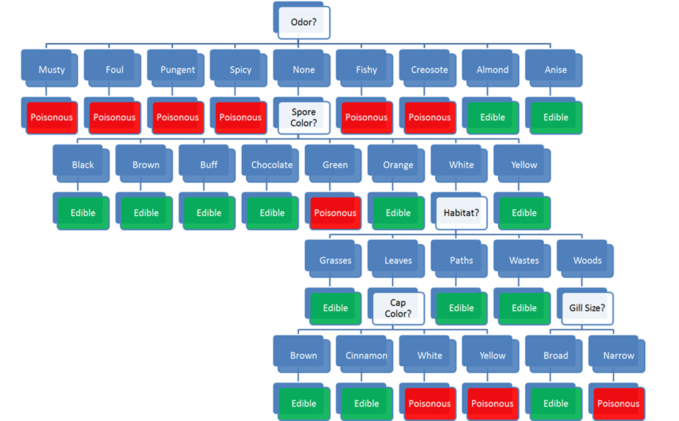
Habitat: woods
Gill Size: narrow
Odor: none
Spores: white
Cap Colour: red
Classification problem: edible or poisonous

Slide 58
Habitat: woods
Gill Size: narrow
Odor: none
Spores: white
Cap Colour: red
Classification problem: edible or poisonous

Slide 59
Habitat: woods
Gill Size: narrow
Odor: none
Spores: white
Cap Colour: red
Classification problem: edible or poisonous

Slide 60
Habitat: woods
Gill Size: narrow
Odor: none
Spores: white
Cap Colour: red
Classification problem: edible or poisonous

Slide 61
Habitat: woods
Gill Size: narrow
Odor: none
Spores: white
Cap Colour: red
Classification problem: edible or poisonous

Slide 62
Habitat: woods
Gill Size: narrow
Odor: none
Spores: white
Cap Colour: red
Classification problem: edible or poisonous

Slide 63
Discussion
Would you have trusted an “edible” prediction?
Where is the model coming from?
What would you need to know to trust the model?
What’s the cost of making a classification mistake, in this case?

Slide 64

What is Data?
It is difficult to give a clear-cut definition of data (is it singular or plural?).
Linguistically, a datum is “a piece of information”; data means “pieces of information,” or a collection of “pieces of information”.
Data represents the whole (greater than the sum of its parts?) or simply the idealized concept.
Is that clear?

Slide 65
What is Data?
Is the following data?
4,529 red 25.782 Y
Why? Why not? What, if anything is missing?
The Stewart approach: “we know it when we see it.”
Pragmatically, we think of data as a collection of facts about objects and their attributes.

Slide 66


Objects and Attributes
Object: apple
  Shape: spherical
  Colour: red
  Function: food
  Location: fridge
  Owner: Jen
Object: sandwich
  Shape: rectangle
  Colour: brown
  Function: food
  Location: office
  Owner: Pat
Remember: an object is not simply the sum of its attributes.

Slide 67
Objects and Attributes
Ambiguities when it comes to measuring (and recording) the attributes:
  apple picture is a 2-dimensional representation of a 3-dimensional object
  overall shape of the sandwich is vaguely rectangular, it is not exact (measurement error?)
  insignificant for most, but not necessarily all, analytical purposes
  apple’s shape = volume, sandwich’s shape = area (incompatible measurements)
  a number of potential attributes are not mentioned: size, weight, time, etc.
  are there other issues?
Measurement errors and incomplete lists are always part of the picture; is this collection of attributes providing a reasonable description of the objects?

Slide 68

[R. Magritte, La trahison des images (ceci n’est pas une pipe)]

Slide 69
From Objects and Attributes to Datasets
Raw data may exist in any format.
A dataset represents a collection of data that could conceivably be fed into algorithms for analytical purposes.
Datasets appear in a table format, with rows and columns; attributes are the fields (or columns, variables); objects are instances (or cases, rows, records).
Objects are described by their feature vector (observation’s signature) – the collection of attributes associated with value(s) of interest.

Slide 70
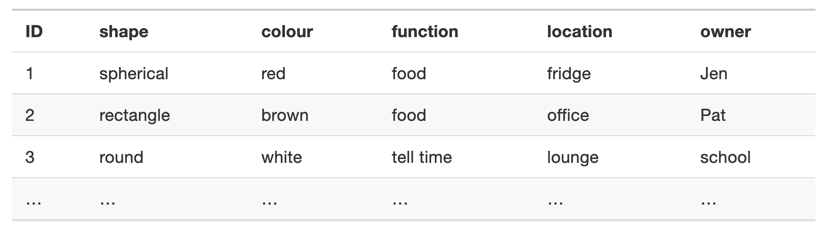
From Objects and Attributes to Datasets
The dataset of physical objects could start with:

Slide 71
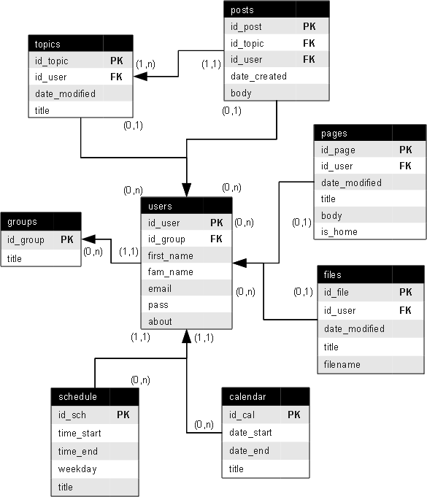
From Objects and Attributes to Data
[Wooptoo, “Entity - relationship model.” Wikimedia]
In practice, more complex databases are used, for a variety of reasons that we briefly discuss at a later stage.
data-action-lab.com

Slide 72



Analytics Modes
Looking Backwards
Descriptive
Diagnostic
b
c
a
Show what happened
Explain why something happened
Easy
Difficult
Predictive
Prescriptive
Guess what will happen
Suggest what should happen
Looking Ahead

Slide 73
GBA+
[https://www.statcan.gc.ca/eng/topics-start/gender_diversity_and_inclusion]
Gender-Based Analysis Plus is an analytical process used to assess how different gendered people may experience policies, programs and initiatives.
Example: Work interruptions and financial vulnerability, D. Messacar, R. Morrissette
  If the data had not been collected and/or analyzed in a GBA+ manner, it would be harder to see how financial vulnerability affects different groups (if the analysis had looked only at age groups and gender, for example, instead of also including family composition).
Policies and events impact real people in real way, and not always in the same manner. Data analysis methods are typically used to predict and/or describe average (or central) outcomes, but it is often those who are far from the centre who are most affected.

Slide 74

Analytics Workflows
You are probably sick of discussions about context and would rather move to data analysis proper.
Very soon. One last thing, then: the project context.
Data science is more than just the analysis of data; this is apparent when we look at the typical steps involved in a data science project.
Data analysis pieces take place within this larger project context, as well as in the context of a larger technical infrastructure or pre-existing system.

Slide 75
The “Analytical” Method
As with the scientific method, there is a “step-by-step” guide to data analysis:
  statement of objective
  data collection
  data clean-up
  data analysis/analytics
  dissemination
  documentation
Notice that data analysis only makes up a small segment of the entire flow.
In practice, the process is quite often messy, with steps added in and taken out of the sequence, repetitions, re-takes, etc.
Surprisingly, it tends to work… when conducted correctly.

Slide 76
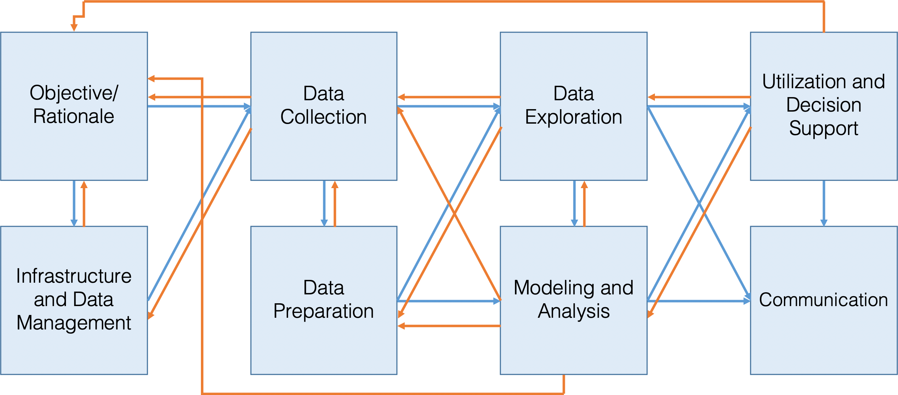
The “Analytical” Methods

Slide 77
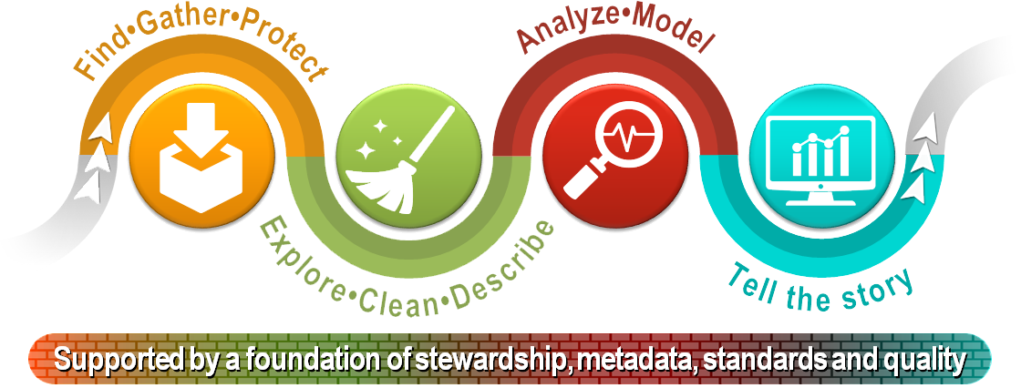
[StatCan, Steps of the Data Journey]

Slide 78
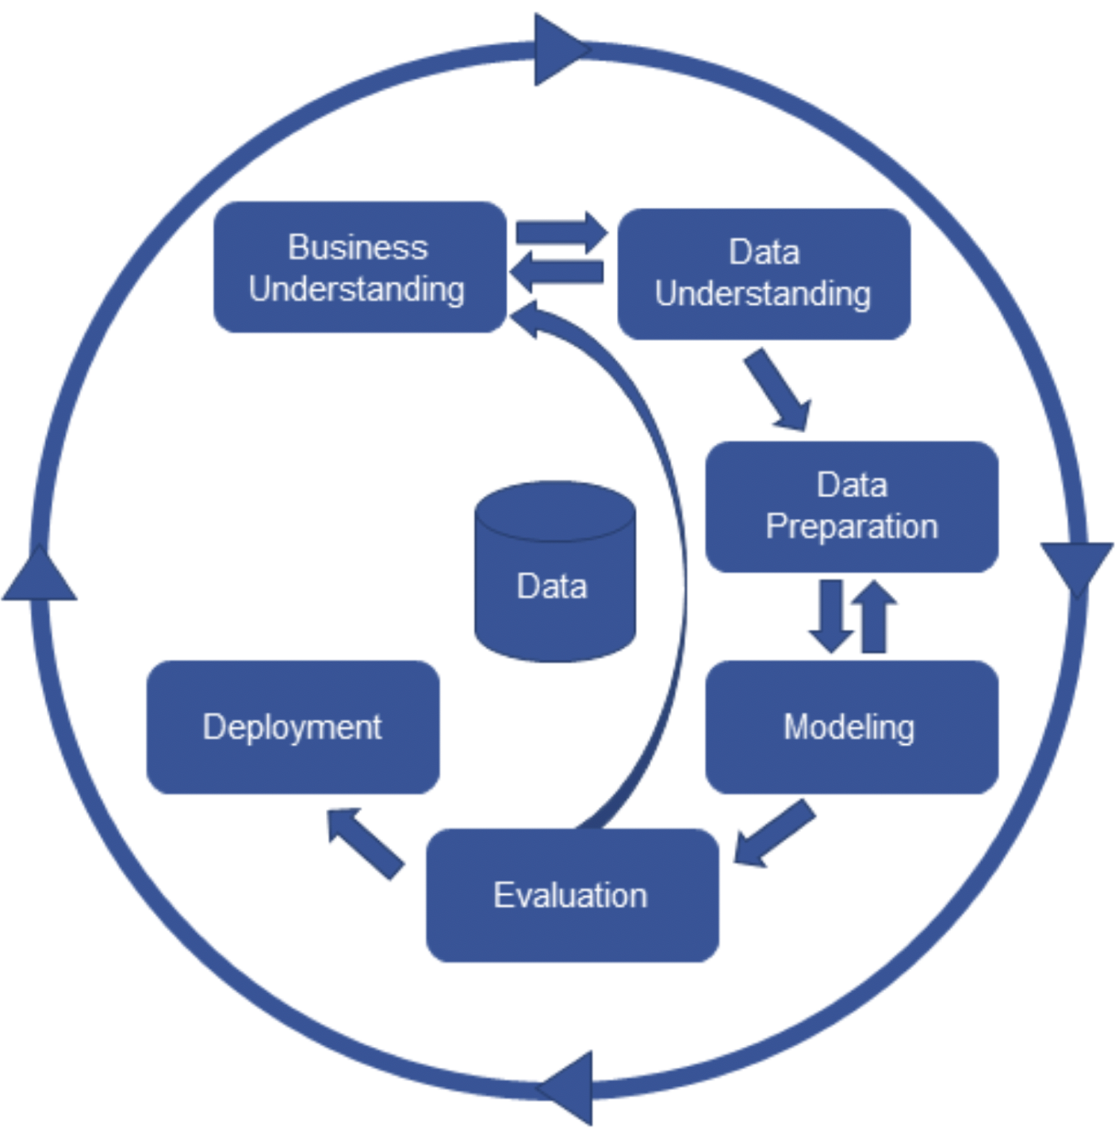
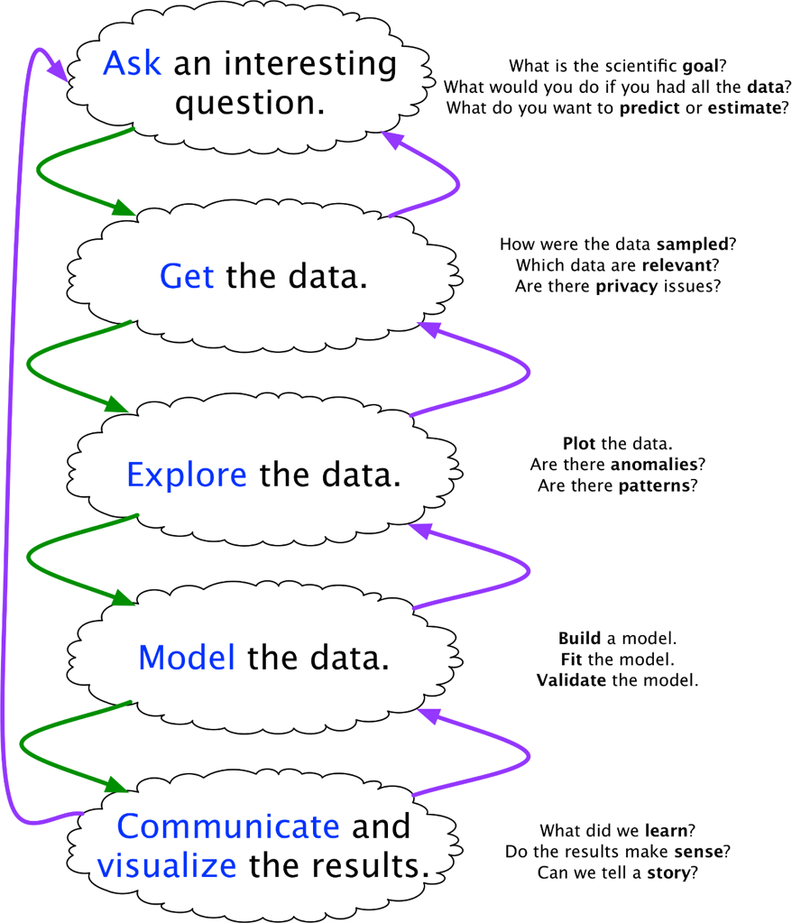
The “Analytical” Methods
[CRISP-DM framework (left); Blitzstein and Pfister’s data science workflow (right)]

Slide 79
The “Analytical” Methods
In practice, data analysis is often corrupted by:
  lack of clarity
  mindless rework
  blind hand-off to IT
  failure to iterate
All approaches have a common core
  data science projects are iterative
  (often) non-sequential.
Helping stakeholders recognize this central truth makes it easier for data scientists to:
  plan the data science process
  obtain actionable insights
Take-away: there is a lot to consider in advance of modeling and analysis
  data analysis is not just about data analysis.

Slide 80

Data Collection
Data enters the data science pipeline by being collected.
There are various ways to do this:
  data may be collected in a single pass;
  it may be collected in batches;
  it may be collected continuously.
The mode of entry may have an impact on the subsequent steps, including how frequently models, metrics, and other outputs are updated.

Slide 81

Data Storage
Once collected, data must be stored.
Choices related to storage (and processing) must reflect:
  how the data is collected (mode of entry);
  how much data there is to store and process (small vs. big);
  the type of access and processing that will be required (how fast, how much, by whom).
Stored data may go stale (figuratively and literally); regular data audits are recommended.

Slide 82

Data Processing
The data must be processed before it can be analyzed.
The key point is that raw data has to be converted into a format that is amenable to analysis, by:
  identifying invalid, unsound, and anomalous entries
  dealing with missing values
  transforming the variables so that they meet the requirements of the selected algorithms
The analysis itself is almost anti-climactic: run the selected methods or algorithms on the processed data.

Slide 83
Modeling
Data science teams should know:
  data cleaning
  descriptive statistics and correlation
  probability and inferential statistics
  regression analysis
  classification and supervised learning
  clustering and unsupervised learning
  anomaly detection and outlier analysis
  big data/high-dimensional data analysis
  stochastic modeling, etc.
These only represent a small slice of the analysis pie (see earlier slide).
No one analyst/data scientist could master all (or even a majority of them) at any moment, but that is one of the reasons why data science is a team activity.

Slide 84

Assessment and Life POST Analysis
Before applying findings, we must first confirm that the model is reaching valid conclusions about the system.
Analytical processes are reductive: raw data is transformed into a small(er) numerical summaries, which we hope is related to the system of interest.
Data science methodologies include an assessment phase, an analytical sanity check: is anything out of alignment?
Beware the tyranny of past success: even if the analytical approach has been vetted and has given useful answers in the past, it may not always do so.

Slide 85
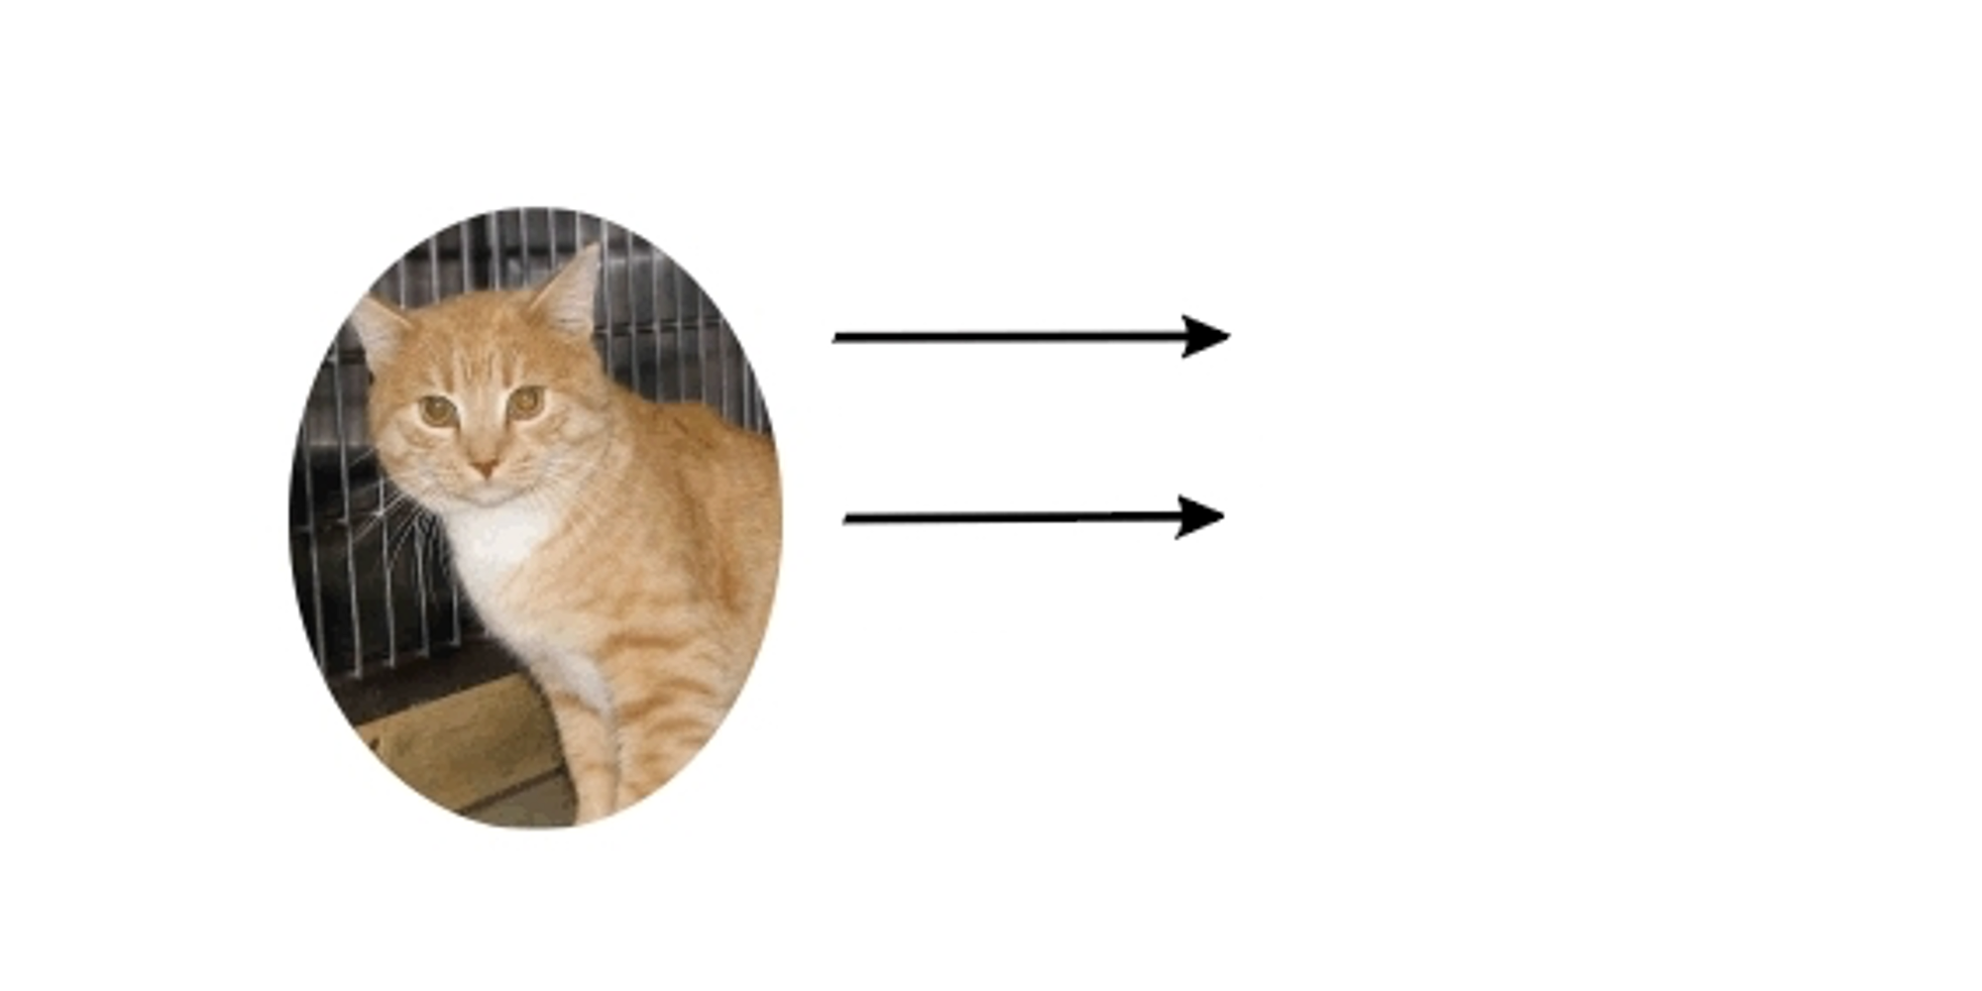

[http://dailycatdrawings.tumblr.com; #309]
Real World
Model
Theory
Identification of details relevant to description and translation of real-world objects into model variables

Slide 86
Model Assessment and Life After Analysis
When an analysis or model is ‘released into the wild’, it often takes on a life of its own. When it inevitably ceases to be current, there may be little that data scientists can do to remedy the situation.
How do we determine if the current data model is:
  out-of-date?
  no longer useful?
  how long does it take a model to react to a conceptual shift?
Regular audits can be used to answer these questions.

Slide 87
Model Assessment and Life After Analysis
Data scientists rarely have full control over model dissemination.
  results may be misappropriated, misunderstood, shelved, or failed to be updated
  can conscientious analysts do anything to prevent this?
There is no easy answer: analysts should not only focus on the analysis, but also recognize opportunities that arises to educate stakeholders on the importance of these auxiliary concepts.
Due to analytic decay, the last step in the analytical process is not a static dead end, but an invitation to re-iterate to the beginning of the process.

Slide 88
Data Pipelines (First Pass)
In the service delivery context, the data analysis process is implemented as an automated data pipeline to enable automatic runs.
Data pipelines usually consist of 9 components (5 stages and 4 transitions):
  data collection
  data storage
  data preparation
  data analysis
  data presentation

Slide 89
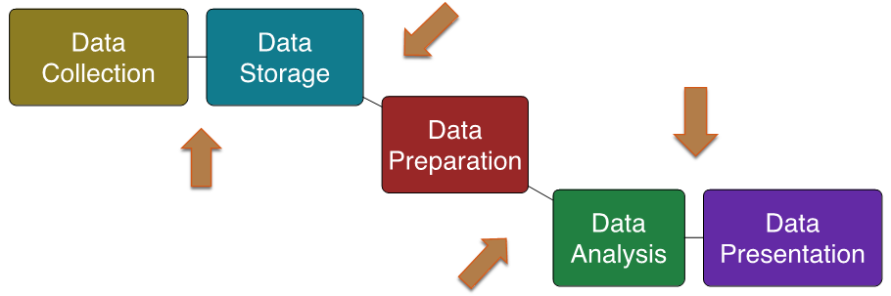
Data Pipelines (First Pass)
Each components must be designed and then implemented.
Typically, at least one data analysis pass process must be done manually before the implementation is complete.

