Slide 1
MODULE 3: Data Analysis and Visual Storytelling
CT Academy | Data Action Lab

Slide 2

8. Data Analytics (Intermediate)
DATA ANALYSIS and VISUAL STORYTELLING
data-action-lab.com

Slide 3
Contingency/Pivot Tables
Contingency table: examines the relationship between two categorical variables via their relative (cross-tabulation).
Pivot table: a table generated by applying operations (sum, count, mean, etc.) to variables, possibly based on another (categorical) variable.
Contingency tables are special cases of pivot tables.
Type | Count | Signal avg | Signal stdev
Blue | 4 | 4.04 | 0.98
Green | 1 | 4.93 | N.A.
Orange | 4 | 5.37 | 1.60
 | Large | Medium | Small
Window | 1 | 32 | 31
Door | 14 | 11 | 0

Slide 4
Analysis Through Visualization
Analysis (broad definition):
  identifying patterns or structure
  adding meaning to these patterns or structure by interpreting them in the context of the system.
Option 1: use analytical methods to achieve this.
Option 2: visualize the data and use the brain’s analytic power (perceptual) to reach meaningful conclusions about these patterns.

Slide 5

Numerical Summaries
In a first pass, a variable can be described along 2 dimensions: centrality & spread (skew and kurtosis are also used).
Centrality measures include:
  median, mean, mode
Spread (or dispersion) measures include:
  standard deviation (sd), variance, quartiles, range, etc.
The median, range and the quartiles are easily calculated from ordered lists.

Slide 6
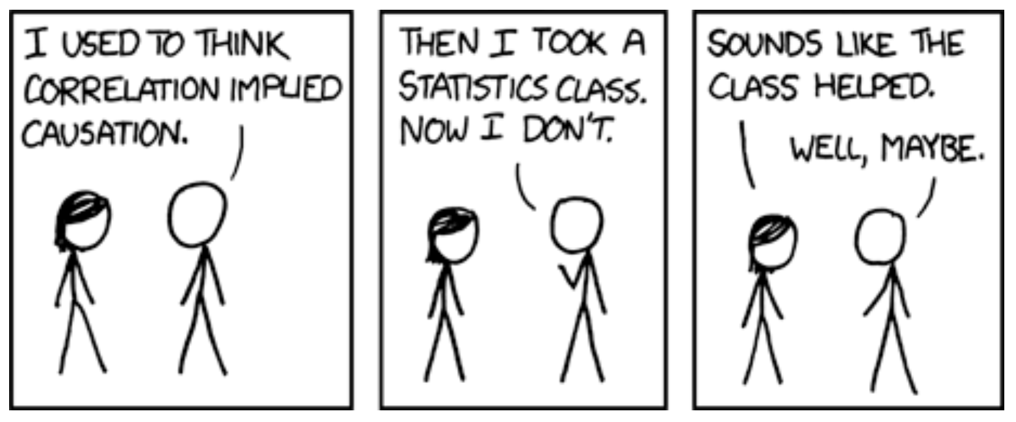
Correlation
[https://xkcd.com/552]
Correlation doesn't imply causation, but it does waggle its eyebrows suggestively and gesture furtively while mouthing 'look over there'.

Slide 7
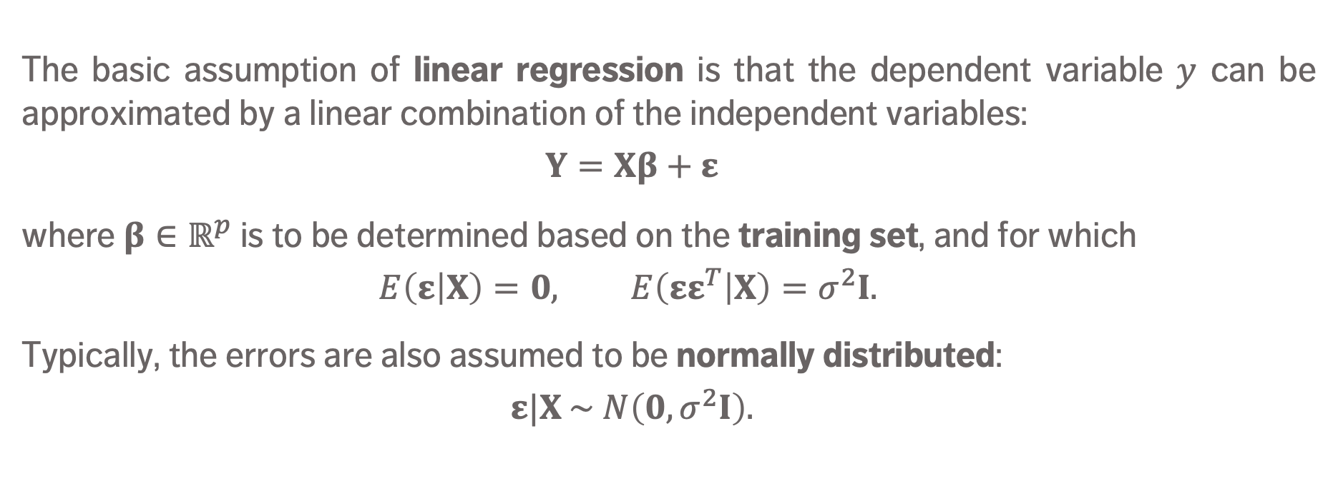
Linear Regression
The basic assumption of linear regression is that the dependent variable $y$ can be approximated by a linear combination of the independent variables:
    $$Y=Xβ+ε$$
where $β∈ℝ^{p}$ is to be determined based on the training set, and for which
    $$E\left(ε | X\right)=0, E\left(εε^{T} | X\right)=σ^{2}I.$$
Typically, the errors are also assumed to be normally distributed:
    $$ε|X \sim N\left(0, σ^{2}I\right).$$

Slide 8
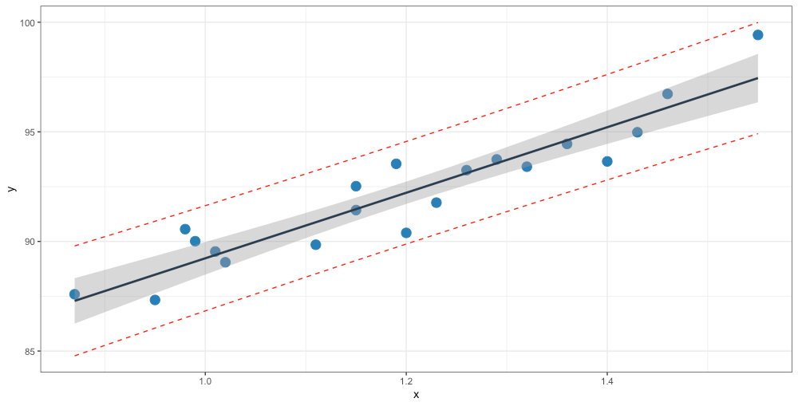
$$\text{oxygen}=14.95 × \text{hydrocarbon}+74.28$$
oxygen
prediction interval for new responses
confidence interval for mean response
hydrocarbon

Slide 9

Machine Learning Tasks
Classification, class probability estima-tion: which clients are likely to be repeat customers?
Clustering: do customers form natural groups?
Association rule discovery: what books are commonly purchased together?
Others: value estimation (how much is a client likely to spend in a restaurant); profiling and behaviour description; link prediction; data reduction; influence/ causal modeling; similarity matching (which prospective clients are similar to a company's best clients?), etc.

Slide 10
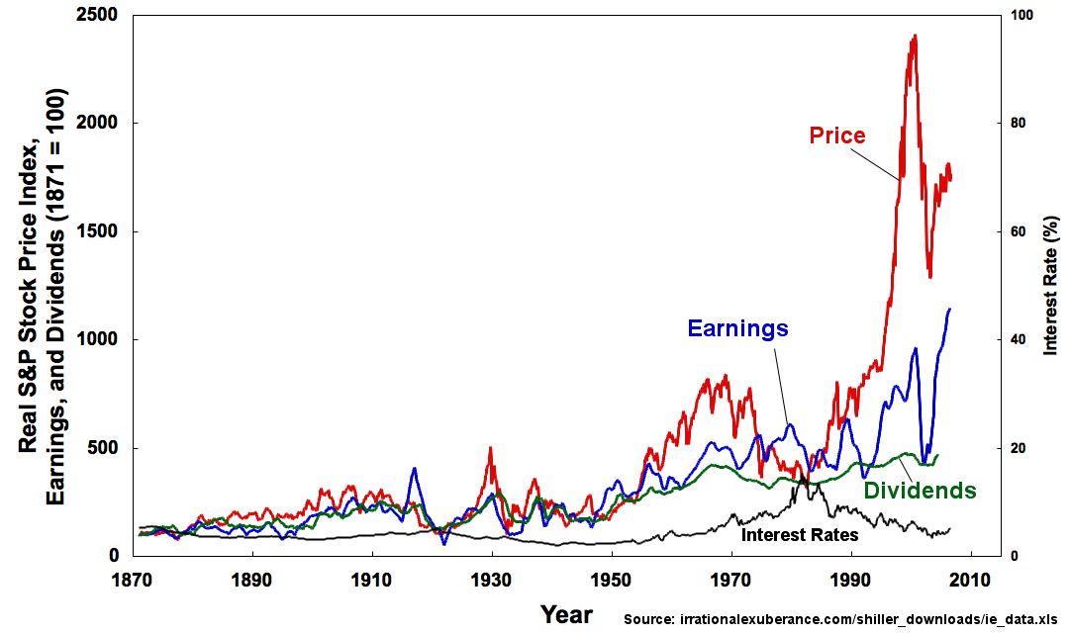
Time Series Analysis
A simple time series:
  has two variables: time + 2nd variable
  the second variable is sequential
What is the pattern of behaviour of this second variable over time? Relative to other variables?
Can we use this to forecast the future behaviour of the variable?

Slide 11

Anomaly Detection
Anomaly: an unexpected, unusual, atypical or statistically unlikely event
Wouldn’t it be nice to have a data analysis pipeline that alerted you when things were out of the ordinary?
Many different analytic approaches to take!
  clustering
  classification
  ensemble techniques, etc.

Slide 12
The Hot Mess
“Data is messy, you know.”
“Even after it’s been cleaned?”
“Especially after it’s been cleaned.”
Data cleaning, processing, wrangling are essential aspects of data science projects; analysts may spend up to 80% of their time on data preparation.

Slide 13
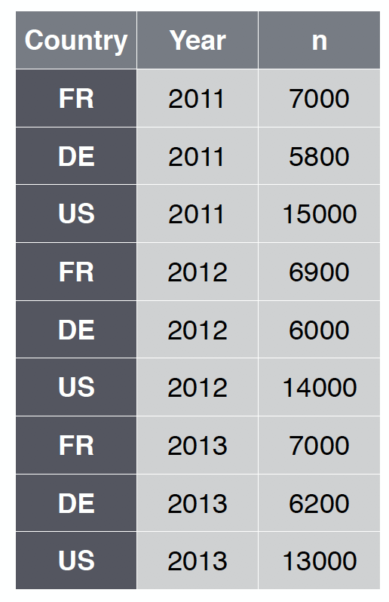
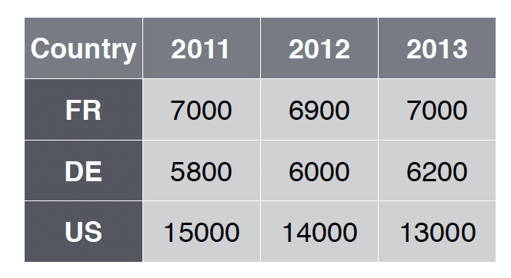
Data Wrangling and Tidy Data
Tidy data has a specific structure:
  each variable is in a single column
  each observation is in a single row
  each type of observational unit is in a single table
vs.

Slide 14
Data Wrangling Functionality
Data wrangling functions should allow the analyst to:
  extract a subset of variables from the data frame
  extract a subset of observations from the data frame
  sort the data frame along any combination of variables in increasing or decreasing order
  to create new variables from existing variables
  to create (so-called) pivot tables, by observation groups
  database functionality (joins, etc.)
  etc.

Slide 15

Approaches to Data Cleaning
There are 2 philosophical approaches to data cleaning and validation:
  methodical
  narrative
The methodical approach consists of running through a check list of potential issues and flagging those that apply to the data.
The narrative approach consists of exploring the dataset and trying to spot unlikely and irregular patterns.

Slide 16
Approaches to Data Cleaning
Methodical (syntax)
  Pros: checklist is context-independent; pipelines easy to implement; common errors and invalid observations easily identified
  Cons: may prove time-consuming; cannot identify new types of errors
Narrative (semantics)
  Pros: process may simultaneously yield data understanding; false starts are (at most) as costly as switching to mechanical approach
  Cons: may miss important sources of errors and invalid observations for datasets with high number of features; domain knowledge may bias the process by neglecting uninteresting areas of the dataset

Slide 17
Data Soundness
The ideal dataset will have as few issues as possible with:
  validity: data type, range, mandatory response, uniqueness, value, regular expressions
  completeness: missing observations
  accuracy and precision: related to measurement and data entry errors; target diagrams (accuracy as bias, precision as standard error)
  consistency: conflicting observations
  uniformity: are units used uniformly throughout?
Checking for data quality issues at an early stage can save headaches later in the analysis.

Slide 18
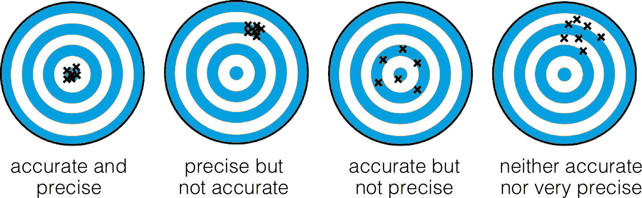
Data Soundness

Slide 19

Common Error Sources
When dealing with legacy, inherited or combined datasets (i.e., datasets over which there is no collection and initial processing control):
  missing data given a code
  ‘NA’/‘blank’ given a code
  data entry error
  coding error
  measurement error
  duplicate entries
  heaping

Slide 20
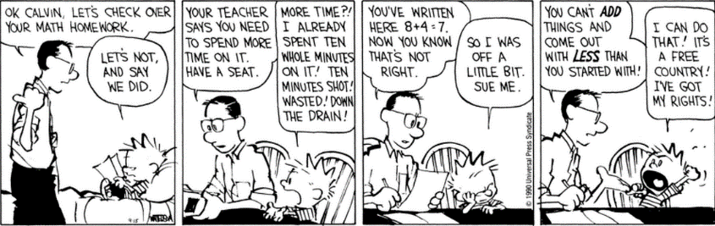
[Bill Watterson, Calvin and Hobbes, 15 Sep. 1990]

Slide 21
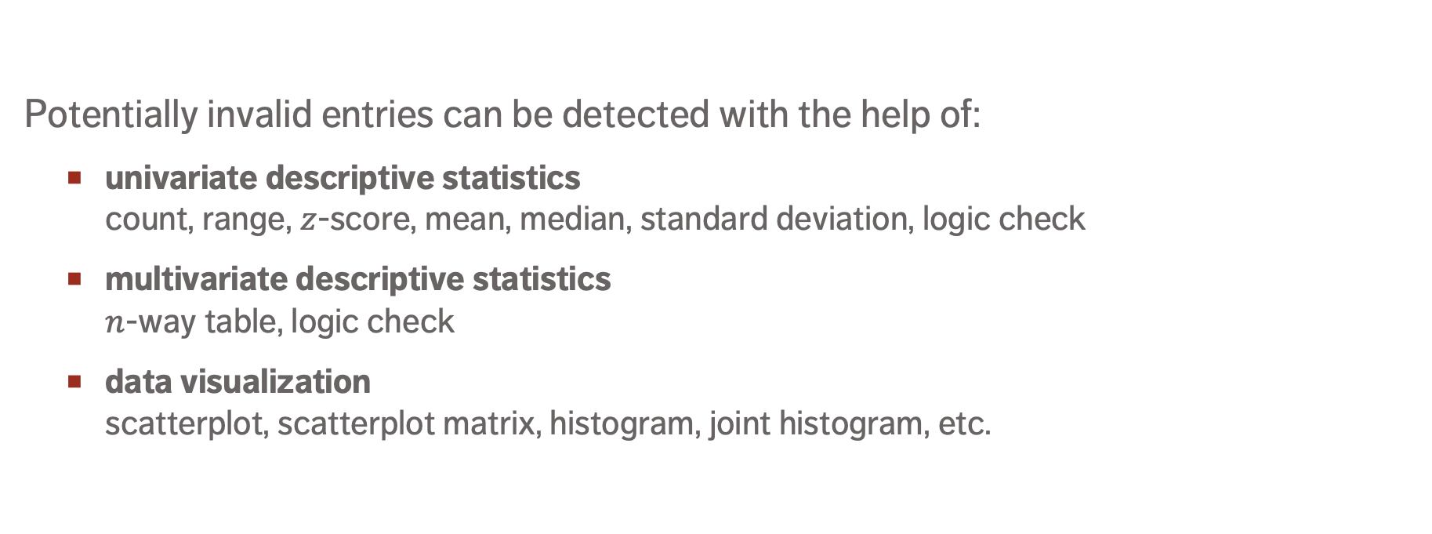
Detecting Invalid Entries
Potentially invalid entries can be detected with the help of:
  univariate descriptive statistics
  count, range, $z$-score, mean, median, standard deviation, logic check
  multivariate descriptive statistics
  $n$-way table, logic check
  data visualization
  scatterplot, scatterplot matrix, histogram, joint histogram, etc.

Slide 22


Detecting Invalid Entries
Univariate tests do not always tell the whole story.
This step might allow for the identification of potential outliers.
Failure to detect invalid entries $≠$ all entries are valid.
Small numbers of invalid entries recoded as “missing.”

Slide 23
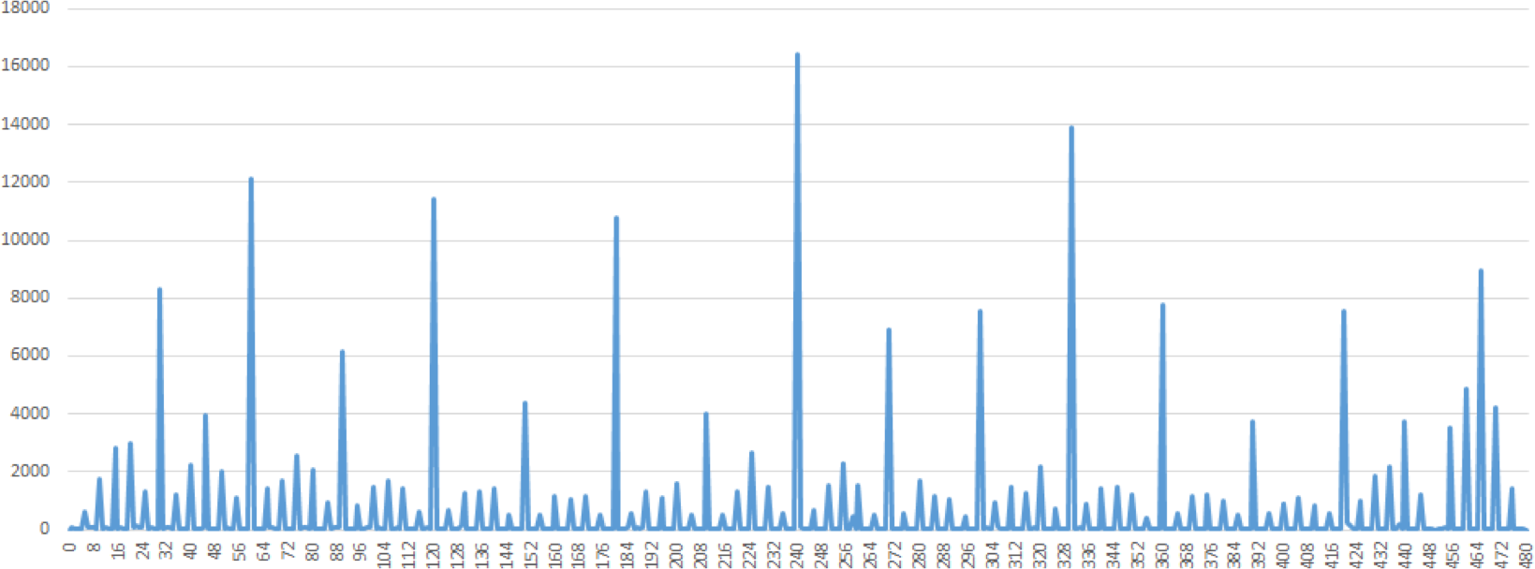
Detecting Invalid Entries

Slide 24
Detecting Invalid Entries
Time of arrivals at screening station, prior to departure (mins)

Slide 25
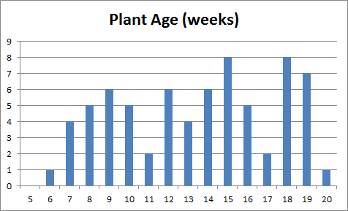
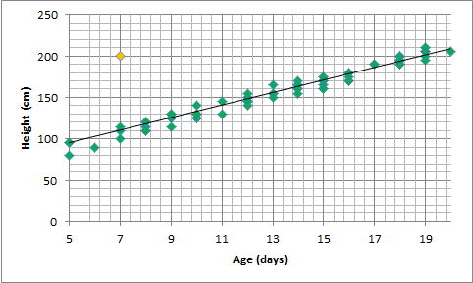
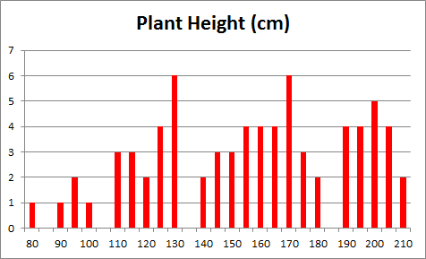
Detecting Invalid Entries
(days)
vs.

Slide 26
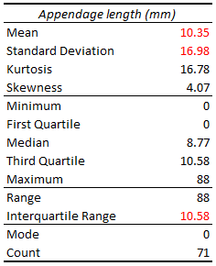
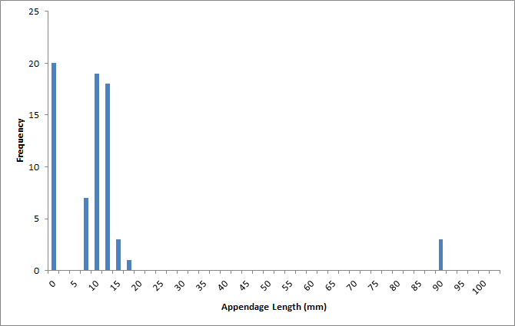
Detecting Invalid Entries

Slide 27
Types of Missing Observations
Blank fields come in 4 flavours:
  nonresponse
  an observation was expected but none had been entered
  data entry issue
  an observation was recorded but was not entered in the dataset
  invalid entry
  an observation was recorded but was considered invalid and has been removed
  expected blank
  a field has been left blank, but expectedly so

Slide 28
Types of Missing Observations
Too many missing values (of the first three type) can be indicative of issues with the data collection process (more on this later).
Too many missing values (of the fourth type) can be indicative of poor questionnaire design.
Finding missing values can help you deal with other data science problems.

Slide 29
The Case for Imputation
Not all analytical methods can easily accommodate missing observations:
  discard the missing observation
    not recommended, unless the data is MCAR in the dataset as a whole
    acceptable in certain situations (e.g., small number of missing values in a large dataset)
  come up with a replacement (imputation) value
    main drawback: we never know what the true value would have been
    often the best available option
data-action-lab.com

Slide 30
Missing Values Mechanism
Missing Completely at Random (MCAR)
  item absence is independent of its value or of auxiliary variables
  example: an electrical surge randomly deletes an observation in the dataset
Missing at Random (MAR)
  item absence is not completely random; can be accounted by auxiliary variables with complete info
  example: if women are less likely to tell you their age than men for societal reasons, but not because of the age values themselves)

Slide 31
Missing Values Mechanism
Not Missing at Random (NMAR)
  reason for nonresponse is related to item value (also called non-ignorable non-response)
  example: if illicit drug users are less likely to admit to drug use than teetotallers
In general, the missing mechanism cannot be determined with any certainty; we may need to make assumptions (domain expertise can help).

Slide 32


Imputation Methods
  list-wise deletion
  mean or most frequent imputation
  regression or correlation imputation
  stochastic regression imputation
  last observation carried forward
  next observation carried backward
  $k$-nearest neighbours imputation
  multiple imputation
  etc.

Slide 33
Imputation Methods
List-wise deletion: remove units with at least one missing values
  assumption: MCAR
  cons: can introduce bias (if not MCAR), reduction in sample size, increase in standard error
Mean/most frequent imputation: substitute missing values by average/most frequent value
  assumption: MCAR
  cons: distortions of distribution (spike at mean) and relationships among variables

Slide 34
Imputation Methods
Regression/correlation imputation: substitute missing values using fitted values based on other variables with complete information
  assumption: MAR
  cons: artificial reduction in variability, over-estimation of correlation
Stochastic regression imputation: regression/correlation imputation with a random error term added
  assumption: MAR
  cons: increased risk of type I error (false positives) due to small std error

Slide 35
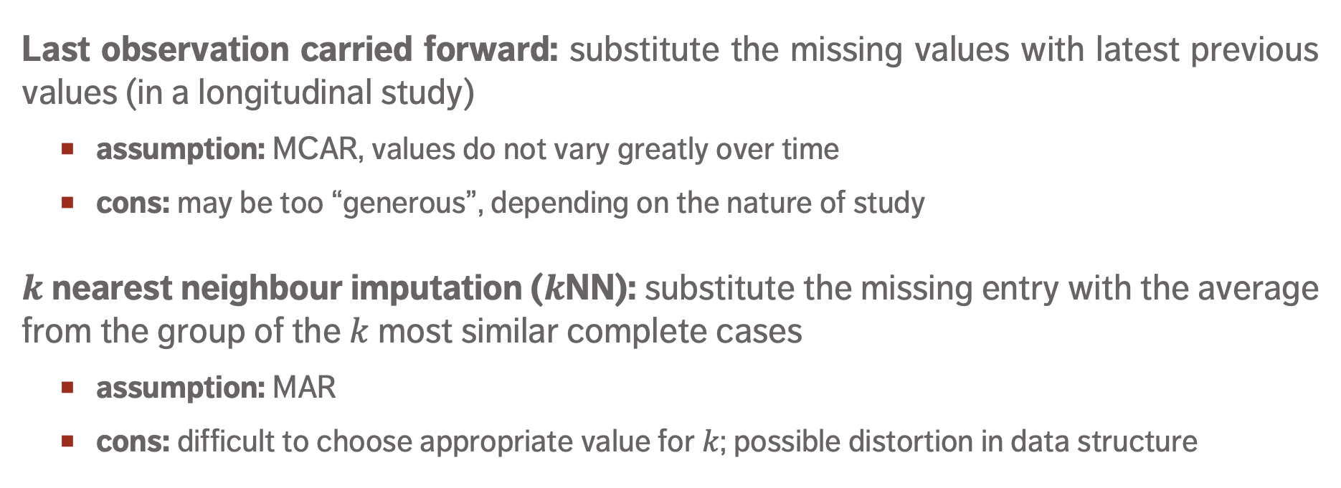
Imputation Methods
Last observation carried forward: substitute the missing values with latest previous values (in a longitudinal study)
  assumption: MCAR, values do not vary greatly over time
  cons: may be too “generous”, depending on the nature of study
$k$nearest neighbour imputation ($k$NN): substitute the missing entry with the average from the group of the $k$ most similar complete cases
  assumption: MAR
  cons: difficult to choose appropriate value for $k$; possible distortion in data structure

Slide 36
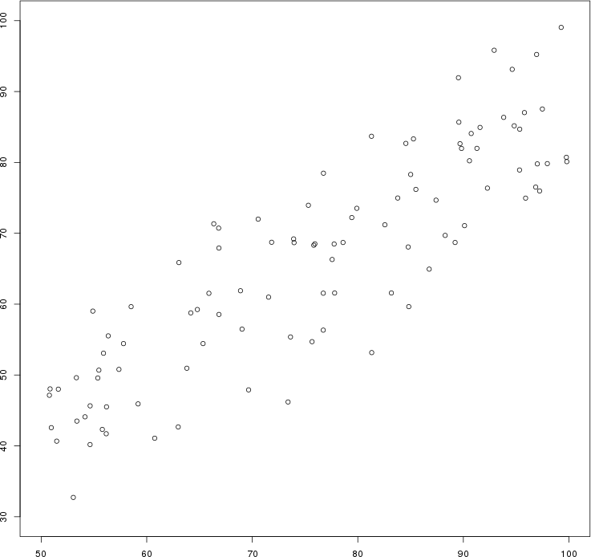
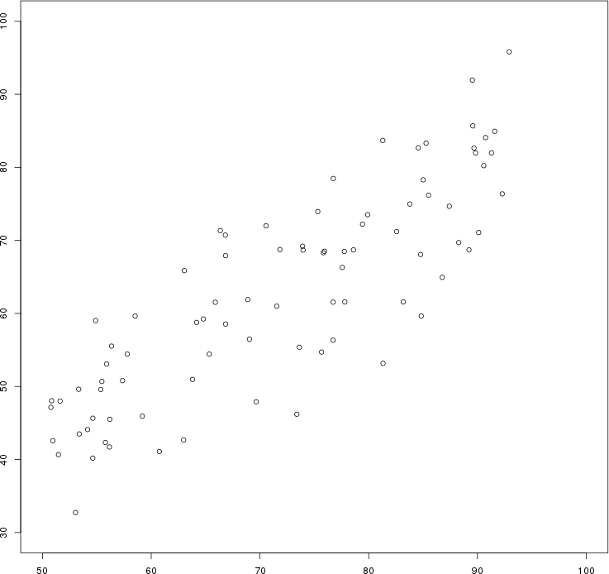
Artificial data: the $y$ values of all points for which $x>92$ have been erased by mistake.
Original data
List-wise deletion

Slide 37
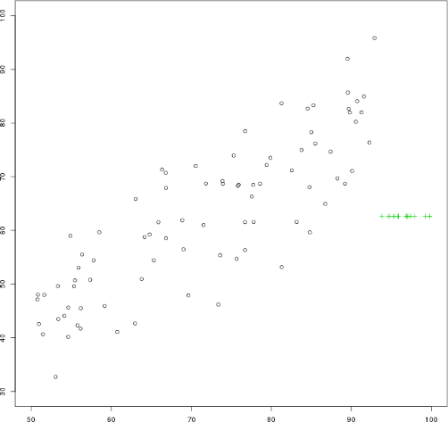
Artificial data: the $y$ values of all points for which $x>92$ have been erased by mistake.
Original data
Mean imputation

Slide 38
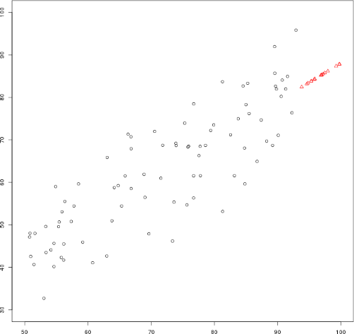
Artificial data: the $y$ values of all points for which $x>92$ have been erased by mistake.
Original data
Regression imputation

Slide 39
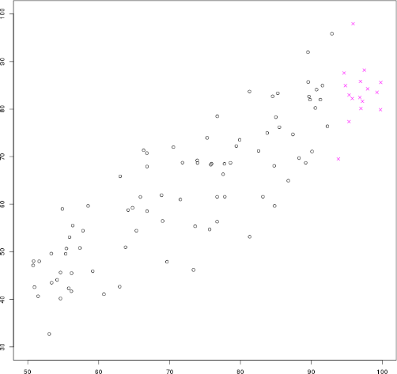
Artificial data: the $y$ values of all points for which $x>92$ have been erased by mistake.
Original data
Stochastic regression imputation

Slide 40
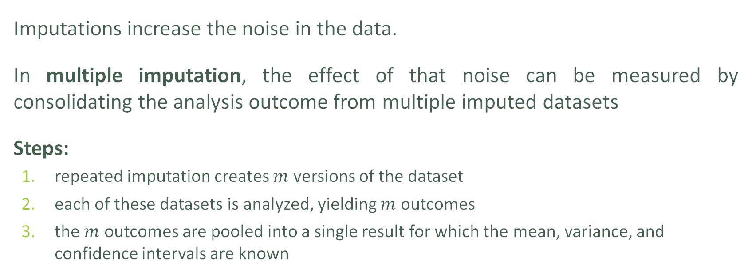
Multiple Imputation
Imputations increase the noise in the data.
In multiple imputation, the effect of that noise can be measured by consolidating the analysis outcome from multiple imputed datasets
Steps:
  repeated imputation creates $m$ versions of the dataset
  each of these datasets is analyzed, yielding $m$ outcomes
  the $m$ outcomes are pooled into a single result for which the mean, variance, and confidence intervals are known

Slide 41
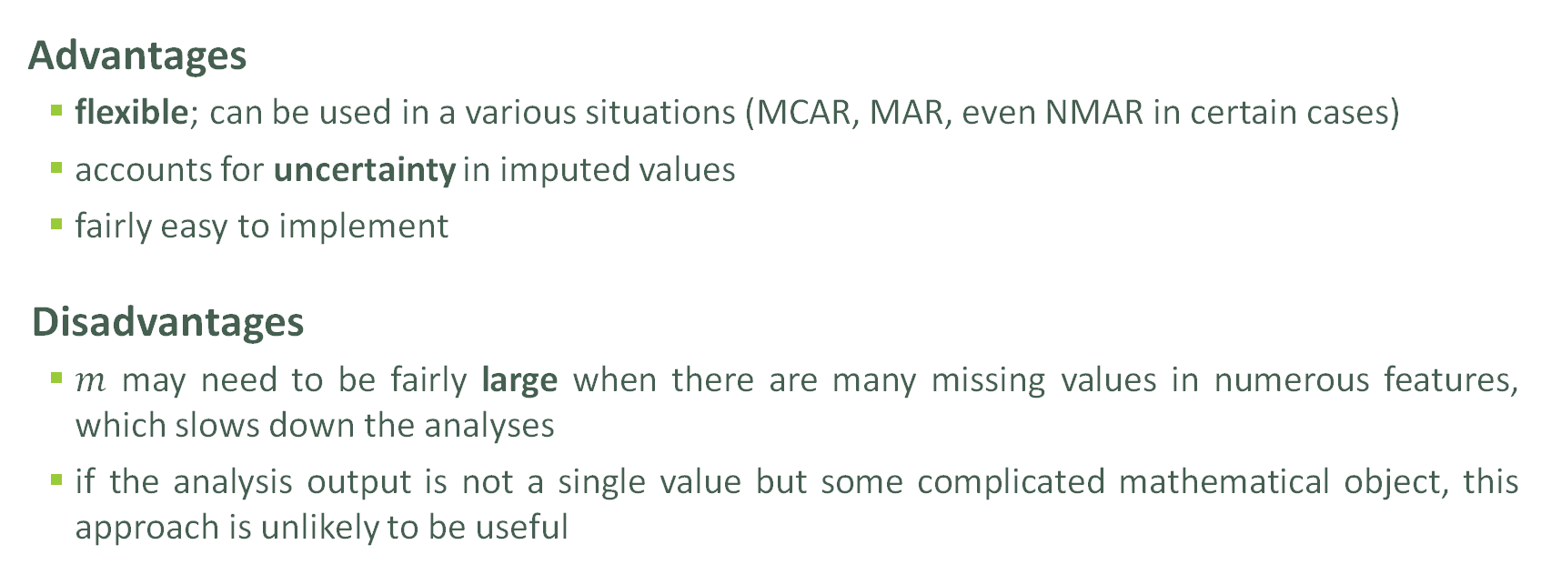
Multiple Imputation
Advantages
  flexible; can be used in a various situations (MCAR, MAR, even NMAR in certain cases)
  accounts for uncertainty in imputed values
  fairly easy to implement
Disadvantages
  $m$ may need to be fairly large when there are many missing values in numerous features, which slows down the analyses
  if the analysis output is not a single value but some complicated mathematical object, this approach is unlikely to be useful

Slide 42
Take-Aways
Missing values cannot simply be ignored.
The missing mechanism cannot typically be determined with any certainty.
Imputation methods work best when values are MCAR or MAR, but imputation methods tend to produce biased estimates.
In single imputation, imputed data is treated as the actual data; multiple imputation can help reduce the noise.
Is stochastic imputation best? In our example, yes – but … No-Free Lunch theorem!

Slide 43
Anomalous Observations
In practice, an anomalous observation may arise as
  a “bad” object/measurement: data artifacts, spelling mistakes, poorly imputed values, etc.
  a misclassified observation: according to the existing data patterns, the observation should have been labeled differently;
  an observation whose measurements are found in the distribution tails of a large enough number of features;
  an unknown unknown: a completely new type of observations whose existence was heretofore unsuspected.

Slide 44
Anomalous Observations
Observations could be anomalous in one context, but not in another:
  a 6-foot tall adult male is in the 86th percentile for Canadian males (tall, but not unusual);
  in Bolivia, the same man would be in the 99.9th percentile (very tall and unusual).
Anomaly detection points towards interesting questions for analysts and SMEs: in this case, why is there such a large discrepancy in the two populations?
data-action-lab.com

Slide 45
Outliers
Outlying observations are data points which are atypical in comparison to
  the unit's remaining features (within-unit),
  the field measurements for other units (between-units)
Outliers are observations which are dissimilar to other cases or which contradict known dependencies or rules.
Careful study is needed to determine whether outliers should be retained or removed from the dataset.

Slide 46
Detecting Anomalies
Outliers may be anomalous along any of the unit’s variables, or in combination.
Anomalies are by definition infrequent, and typically shrouded in uncertainty due to small sample sizes.
Differentiating anomalies from noise or data entry errors is hard.
Boundaries between normal and deviating units may be fuzzy.
Anomalies associated with malicious activities are typically disguised.

Slide 47
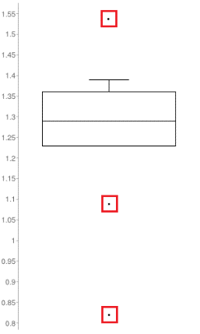
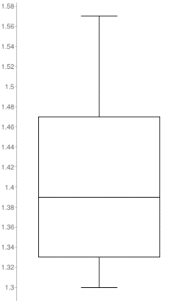
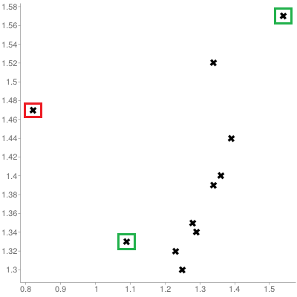
Visual Outlier Detection
Queuing dataset:
processing rate vs. arrival rate

Slide 48
Detecting Anomalies
Numerous methods exist to identify anomalous observations; none of them are foolproof and judgement must be used.
Graphical methods are easy to implement and interpret:
  outlying observations
  box-plots, scatterplots, scatterplot matrices, 2D tour, Cooke's distance, normal qq plots
  influential data
  some level of analysis must be performed (leverage)
Careful: once anomalous observations have been removed from the dataset, previously “regular" units may become anomalous.
DATA SCIENCE ESSENTIALS

Slide 49
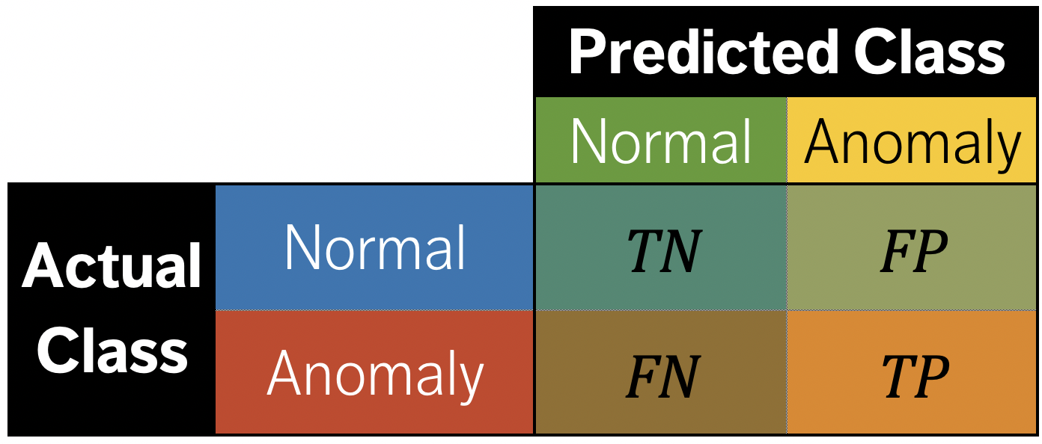
Anomaly Detection Algorithms
Supervised methods use a historical
record of labeled anomalous observations:
  domain expertise is required to tag the data
  classification or regression task
  rare occurrence problem
Unsupervised methods don’t use external information:
  traditional methods and tests
  can also be seen as a clustering or association rules problem

Slide 50
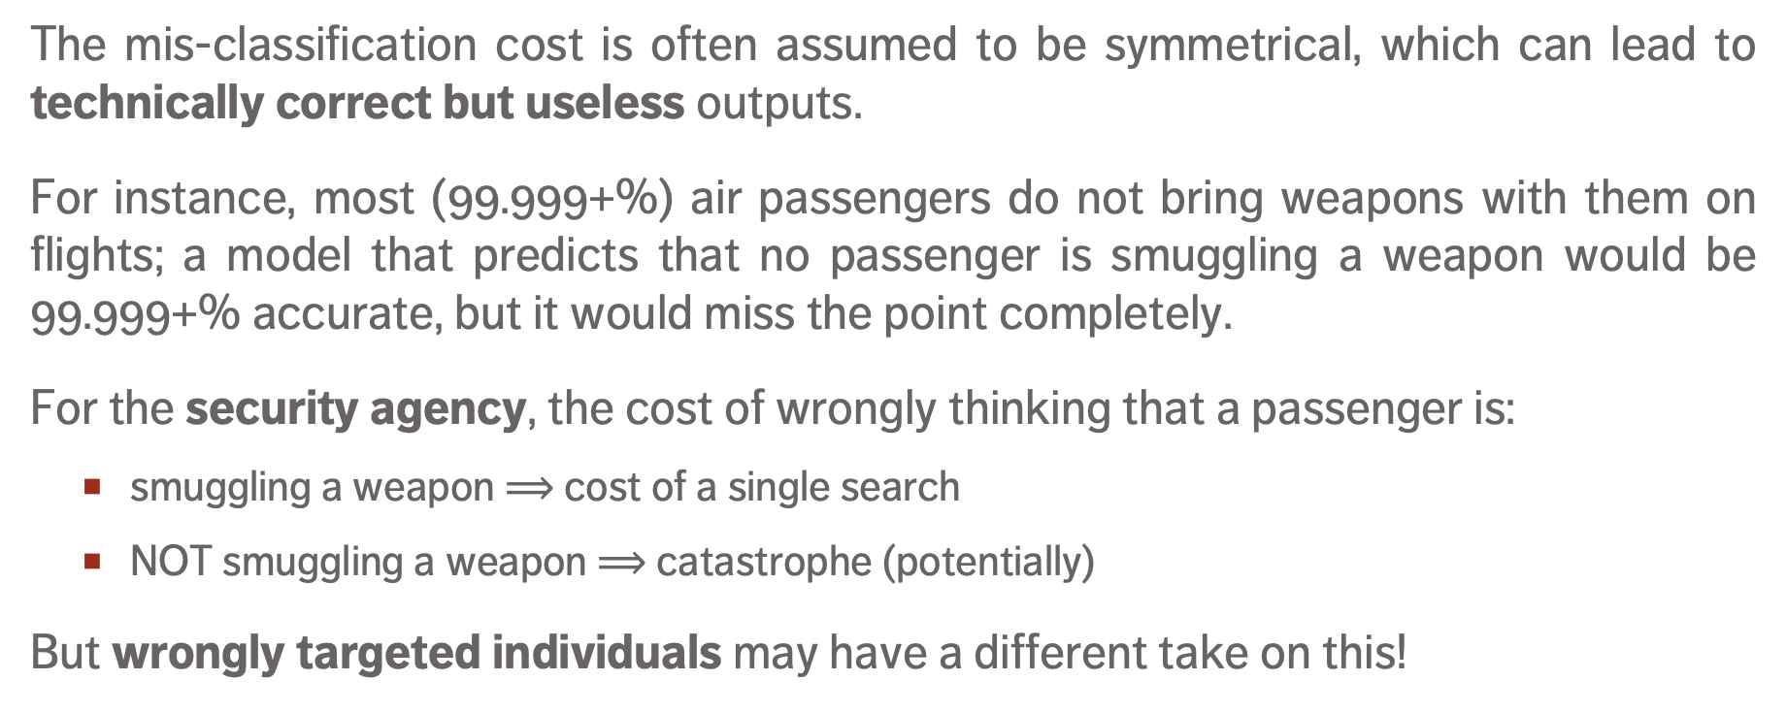
Anomaly Detection Algorithms
The mis-classification cost is often assumed to be symmetrical, which can lead to technically correct but useless outputs.
For instance, most (99.999+%) air passengers do not bring weapons with them on flights; a model that predicts that no passenger is smuggling a weapon would be 99.999+% accurate, but it would miss the point completely.
For the security agency, the cost of wrongly thinking that a passenger is:
  smuggling a weapon $⟹$ cost of a single search
  NOT smuggling a weapon $⟹$catastrophe (potentially)
But wrongly targeted individuals may have a different take on this!

Slide 51

Anomaly Detection Algorithms
If all participants in a workshop except for one can view the video conference lectures, then the one individual/internet connection/computer is anomalous – it behaves in a manner which is different from the others.
But this DOES NOT MEAN that the different behaviour is necessarily the one we are interested in…

Slide 52
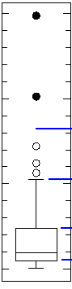
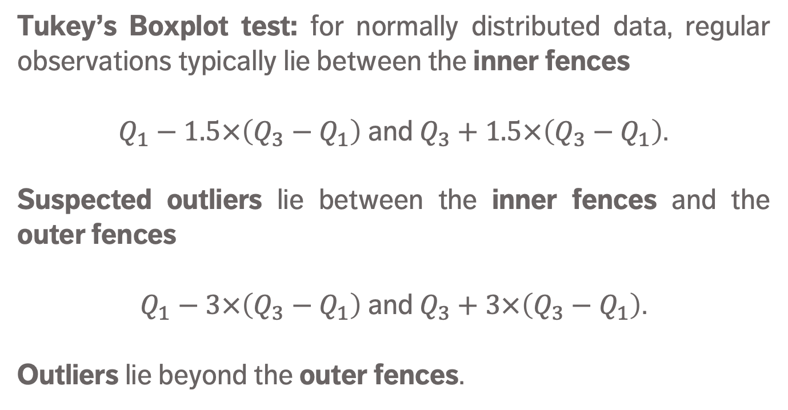
Simple Outlier Tests
Tukey’s Boxplot test: for normally distributed data, regular observations typically lie between the inner fences
$Q_{1}−1.5×\left(Q_{3}−Q_{1}\right)$ and $Q_{3}+1.5×\left(Q_{3}−Q_{1}\right)$.
Suspected outliers lie between the inner fences and the outer fences
$Q_{1}−3×\left(Q_{3}−Q_{1}\right)$ and $Q_{3}+3×\left(Q_{3}−Q_{1}\right)$.
Outliers lie beyond the outer fences.
outliers
outer fence
suspected
outliers
inner fence
regular
points

Slide 53
Simple Outlier Tests
The Dixon Q Test is used in experimental sciences to find outliers in (extremely) small datasets (dubious validity).
The Mahalanobis Distance (linked to the leverage) can be used to find multi-dimensional outliers (when relationships are linear).
Other simple tests:
  Grubbs (univariate)
  Tietjen-Moore (for a specific # of outliers)
  generalized extreme studentized deviate (for unknown # of outliers)
  chi-square (outliers affecting goodness-of-fit)

Slide 54
Influential Observations
Influential data points are observations whose absence leads to markedly different analysis results.
When influential observations are identified, remedial measures (such as data transformations) may be required to minimize their undue effects.
Outliers may be influential data points; influential data points need not be outliers (and vice-versa).

Slide 55
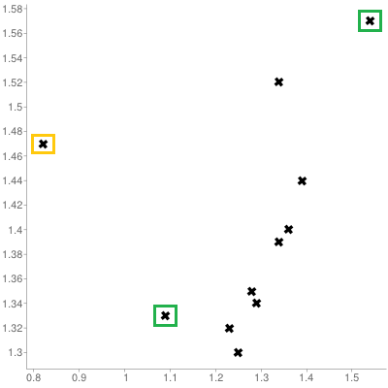
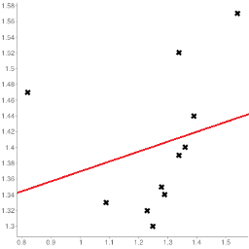
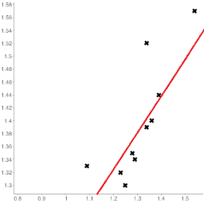
Influential Observations
Queuing dataset:
processing rate vs. arrival rate

Slide 56
Anomaly Detection Remarks
Identifying influential points is an iterative process as the various analyses have to be run numerous times.
Fully automated identification and removal of anomalous observations is NOT recommended.
Use data transformations if the data is NOT normally distributed.
Whether an observation is an outlier or not depends on various factors; what observations end up being influential data points depends on the specific analysis to be performed.

Slide 57
Dimensionality of Data
In data analysis, the dimension of the data is the number of attributes that are collected in a dataset, represented by the number of columns.
We can think of the number of variables used to describe each object (row) as a vector describing that object: the dimension is simply the size of that vector.
(Note: “dimension” is used differently in business intelligence contexts)

Slide 58
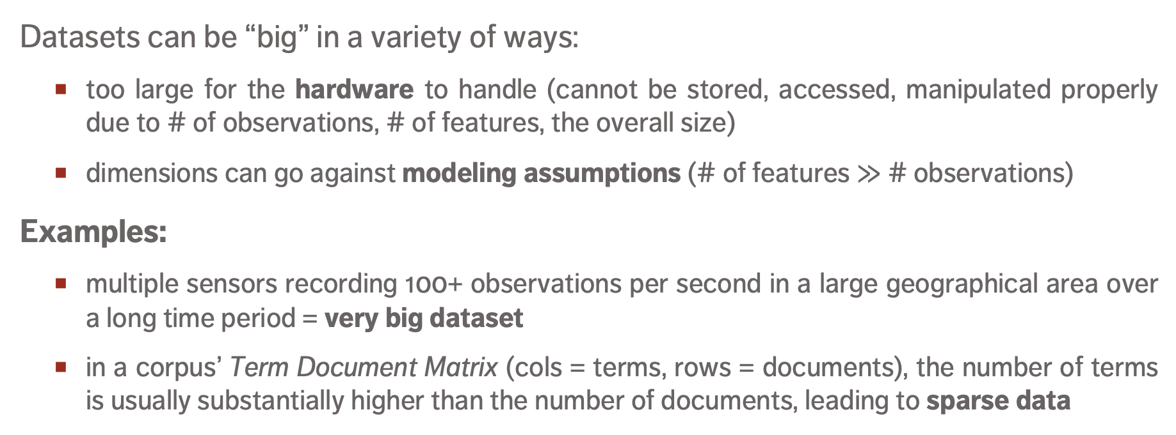
High Dimensionality and Big Data
Datasets can be “big” in a variety of ways:
  too large for the hardware to handle (cannot be stored, accessed, manipulated properly due to # of observations, # of features, the overall size)
  dimensions can go against modeling assumptions (# of features $≫$ # observations)
Examples:
  multiple sensors recording 100+ observations per second in a large geographical area over a long time period = very big dataset
  in a corpus’ Term Document Matrix (cols = terms, rows = documents), the number of terms is usually substantially higher than the number of documents, leading to sparse data

Slide 59
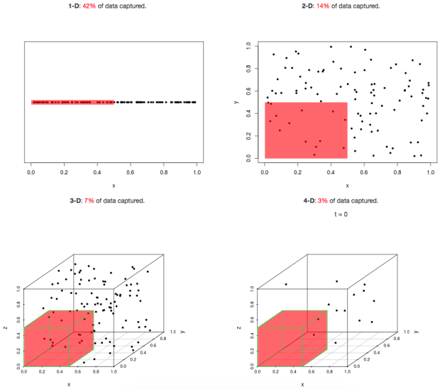
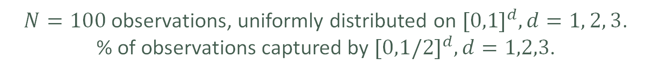
Curse of Dimensionality
[http://simplystatistics.org]
42% of data is captured
14% of data is captured
7% of data is captured
$N=100$observations, uniformly distributed on ${[0,1]}^{d}, d=1, 2, 3$.
% of observations captured by ${[0,1/2]}^{d},d=1,2,3$.

Slide 60
Sampling Observations
Question: does every row of the dataset need to be used?
If rows are selected randomly (with or without replacement), the resulting sample might be representative of the entire dataset.
Drawbacks:
  if the signal of interest is rare, sampling might drown it altogether
  if aggregation is happening down the road, sampling will necessarily affect the numbers (passengers vs. flights)
  even simple operations on a large file (finding the # of lines, say) can be taxing on the memory – prior information on the dataset structure can help

Slide 61
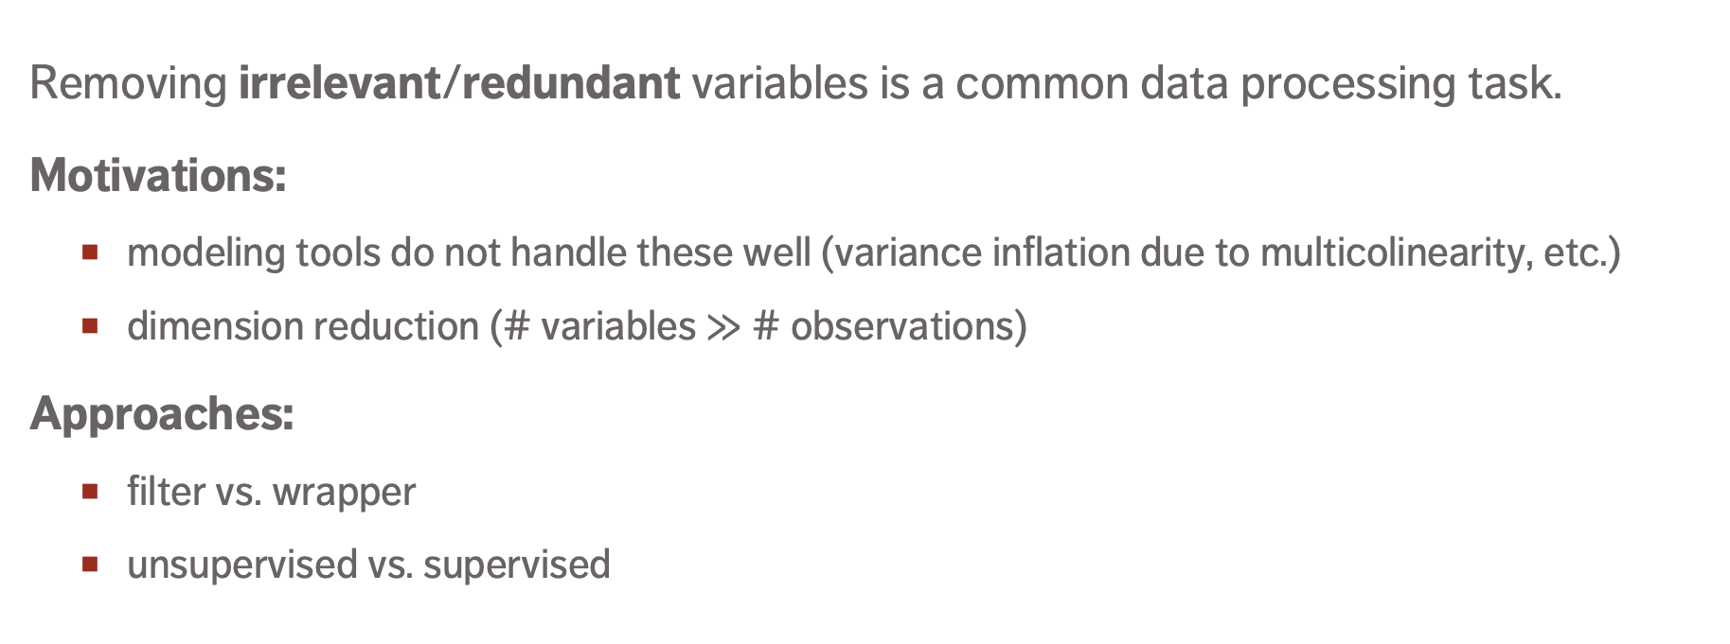
Feature Selection
Removing irrelevant/redundant variables is a common data processing task.
Motivations:
  modeling tools do not handle these well (variance inflation due to multicolinearity, etc.)
  dimension reduction (# variables $≫$ # observations)
Approaches:
  filter vs. wrapper
  unsupervised vs. supervised

Slide 62
Common Transformations
Models sometimes require that certain data assumptions be met (normality of residuals, linearity, etc.).
If the raw data does not meet the requirements, we can either:
  abandon the model
  attempt to transform the data
The second approach requires an inverse transformation to be able to draw conclusions about the original data.

Slide 63
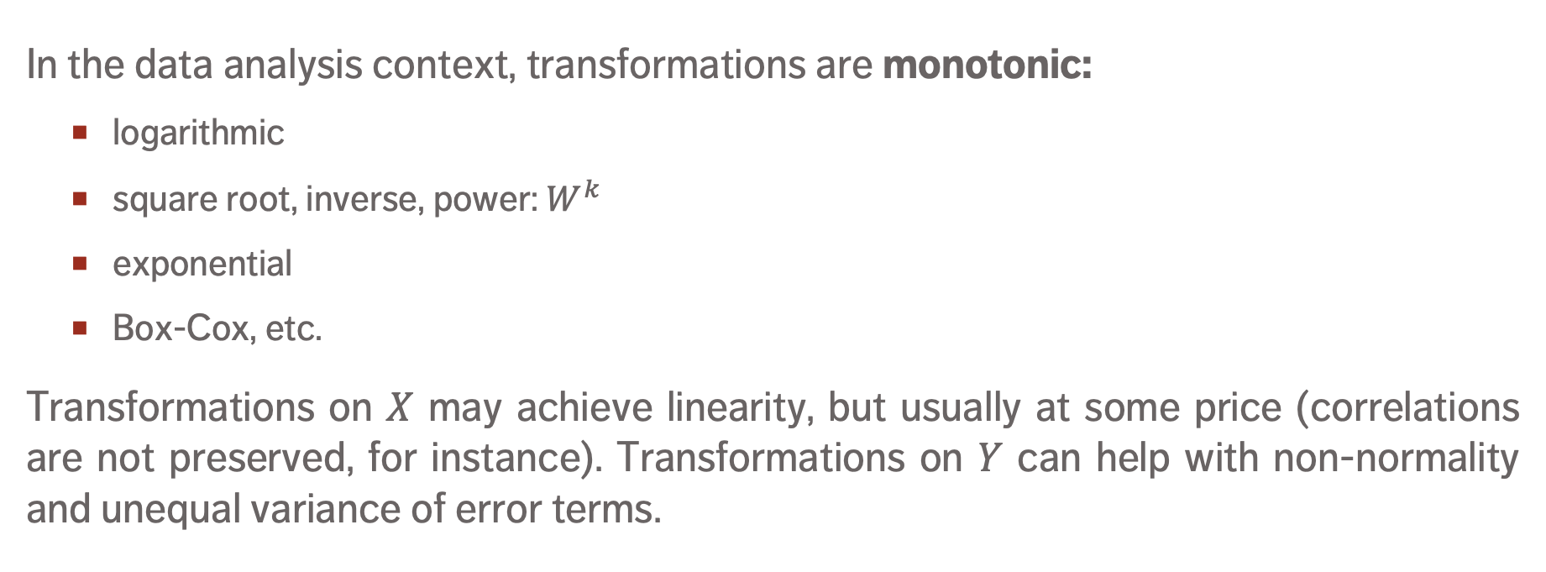
Common Transformations
In the data analysis context, transformations are monotonic:
  logarithmic
  square root, inverse, power: $W^{k}$
  exponential
  Box-Cox, etc.
Transformations on $X$ may achieve linearity, but usually at some price (correlations are not preserved, for instance). Transformations on $Y$ can help with non-normality and unequal variance of error terms.

Slide 64
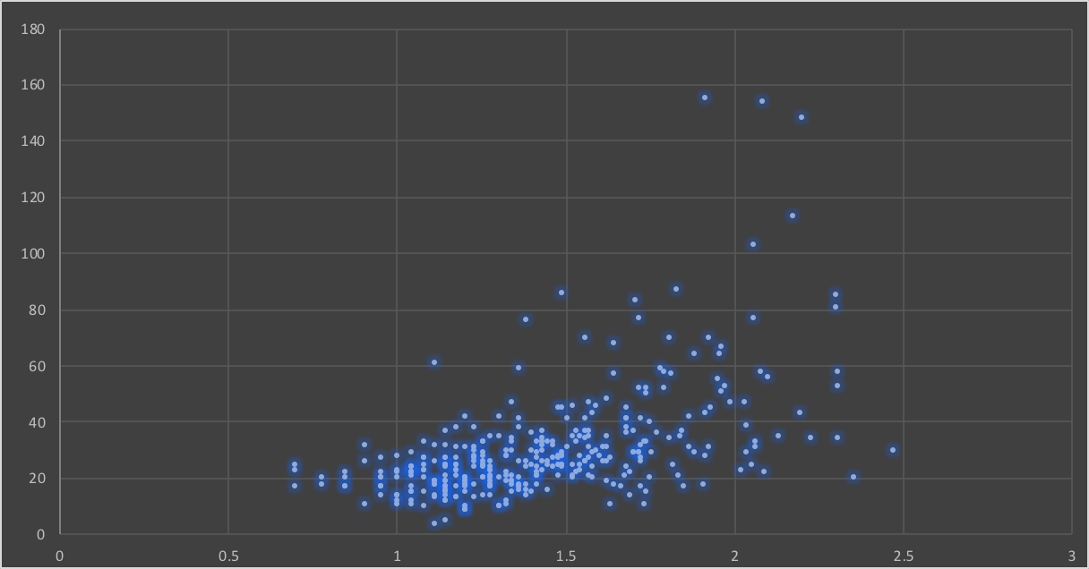
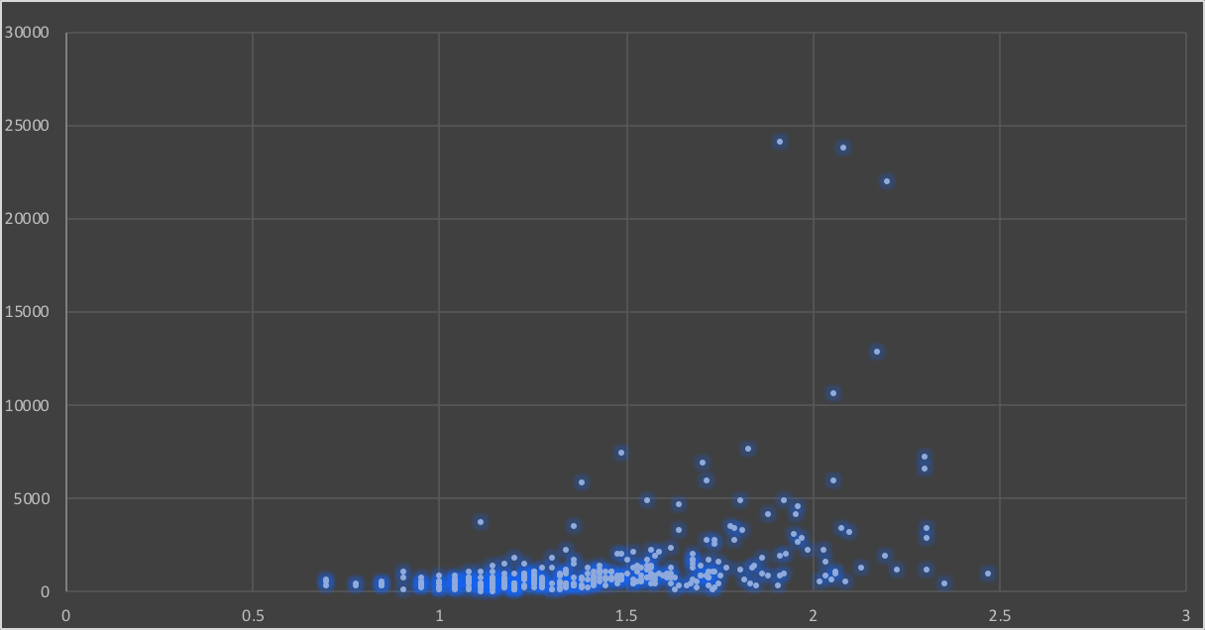
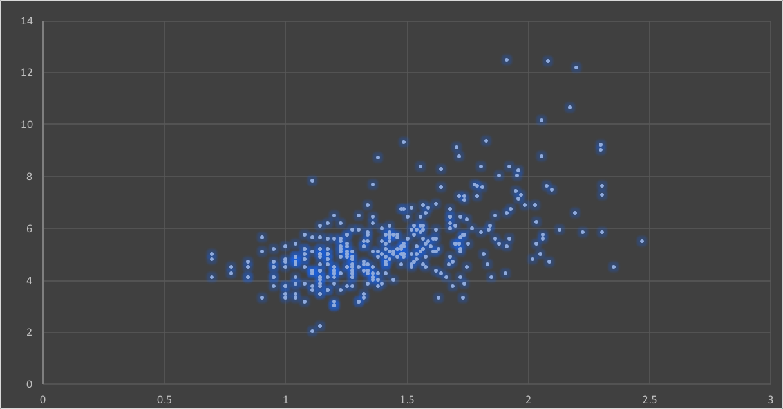
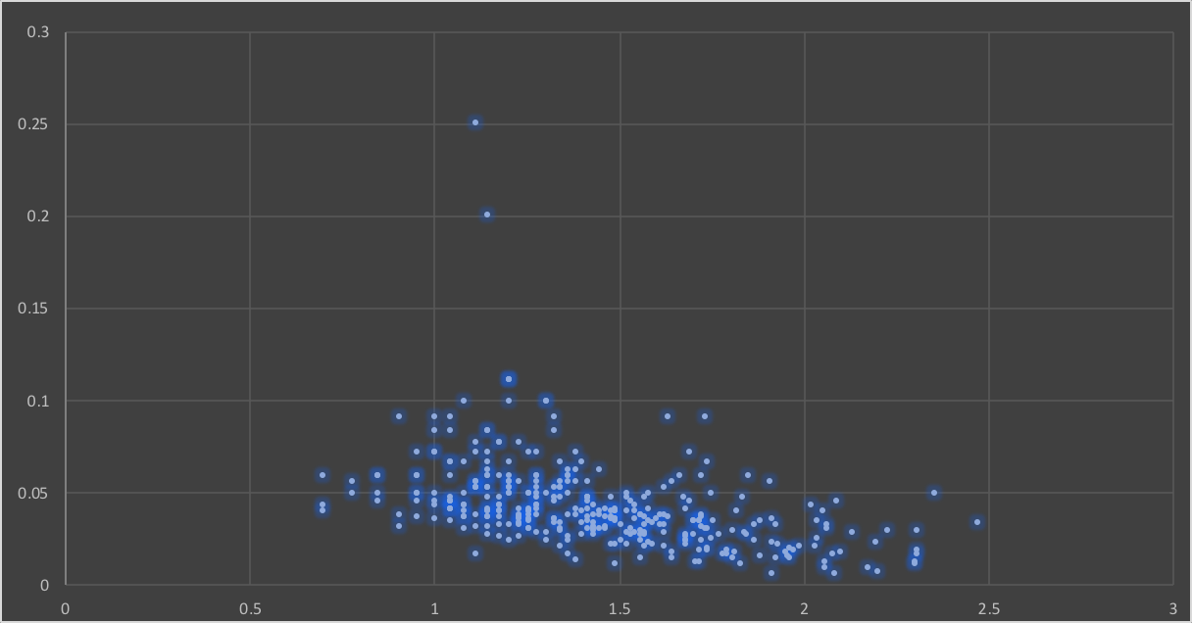



Original Data
Square $(Y^{2})$
Square Root $(\sqrt{Y})$
Reciprocal $(1/Y)$

Slide 65
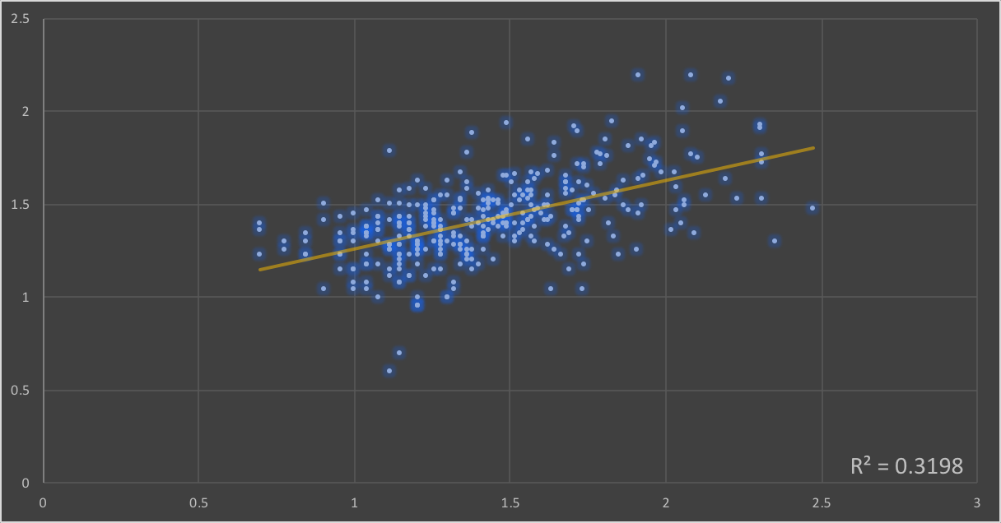

Logarithm (Box-Cox, $λ=0$)

Slide 66
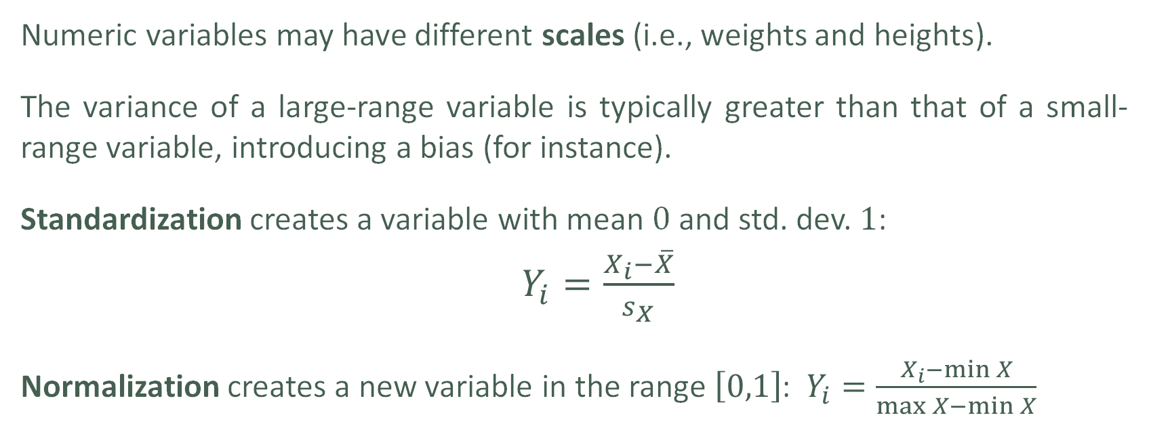
Scaling
Numeric variables may have different scales (i.e., weights and heights).
The variance of a large-range variable is typically greater than that of a small-range variable, introducing a bias (for instance).
Standardization creates a variable with mean $0$ and std. dev. $1$:
  $Y_{i}=\frac{X_{i}−\overline{X}}{s_{X}}$
Normalization creates a new variable in the range $\left[0,1\right]$: $Y_{i}=\frac{X_{i}−\min{X}}{\max{X−\min{X}}}$

Slide 67
Discretizing
To reduce computational complexity, a numeric variable may need to be replaced by an ordinal variable (from height value to “short”, “average”, “tall”, for instance).
Domain expertise can be used to determine the bins’ limits (although that may introduce unconscious bias to the analyses)
In the absence of such expertise, limits can be set so that either
  the bins each contain the same number of observations
  the bins each have the same width
  the performance of some modeling tool is maximized

Slide 68
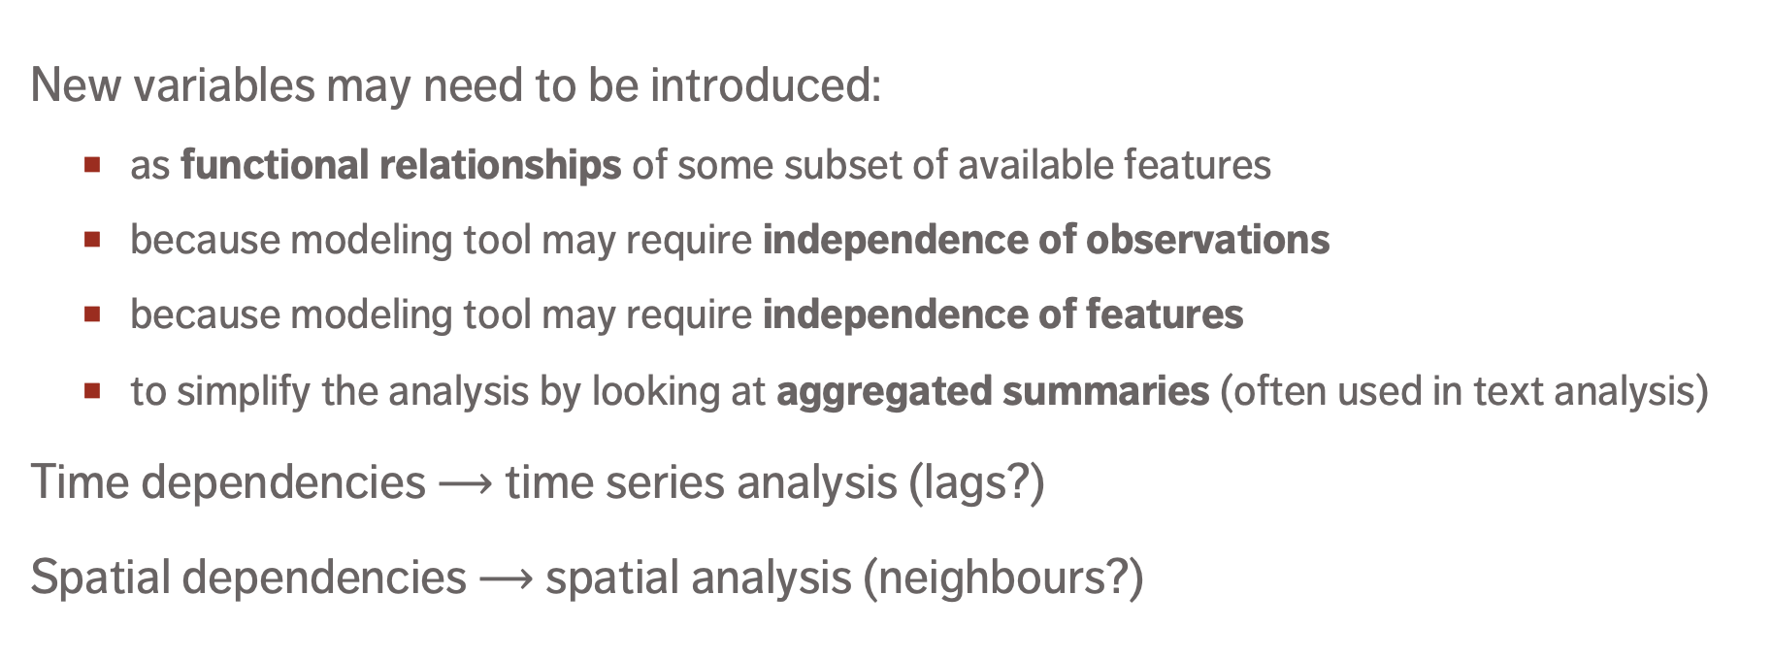
Creating Variables
New variables may need to be introduced:
  as functional relationships of some subset of available features
  because modeling tool may require independence of observations
  because modeling tool may require independence of features
  to simplify the analysis by looking at aggregated summaries (often used in text analysis)
Time dependencies $⟶$ time series analysis (lags?)
Spatial dependencies $⟶$ spatial analysis (neighbours?)
DATA SCIENCE ESSENTIALS

Slide 69
9. Storytelling and Visualization
DATA ANALYSIS and VISUAL STORYTELLING
data-action-lab.com

Slide 70
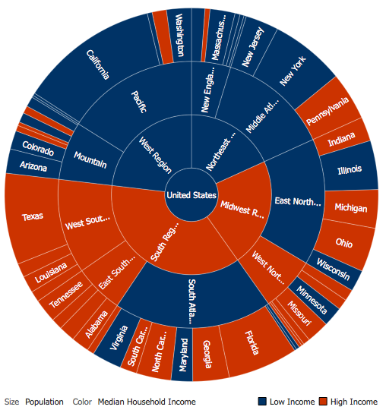
Data Visualization vs. Infographics
[Author unknown]
Data Visualization
  A method, as well as an item (objective)
  Typically focuses on the quantifiable
  Used to make sense of the data or to make it accessible (datasets can be massive and unwieldy)
  May be generated automatically
  The look and feel are less important than the insights conveyed by the data

Slide 71
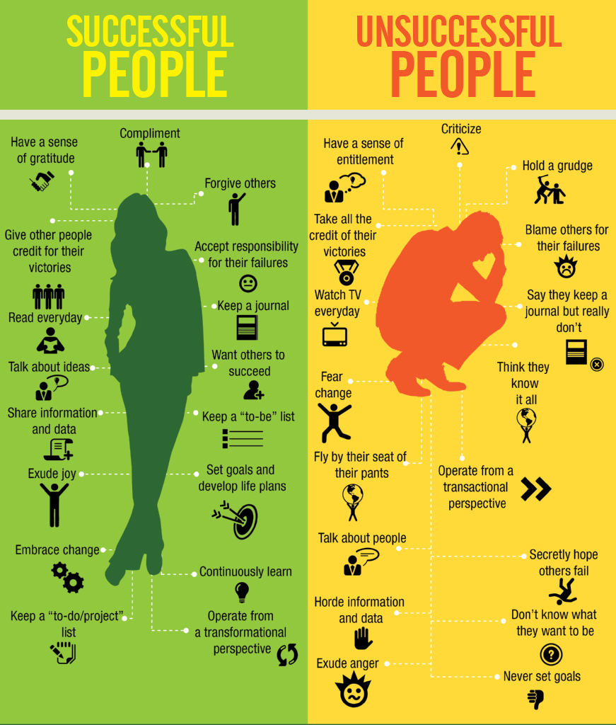
Data Visualization vs. Infographics
[J.P. Blackard]
Infographics
  Created for story-telling purposes (subjective)
  Intended for a specific audience
  Self-contained and discrete
  Graphic design aspect is key
  Cannot usually be re-used with other data
  Can incorporate unquantifiable information

Slide 72
Historical Charts
Data visualization is not confined to the recent past: charts have been used for many years to help communicate information and tell stories.
Due to the absence of technical tools, a lot of thought had to go into the design and creation of these visualizations.
Consequently, there is a lot we can (and should) learn to bring into the development of charts from a design and storytelling perspective.

Slide 73
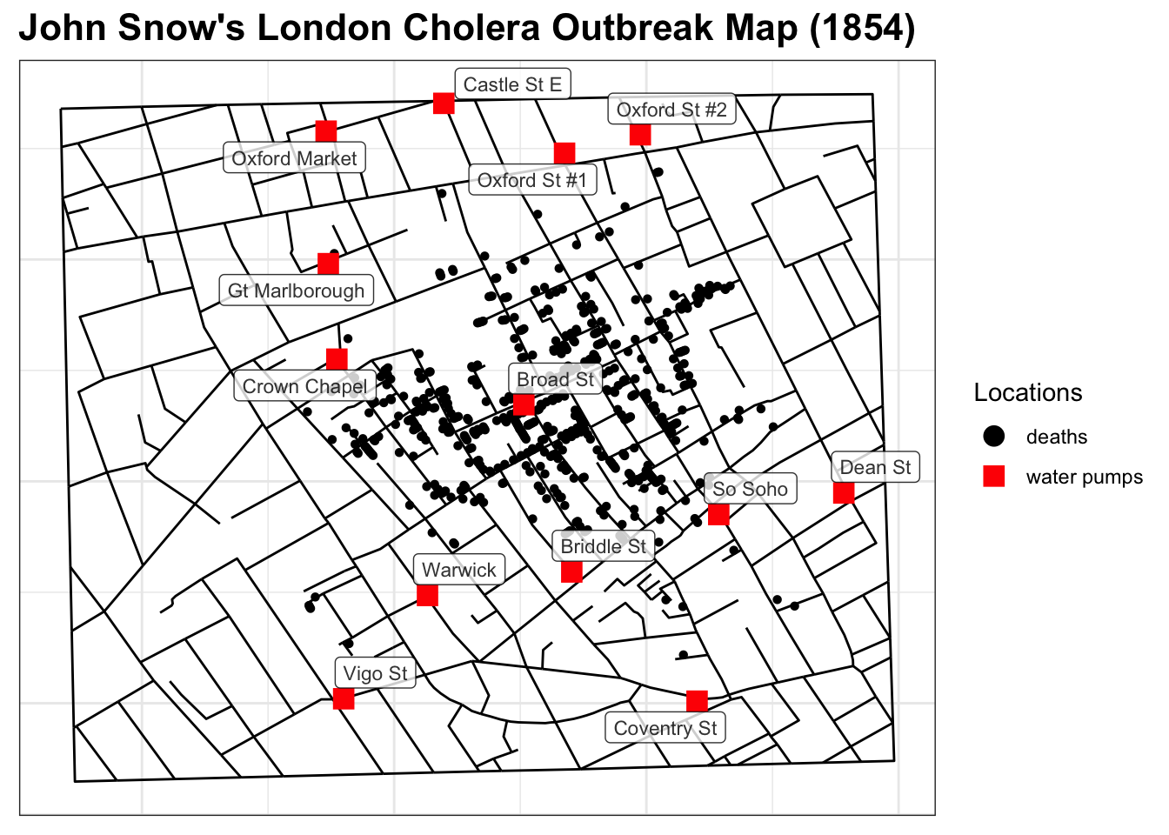
London’s Cholera Outbreak of 1854
Physician John Snow links the outbreak to a contaminated well by plotting number of cases on a map, jump-starting the science of epidemiology.

Slide 74
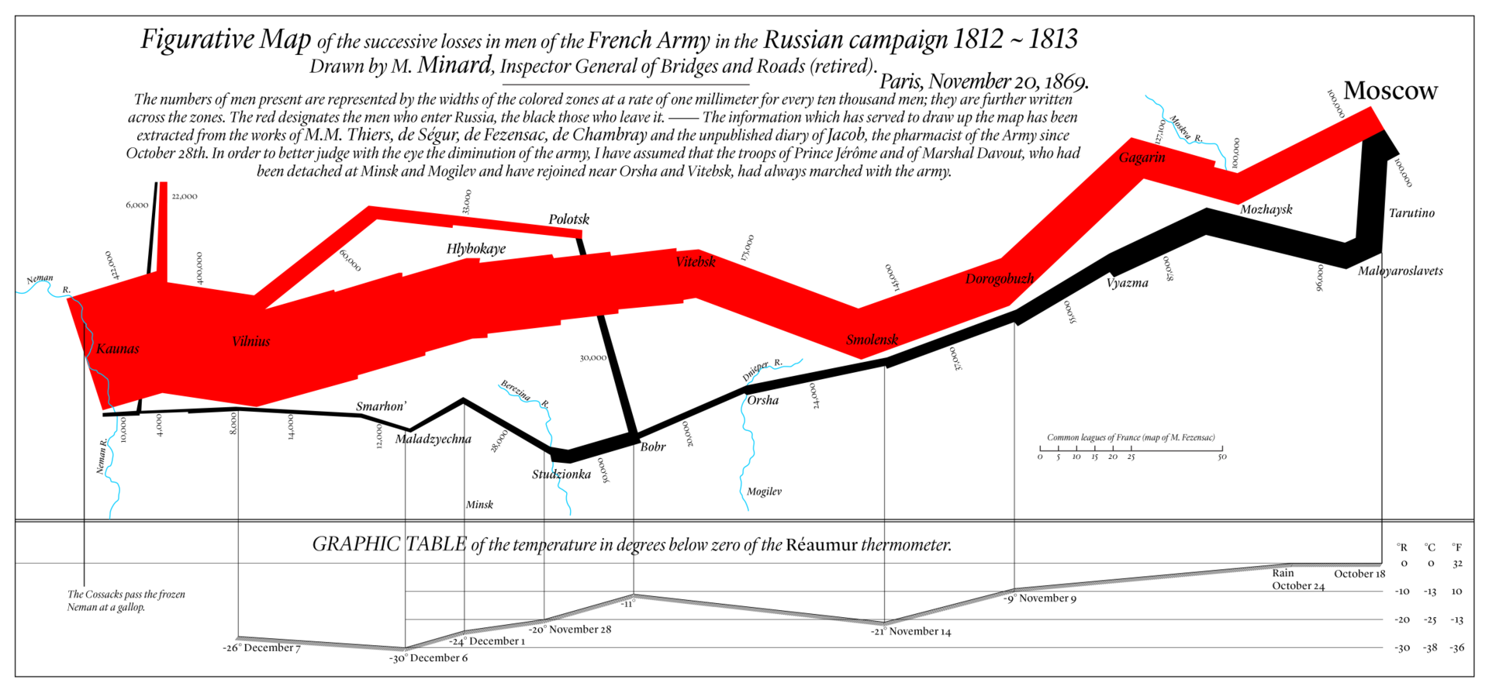
[DAL Podcast #3: https://youtu.be/tS_2_IQ5gRw]
Minard’s March to Moscow
data-action-lab.com

Slide 75
The (Messy) Analysis Process
Session 1
Objective/
Rationale
Utilization and Decision Support
Data Collection
Data Exploration
Infrastructure and Data Management
Data Preparation
Modeling and Analysis
Communication

Slide 76
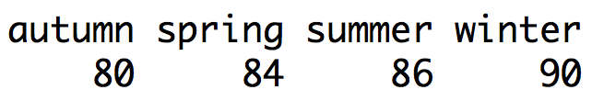

Non-Visualization Summaries

Slide 77
Pre-Analysis Use
Data visualization can be used to set the stage for analysis:
  detecting anomalous entries
  invalid entries, missing values, outliers
  shaping the data transformations
  binning, standardization, Box-Cox transformations, PCA-like transformations
  getting a sense for the data
  data analysis as an art form, exploratory analysis
  identifying hidden data structure
  clustering, associations, patterns informing the next stage of analysis

Slide 78
[Personal dataset]
Customers served at counter (per minute)
Customer arrivals at counter (per minute)
data-action-lab.com

Slide 79

[https://ourworldindata.org/life-expectancy]
This graph displays the correlation between life expectancy and GDP per capita.
Countries with higher GDP have a higher life expectancy, in general.
The relationship seems to follow a logarithmic trend: the unit increase in life expectancy per unit increase in GDP decreases as GDP per capita increases.
data-action-lab.com

Slide 80
Line Chart/Rug Chart
Gaps in the number line: absence of those numeric values in the data.
Remember: this is (possibly) different from the order that values appear in the dataset – since it is a number line, it shows where the values fall numerically.
If some values are identical, they lie on top of each other (use jitter?).

Slide 81
Simple Text
One or two numbers to focus on.
Good at “setting the scene”.
Draws focus to an area of the report.
95% of the population
drinks tea today compared to
75% in 2007

Slide 82
Tables
Tables interact with our verbal system, which means we read them:
  used to compare values
  audiences will look for their rows
Table design needs to blend into background
  the data should stand out, not the borders
  dense table/data: use alternating row colour
Name | Last Year | This Year
Bob | 20 | 30
Fred | 30 | 40
George | 10 | 15
Name |  | Last Year | This Year
Bob |  | 20 | 30
Fred |  | 30 | 40
George |  | 10 | 15

Slide 83
Bar Charts
Very versatile and useful.
ALWAYS (?) have a zero baseline.
Use graph axis OR data labels. Axis for broad statements, data labels for more detail.
Horizontal charts are apparently easier to read (according to many studies).
Think about the ordering of categories.

Slide 84
Stacked Bar Charts
Designed for comparing totals, but can quickly become overwhelming.
Hard to sort / order.
Filtering is complicated in Power BI (what do you click on & how the chart responds when filter is clicked on?)

Slide 85
The (Messy) Analysis Process
Objective/
Rationale
Utilization and Decision Support
Data Collection
Data Exploration
Infrastructure and Data Management
Data Preparation
Modeling and Analysis
Communication

Slide 86

Principles of Analytical Design
[E. Tufte, Beautiful Evidence]
Reasoning and communicating our thoughts are intertwined with our lives in a causal and dynamic multivariate Universe.
Symmetry to visual displays of evidence: consumers should be seeking exactly what producers should be providing, namely:
  meaningful comparisons
  potential causal networks and underlying structure
  multivariate links
  integrated and relevant data
  honest documentation
  primary focus on content

Slide 87

[Gapminder Foundation]
Non-Integrated Data

Slide 88

[Gapminder Foundation, https://www.ted.com/talks/hans_rosling_shows_the_best_stats_you_ve_ever_seen]

Slide 89


[Gapminder Foundation, https://www.ted.com/talks/hans_rosling_shows_the_best_stats_you_ve_ever_seen]
Meaningful Comparisons

Slide 90
[Gapminder Foundation, https://www.ted.com/talks/hans_rosling_shows_the_best_stats_you_ve_ever_seen]
Underlying Structure and Multivariate Links

Slide 91
[Gapminder Foundation, https://www.ted.com/talks/hans_rosling_shows_the_best_stats_you_ve_ever_seen]
Underlying Structure and Multivariate Links
Underlying Structure and Multivariate Links

Slide 92
[Gapminder Foundation, https://www.ted.com/talks/hans_rosling_shows_the_best_stats_you_ve_ever_seen]
Underlying Structure and Multivariate Links
Underlying Structure and Multivariate Links

Slide 93
[Gapminder Foundation, https://www.ted.com/talks/hans_rosling_shows_the_best_stats_you_ve_ever_seen]
Documentation

Slide 94

Representing Multivariate Data
[http://promise.site.uottawa.ca/SERepository/datasets/cm1.arff]
2 variables can be represented by position in the plane. Additional factors can be depicted with:
  size
  color
  value
  texture
  line orientation
  shape
  (motion?)
NASA CM1 Dataset (subset)

Slide 95

[http://promise.site.uottawa.ca/SERepository/datasets/cm1.arff]
NASA CM1 Dataset (subset)
colour
size
shape
position

Slide 96


Slide 97


Heat Maps (Choropleths)
[left: A.E. McCann, right: author unknown]

Slide 98

Geographical Maps
[New Scientist, Jan 2014]

Slide 99

Distorted Geographical Maps
[New Scientist, Jan 2014]

Slide 100


Network Diagrams
[A.B. Jensen et al., Nature Communications]
[Author unknown]
Diagnosis path around COPD in Danish population

Slide 101


Small Multiples
[Metrocosm.com]
U.S. Electoral College Results 1952 – 2012

Slide 102

Gauge Charts
Often used as a dashboard component (with or without needle).
Displays single value measures towards goal / KPI.
Great to show progress (a bit of a management fad, though…)
Displays information that can be quickly scanned and understood.

Slide 103
Interactive & Animated Visualizations
“There is always a danger that if certain types of visualization techniques take over, the kinds of questions that are particularly well-suited to providing data for these techniques will come to dominate the landscape, which will then affect data collection techniques, data availability, future interest, and so on.” (P. Boily)
Even when done well, 85% of users don’t bother with interactive viz (NY Times).
Take-Away: explore the data and try different methods
Notes:
There is always a danger that if certain types of visualization techniques take over, the kinds of questions that are particularly well-suited to providing data for these techniques will come to dominate the landscape, which will then affect data collection techniques, data availability, future interest, and so forth.

Slide 104
Charts to Avoid
ANYTHING with an arc (except gauge)
  pie
  donut
Brain cannot compare arcs and they can be misleading: how different are Steve & Bob in the pie chart?
ALL 3D IS EVIL!
  as with arc, we cannot easily visually compare data series
  adds way too much clutter

Slide 105
Gestalt Principles
[www.interaction-design.org/literature/topics/gestalt-principles]
The Gestalt principles are the “laws” of human perception.
They describe how humans group similar elements, recognize patterns and simplify complex images when they perceive objects.
Designers use them to organize content on charts, dashboards, websites, and other interfaces so that they be aesthetically pleasing/easy to understand.

Slide 106
Gestalt Principles
[www.interaction-design.org/literature/topics/gestalt-principles]
“Gestalt” is German for “unified whole”.
The first principles were devised in the 1920s by German psychologists Wertheimer, Koffka (“the whole is greater than the sum of the parts”), Kohler.
Aim: understand how we gain meaning from the chaotic stimuli around us.
The Gestalt principles are a set of “laws” which address the natural compulsion to find order in disorder. According to this, the mind “informs” what the eye sees by perceiving a series of individual elements as a whole.

Slide 107
Gestalt Principles
  simplicity
  continuation
  proximity
  similarity (invariance)
  focal point
  isomorphic correspondence
  figure / ground duality
  common fate
  closure
  uniform connectedness

Slide 108
Gestalt Principles – Simplicity
The brain has a preference for simplicity – it tends to process simple patterns faster than patterns that are more complex.
Lesson: arrange data simply and logically wherever possible.

Slide 109
Gestalt Principles – Proximity
Objects/shapes that are in proximity (close) appear to form groups.
The effect generated by the collected group is more “powerful” than that generated by separate elements.
Elements which are grouped together create the illusion of shapes/planes in space, even if the elements are not touching.
Lesson: understand the chart’s priorities and create groupings through proximity that support those priorities.

Slide 110
Gestalt Principles – Proximity

Slide 111
Gestalt Principles – Similarity
Stimuli that physically resemble each other are viewed as part of the same object; stimuli that don’t are viewed as part of a different object.
Similarity and proximity often come together to form a visual hierarchy. Either principle can dominate the other, depending on their application and combination.
Lesson: use similar characteristics to establish relationships and to encourage groupings of objects.

Slide 112


Gestalt Principles – Similarity
In these examples, similarity dominates over proximity: we see rows before we see columns.

Slide 113
Gestalt Principles – Focal Point
In opposition to similarity, the focal point principle states that distinctive-looking objects can create a focal point.
To highlight one salesperson’s performance, make their bar graph color different.
Lesson: use different characteristics to highlight and create focal points.

Slide 114
Gestalt Principles – Duality
Chart elements are either perceived as figures (focus) or as (back)ground.
Foreground objects are promoted by the brain, background objects are demoted.
Strong contrast makes it easier to distinguish between the two types of objects.
Lesson: ensure there is enough contrast between the chart foreground (figures) and their background.

Slide 115
Gestalt Principles – Duality
Because of the low contrast between the figure and background in the chart on the left, there is an additional cognitive load.
Increasing the contrast on the right improves readability.

Slide 116
Decluttering
Clutter is the enemy!
Every element on a page adds cognitive load
  identify and remove anything that isn’t adding value
  think of cognitive load as mental effort required to process information (lower is better)
Tufte refers to the data-to-ink ratio – “the larger the share of a graphic’s ink devoted to data, the better”
In Resonate, Duarte refers to this as “maximizing the signal-to-noise ratio” where the signal is the information or the story we want to communicate.

Slide 117
Decluttering
Use the Gestalt Principles to organize/highlight data in the chart.
Align all elements (graphs, text, lines, etc.):
  don’t rely on eye, use position boxes and values
Charts:
  remove border, gridlines, data markers
  clean up axis labels
  label data directly
Things
More things
DATA VISUALIZATION AND DASHBOARDS

Slide 118
Decluttering
[L.C. Muth, https://blog.datawrapper.de/fonts-for-data-visualization]
Use consistent fonts, font size, colour and alignment.
Don’t rotate text to anything other than 0 or 90 degrees (however: English/French incompatibility with vertical text).
Use white space:
  margins should remain free of text and visuals
  don’t stretch visuals to edge of page or too close to other visuals
  think of white space as a border

Slide 119




Colour Schemes
Achromatic (colourless, using only blacks, whites and grays)
Monochromatic (1-colour schemes)
Complementary (colours directly across from each other on the colour wheel)
Split complementary (2 of the 3 colors are adjacent; 1 of the colours is opposite)

Slide 120
Colour Tips
When it comes to colour, less is more: use it sparingly (graphic designers are taught to “get it right, in black and white”).
Based on the Gestalt Principles, monochrome schemes can be effective.
When appropriate, pick corporate identity scheme (this maximizes buy in).
Create a template (and stick to it).
Upload images to see what charts look like for flavours of colourblindness:
  https://www.color-blindness.com/coblis-color-blindness-simulator (not the only tool)

Slide 121


Slide 122


Slide 123






















Data Environment
Data storage
Visualizations account for only $\sim 10\%$of the process.
Data collection
Extract
TransformLoad
Visualization generation
Data preparation
Data warehouse
Data analysis
Results integration

Slide 124


Overview
The past is data-driven:
  mostly Excel (or reporting tools like Cognos)
  mostly numbers, tables and non-interactive graphs
  distributed on desktop computers, by email, in PowerPoint presentation
  static, mostly backwards looking (lagging indicators)
  KPIs and dashboards were somewhat contrived

Slide 125

Overview
The future is story-driven:
  new tools: Power BI, Tableau, Qlickview, Shiny, etc.
  mostly visualizations, occasional numbers and tables
  distributed on the web (internal and external)
  dynamic and both backwards and forwards looking (leading and lagging indicators)
  data for everyone

Slide 126



Defining Context
Seconds
Minutes
Fraction of Hour
Hours
Infographics/Data Viz
Dashboards
Reports and Exploration
Data Art

Slide 127

Dashboard Types
Exploration: using visualizations as a tool to explore/understand the data
  high level of interactivity
  high level of detail
  all aspects of data should be represented (tables, columns, calculations etc.)
  no annotations or explanations required

Slide 128

Dashboard Types
Storybook: using visualizations as a tool to explain the data and communicate the story
  low level of interactivity
  low level of detail
  key aspects of data should be represented
  annotations and explanations drive the “story”

Slide 129

Dashboard Types
Situational Awareness: using visualizations as a tool to provide a snapshot of the data
  medium level of interactivity
  not “scripted” but well organized (e.g., categorized)
  summary data should be represented
  anomalies are highlighted
  often used for internal presentations

Slide 130

[https://bigbookofdashboards.com/dashboards.html]
Notes:
https://bigbookofdashboards.com/dashboards.html

Slide 131

[https://www.matillion.com/wp-content/uploads/2014/11/qlikview-poor-use-of-dashboard-software.png]
Notes:
https://bigbookofdashboards.com/dashboards.html

Slide 132

[https://www.geckoboard.com/assets/2-terrible-dashboard-example-min.png]
Notes:
https://bigbookofdashboards.com/dashboards.html

Slide 133
Practical Definition of a Story
To paraphrase U.S. judge Potter Stewart: “I may not be able to define what a story is, but I know one when I see one”.
We could say that a story consists of:
  context,
  series of events, and
  outcome, result, consequence, or resolution.

Slide 134
Storytelling Goals
Cultural Stories
  entertain, inform, teach, explore, shock
Data (Scientific) Stories
  describe, diagnose, predict, prescribe, persuade
Any overlap?
Anything missing?

Slide 135


Slide 136
Storytelling Audiences
Storytelling requires a teller and a story, but also an audience.
The teller’s job is to convince the audience to accept:
  the premise (“I’m about to tell you a really interesting story, so listen up!”)
  the contents (“All these things happened, honest!”)
  the conclusion (“And that’s why you should never put peanut butter in your laundry.”)
The story’s must first and foremost not come in the way of the teller’s job.

Slide 137

Storytelling Audiences
The audience is a more nebulous entity.
In many cases, the teller never interacts directly with the audience. For all they know, the audience could be a single child, or the entire nation of Finland.
This ambiguity typically leads to storytellers imagining the largest possible audience. A story for the ages, which will be all things to all people.
This is a common mistake: less is more. It pays to know the audience (we will discuss this further at a later stage).

Slide 138
Storytelling Context
A given action may be seen as positive or as negative by audiences with different pre-existing feelings/knowledge concerning the agent/situation.
  Would you be able to recognize nobility in a political enemy’s actions?
  Could a fan of the Maple Leafs/Habs ever have something worthy to say about hockey?
Similarly, a story may have different outcomes/impacts in different contexts.

Slide 139

[https://www.lowdownonline.com/post/wakefield-nurse-fires-up-freedom-convoy]
What might lead one to view the subject of this article in a positive light?
A negative light? A neutral light?
What might lead one to view the author of this article in a positive light?
A negative light? A neutral light?

Slide 140


Storytelling Universality
[Illustrations: V. Jaskina]
There once was a shepherd boy who was bored as he sat on the hillside watching the village sheep. To amuse himself he took a great breath and sang out, "Wolf! Wolf! The Wolf is chasing the sheep!"
The villagers came running up the hill to help the boy drive the wolf away. But when they arrived at the top of the hill, they found no wolf. The boy laughed at the sight of their angry faces. "Don't cry 'wolf', shepherd boy," said the villagers, "when there's no wolf!" They went grumbling back down the hill.
Later, the boy sang out again, "Wolf! Wolf! The wolf is chasing the sheep!" To his naughty delight, he watched the villagers run up the hill to help him drive the wolf away.
When the villagers saw no wolf they sternly said, "Save your frightened song for when there is really something wrong! Don't cry 'wolf' when there is NO wolf!"

Slide 141

Storytelling Universality
[Illustrations: V. Jaskina]
But the boy just grinned and watched them go grumbling down the hill once more.
Later, he saw a REAL wolf prowling about his flock. Alarmed, he leaped to his feet and sang out as loudly as he could, "Wolf! Wolf!" But the villagers thought he was trying to fool them again, and so they didn't come.
At sunset, everyone wondered why the shepherd boy hadn't returned to the village with their sheep. They went up the hill to find the boy. They found him weeping.
"There really was a wolf here! The flock has scattered! I cried out, "Wolf!" Why didn't you come?"
An old man tried to comfort the boy as they walked back to the village. "We'll help you look for the lost sheep in the morning," he said, putting his arm around the youth, "Nobody believes a liar ... even when they are telling the truth/so don’t get caught telling the same lie twice."

Slide 142
Data Stories
[online.hbs.edu/blog/post/data-storytelling, C. Cote]
Data storytelling is the ability to effectively communicate insights from a dataset using narratives and visualizations. It can be used to put data insights into context for and inspire action from the audience.
There are 3 key components:
  data: foundation of data story (descriptive, diagnostic, predictive, prescriptive analysis)
  narrative: storyline used to communicate the insights gleaned from data and context, and recommended actions
  visuals: representations of data, analysis results, and narratives, which are used to communicate stories clearly and memorably (charts, graphs, diagrams, pictures, or videos)

Slide 143
[figuresinthesky.visualcinnamon.com]
A SKY FULL OF STARS

Slide 144
[figuresinthesky.visualcinnamon.com]

Slide 145
Storytelling Risks
A good story can help shed insights on a situation, but storytelling requires choices; the outcome is affected by what is included and what is omitted.
It is easy to mislead by accident; it is also easy to mislead by design.
With data stories, there is an additional complication: we usually only have access to the available data. The data that was not collected is, by definition, not available. Some of the data that was collected may also be unavailable for a variety of reasons.
This implicit bias can lead to compelling (yet flawed) data stories.

Slide 146


Slide 148
Words and Images
[based on an idea from S. McCloud, Making Comics]
A picture is worth a thousand words (vs. a picture is worth 1000 words).
Words bring an unparalleled level of specificity. There is no image so vague that words cannot lock it into a desired meaning.
Some concepts and names can only be clearly expressed through words.

Slide 149

[S. McCloud, Making Comics]
“Look, it’s Kelly Donovan, twin brother of the Xander actor on Buffy the Vampire Slayer, plus Humphrey Bogart wearing a Freddy Mercury mask, and a robot duplicate of former U.N. Secretary General Boutros Boutros-Ghali!”

Slide 150
Visual Storytelling Choices
[based on an idea from S. McCloud, Making Comics]
Communicating with clarity means that audience comprehension remains the ultimate goal:
  choice of moment is ‘connecting the dots’, showing only what matters to the story;
  choice of frame is creating and directing the audience’s focus;
  choice of image is selecting the right charts for the story, with emphasis on simplicity and ability to convey the message;
  choice of word is clearly and persuasively communicating ideas in seamless combination with the charts;
  choice of flow is guiding the audience from one chart to the next, from one page to the next, and creating a transparent and intuitive ‘reading’ experience, by arranging pages in a dashboard, charts on a page, and elements within charts intelligently.

Slide 151


Choice of Moment
[Gapminder Tools]

Slide 152


Choice of Frame
[C. Nussbaumer Knaflic, Storytelling With Data]

Slide 153


Choice of Image
[Author unknown]

Slide 154

Choice of Word
[C. Nussbaumer Knaflic, Storytelling With Data]

Slide 155
Visual Storytelling Combinations
[based on an idea from S. McCloud, Making Comics]
  text-specific, where text provides all that is needed to know and the charts illustrate some aspects of the story that is described
  chart-specific, where the charts provide all that is needed to know and the text accentuates some aspects of the story that is shown
  duo-specific, where text and charts are both telling roughly the same story
  intersecting, where text and charts work together in some respects but also contribute to the story independently
  interdependent, where text and charts combine to convey an aspect of the story that neither could convey alone
  parallel, where words and charts follow seemingly different storylines, without intersecting

Slide 156



[https://flourish.studio/blog/accessible-chart-design]
[P. Tickell, The Story of the Impossible Train]

Slide 157
A Word About Accessibility
[http://dataphys.org/list/]
A table can be translated to Braille, but that’s not always possible for charts.
Describing the features and emerging structures in a visualization is a possible solution… if they can be spotted.
Analysts must produce clear and meaningful visualizations, but they must also describe their features in a fashion that allows all to "see" the insights.
But this requires them to have “seen” all the insights, which is not always necessarily the case (if at all possible).

Slide 158

A Word About Accessibility
Data Perception:
  texture-based representations
  text-to-speech
  sound/music
  odor-based representations (?)
  taste-based representations (?!?)
Sonifications:
  TRAPPIST Sounds : TRAPPIST-1 Planetary System Translated Directly Into Music
  Listening to data from the Large Hadron Collider, L. Asquith

Slide 159

Evolving a Visualization
[C. Nussbaumer Knaflic, Storytelling with Data]

Slide 160


Examples
[C. Nussbaumer Knaflic, Storytelling with Data]
1. Change graph type (trope)

Slide 161


Examples
[Based on C. Nussbaumer Knaflic, Storytelling with Data]
2. Remove border and gridlines
3. Remove markers

Slide 162


Examples
[Based on C. Nussbaumer Knaflic, Storytelling with Data]
4. Clean-up axis labels and legend
5. Colour code the lines

Slide 163
Examples
[Based on C. Nussbaumer Knaflic, Storytelling with Data]
Lag in Tickets Processed Since May Layoffs
We have not been able to keep up with tickets received since two employees were let go in May
6. Tell the story

Slide 164

Data Story Tropes
Some visualizations patterns are so familiar that they become tropes:
  a scatterplot with a trend line going straight up or straight down
  a cluster bar chart with two categories where one is always lower than the other
  a line chart with the two lines crossing in one place
  pie charts being used all over the place (to avoid)
  red for republican, blue for democrat (US); red for left-leaning, blue for right-leaning (ROW)
  using broken axes to exaggerate effects (sometimes justified… )
  etc.

Slide 165

Data Storytelling Tropes – Examples
[https://handsondataviz.org/spatial-bias.html]

Slide 166


[https://www.chsglobe.com/13376/cover-stories/sexualharassment]

Slide 167


Visual Processing
pre-attentive
Perception is fragmented – eyes are ever scanning.
Visual thinking seeks patterns
  pre-attentive processes: fast, instinctive, efficient, multitasking
  gather information and build patterns:
        features → patterns → objects
  attentive process: slow, deliberate, focused
  discover features in the patterns:
        objects → patterns → features
attentive
Notes:
Pre-attentive processes

Slide 168

[L. Groeger, A Big Article About Wee Things, ProPublica.com]

Slide 169

[L. Groeger, A Big Article About Wee Things, ProPublica.com]

