Slide 1
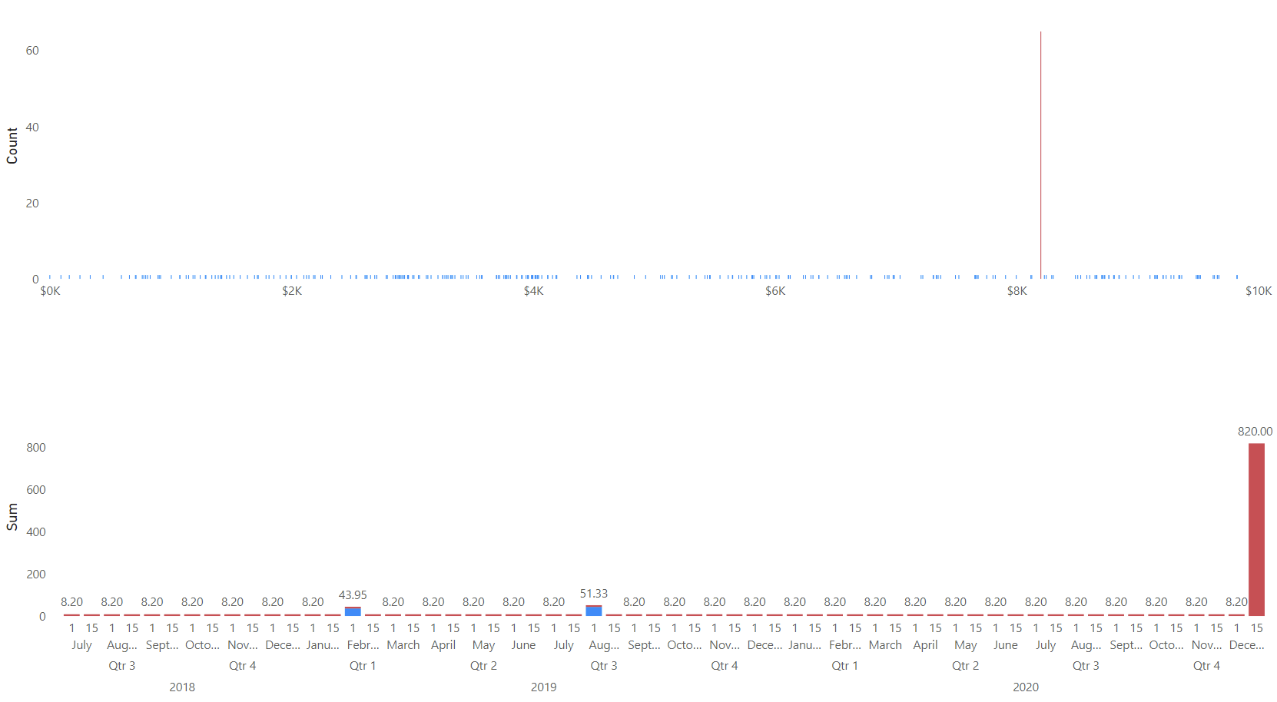
Power’s Minor Capital Expenses Anomaly
Genuine transactions typically do not result in repeating values, but there are 65 repeats of $8200 in C. Power’s MIC expenses.
These MIC transactions of $8200 have been repeating monthly on the 1st and 15th since 2018, terminating most recently in a transaction of $820,000.

